Slide 1
PowerPmac IOC and Software Support
For Australian Synchrotron
Nader Afshar – Controls Systems team
February 2021

Slide 2
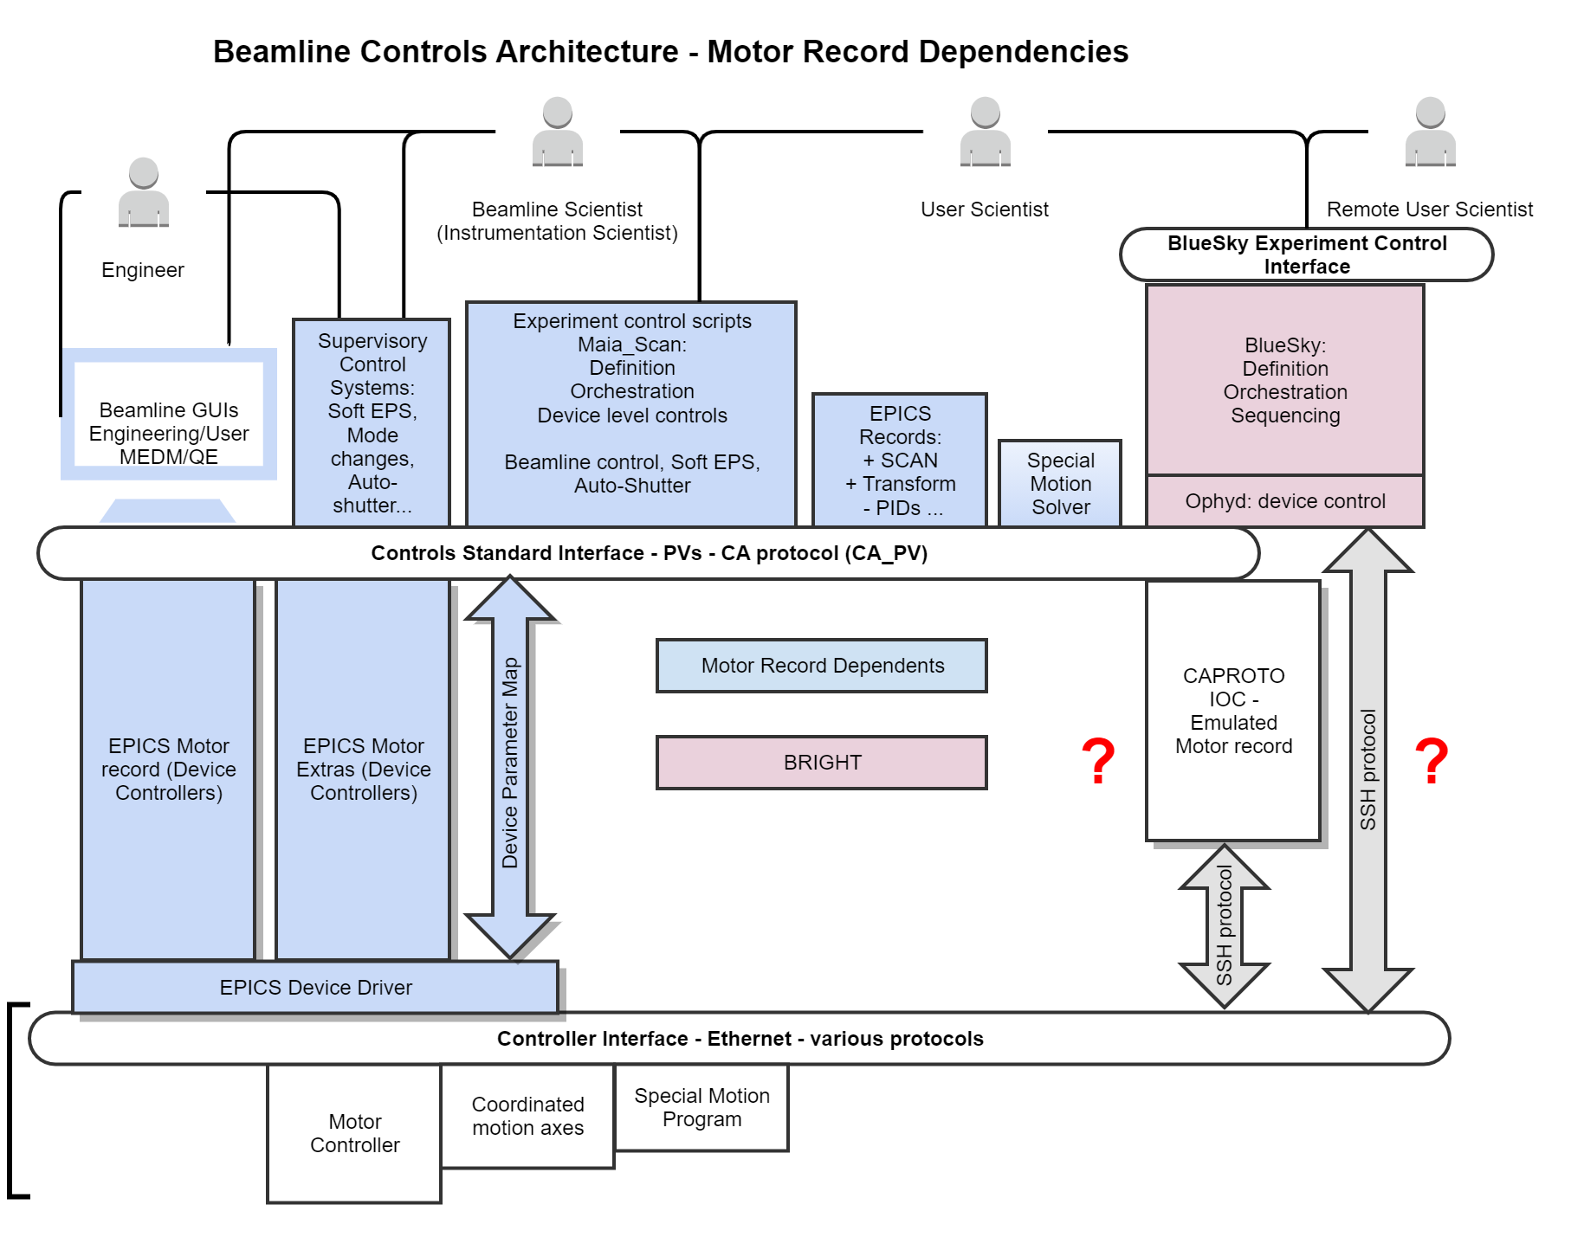

Slide 3
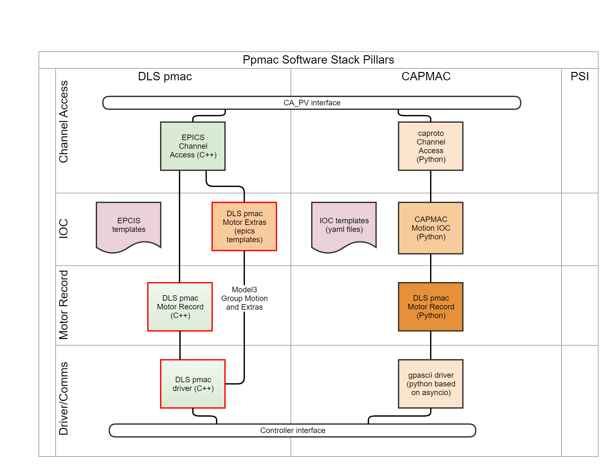

Slide 4
Objectives
Consistent solution, may include more than one technology
Well defined and communicated capability and support limits
Support both BRIGHT and refurbishment
Directed resources according to the plan
After the period, own and support one technology

Slide 5
Decision process
Motion Systems Focus Group has 5 discussion sessions
Reached out to the community
Established decision criteria and decision matrix
Team had constructive and comprehensive discussion but haven’t reached consensus

Slide 6
Option / Merit | Reliability, Validation and Readiness (1,6,7) | Known issues (9,12,13) | Development suitability (2,3,4,5) | Maintenance and Configuration management (8,10) | Compatibility, Standard Interface, Motor Record - (11) | Overall fit for purpose
DLS led PMAC driver and IOC | Low | Low -workarounds | Low | Medium | High | Yes
CAPMAC, based on caproto, the python IOC developed in NSLS-II | Low - Potentially High | Medium | High | High | Low - Potentially High | Yes
PSI dynamic configuration model | ? | ? | Low | Low |  | Not verified

Slide 7
Summary of the findings
After all, no ideal option to satisfy Readiness and Future Development suitability criteria
DLS pmac solution is somewhat better established and readily backward compatible, but not production-worthy and not the best option for future development
CAPMAC has great potential but not ready and needs to stand the test of time

Slide 8
Recommended direction
Keep the old pillar while developing the new one for the future
Focus and invest on CAPMAC
Maintain DLS pmac at a minimum necessary level.
Fix quickly in a sprint OR
Implement workarounds in place to make DLS pmac useable as is

Slide 9
Challenges
CAPMAC development is ambitious, needs investment from facility. Resources and planning.
DLS pmac needs immediate fixes.

Slide 10
When we started working on the ppmac, there were three viable options available for ppmac software stack:
1 – PSI based driver – python – custom –
2 – DLS pmac driver – developed by DLS as a continuation to previous tpmac line and with addition of some custom “group motion” support at the C++ driver level
3 – CAPROTO driver – a pure python channel access IOC created in NSLS2 –

Slide 11
Ben initially embarked on DLS pmac but soon found it frustration to support that because of
Some issues he found. Of these issues, there is one show-stopper and the rest of them are “good to haves”
Then Ben trialled the caproto which is flexible and easy to develop and expand and maintain.

Slide 12
Summary

Slide 13
Strategy
Make the DLS pmac and CAPMAC solutions interchangeable by constraining ppmac configuration and experiment control layers.
Keep DLS pmac as the old pillar. Rely on the DLS development team to fix their code. Contribute to the fixes as much as the resources allow.
Lead development of CAPMAC in a formalised requirement-validation framework.
Phase-out the DLS pmac after the 5 years period, by replacing the instances (IOCs) with CAPMAC IOCs.

Slide 14
I think not working on PSI system was a lost opportunity. But it is no-more an immediately viable option
The DLS is backed up and supported by a team of developers, mainly in DLS but including NSLS2. now gaining momentum after couple of years of silence, as DLS has finally embarked on ppmac.
Caproto on the other hand, is not meant/recommended for production, but opens up opportunities for the future.

Slide 15
How CAPMAC issues are addressed
Caproto is not validated for production – Use it only for the ppmac motion IOC (CAPMAC) with stringent requirements and validation plan
CAPMAC is not an established solution, risk of unknown issues – Gradually roll-in with DLS pmac as roll-back option
CAPMAC is not supported by the community – We will lead the development and setup the collaboration

Slide 16
How the DLS pmac issues are addressed
DLS pmac unsafe features – Can be addressed by usual changes in the epics templates and additional protection plcs in the controller.
Hard to fix and maintain - Use it as is with the limitations as offered by the community developers.
Hard to develop new features – Move the special applications which need new features to capmac IOC.

Slide 17
How the DLS pmac issues are addressed
SHOW-STOPPER: Incompatible with EGU scaling in controller
alt-a) AS modifying the DLS driver C++ code (DLS developers team is aware of the issue and haven’t offered a fix yet)
alt-b) AS reverting the underlying ppmac to “counts” (no scaling) or “x10000” scaling to make it compatible, and wait for the DLS fix to be released

Slide 18
Questions
Is this solution

Slide 19
DLS EPICS IOC, issues Ben’s wording
Used on Smargon on MX1
Lab motors
Issues:
Some setup of the Powerbrick must be done at epics level (so can’t be controlled using version control), eg MRES, acceleration - EXISTING SOLUTION: these settings are version controlled via epics/IOC templates
Hazardous functions such as “send anything” can disable limits, set overcurrent , EXISTING SOLUTION: these PV’s can easily be removed using templates
Motor record clips all low level position set & readback to int32, EXISTING SOLUTION: don’t use EGU scaling in ppmac
Communication speed is limited ~300 cmds/s : YES. ACCEPTED LIMITATION.
module attempts to maintain compatibility with turboPMAC, PVT move interface uses “double buffering” – UNDESIREABLE FEATURE. ACCEPTED LIMITATION
Code is not maintainable/editable – DO NOT EDIT THE CODE (C++)
See also
XPS support, doesn’t detect instantaneous errors and just drops out without cause

Slide 20
DLS EPICS IOC, PVT Move
No integration to pulse start
No “gather” data return, relying on external capture device
module attempts to maintain compatibility with turboPMAC, PVT move interface uses “double buffering” to avoid overloading the turboPMAC, and could be done a lot simpler
No flexibility, or access, record of the trajectory file

Slide 21
Code Maintainability
Complex interaction between IOC and controller, no clear division of functionality
Mapping between PVs <> commands is undocumented
Very difficult to trace functionality through many levels
pmac controller (hardware, broker, commandstore) > axis > drvmotor > motor > asyn > ssh
Mismatch of parameters, eg PID <> Kvff? Jerk?
Hazardous functions such as “send anything” can override limit switches
Motor record soft limit (HLM/LLM) actually sets the limits in the controller (MinPos/MaxPos). Which could otherwise be used effectively as limit switches.

Slide 22
Questions?
What is left to do?
Review of requirements
“busy” feature for setting position (for Capmac)
Status PV mapping to motor record (for Capmac)
Generic coord system GUI
Add homing for incremental & open loop
Clean up slew scan support, add as PVs if appropriate
Ophyd device support
XPS support package (IOC)
Experiment with Zebra position trigger (MCT?)
Documentation, tutorials, testing
In use in the lab, but needs further testing & documentation to make production ready - please help!

