Slide 1
Fast ORM Measurement in Australian Synchrotron
Simin Chen
28/May/2021
Notes:
Good morning guys. My name is Simin Chen. I am from the Accelerator Control and Support team. Today I will introduce the new fast orbit response matrix measurement method in Australian Synchrotron. The new system to implement the fast ORM measurement is named Enhanced Orbit Diagnostics, which is shorted as EOD.

Slide 2
Project Motivation & Features
Motivation
Reduce the measurement time of storage ring ORM from 15 min down to ~1 min
Features
Sinusoidal injection to the electron beam with/without FOFB for fast response measurements
Pink noise generator for closed loop gain analysis
Sinusoidal/pink noise/FOFB correction data output for real-time spectral and spatial analysis & data archiving for offline post-analysis
Notes:
The existing fast orbit feedback system at the Australian Synchrotron is able to make fast corrections for electron beam stability, but it has many limitations. New extension features for the FOFB system are needed to expand its function beyond just a feedback system.
The new EOD system would be capable of reducing the measurement time of the storage ring’s corrector to position response matrix from 15 minutes down to around 1 minute.
The new EOD system is designed to generate sinusoidal injection to the electron beam with or without FOFB correction data for fast response measurements. It is also equipped with a pink noise generator for closed loop gain analysis. With a much larger FPGA, the generated sinusoidal or pink noise or FOFB correction data can be encoded as UDP packets and sent to IOCs for archiving and offline analysis.

Slide 3
System Architecture
Storage Ring
Electrode
x 98 Sets
98 Units
1 Unit
BPM
FOFB
+
EOD
Processor
EPICS
Control
14 Units
6 Channels/Unit
Coil Driver
Corrector Coils
x 42 Horizontal axis
x 42 Vertical axis
Archiver & Analysis
Legend:
FOFB devices and data flows
FOFB & EOD shared devices and data flows
Notes:
This is a simplified FOFB and EOD system architecture diagram. The FOFB processor receives the storage ring electron beam position data stream from the 98 BPMs and generates the correction data stream using an inverted BPM-Corrector response matrix. The correction data is use to drive the 84 corrector coils.
While for the EOD system, it shares the same processor hardware with the FOFB system, the same coil drivers and the same corrector coils. It does not relies on the BPM data input but generates the sinusoidal or noise waves freely, so it is an open-loop system.
The FOFB correction data or the EOD waveform is then encoded following the same format of the BPM data stream. Then it is sent to two EPICS IOCs, one for archiving and one for data analysis.

Slide 4
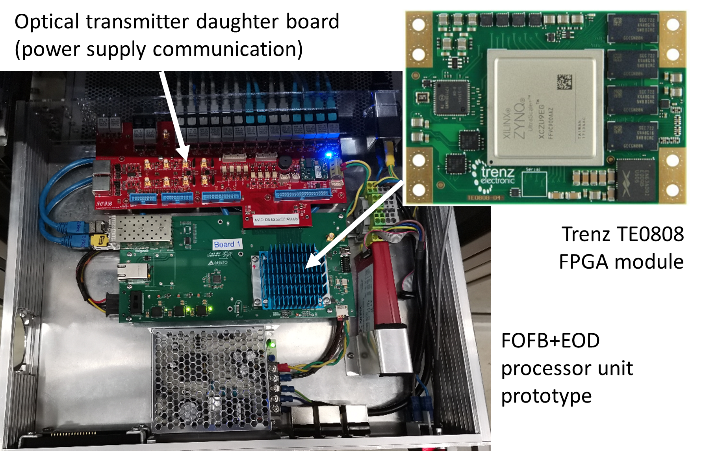
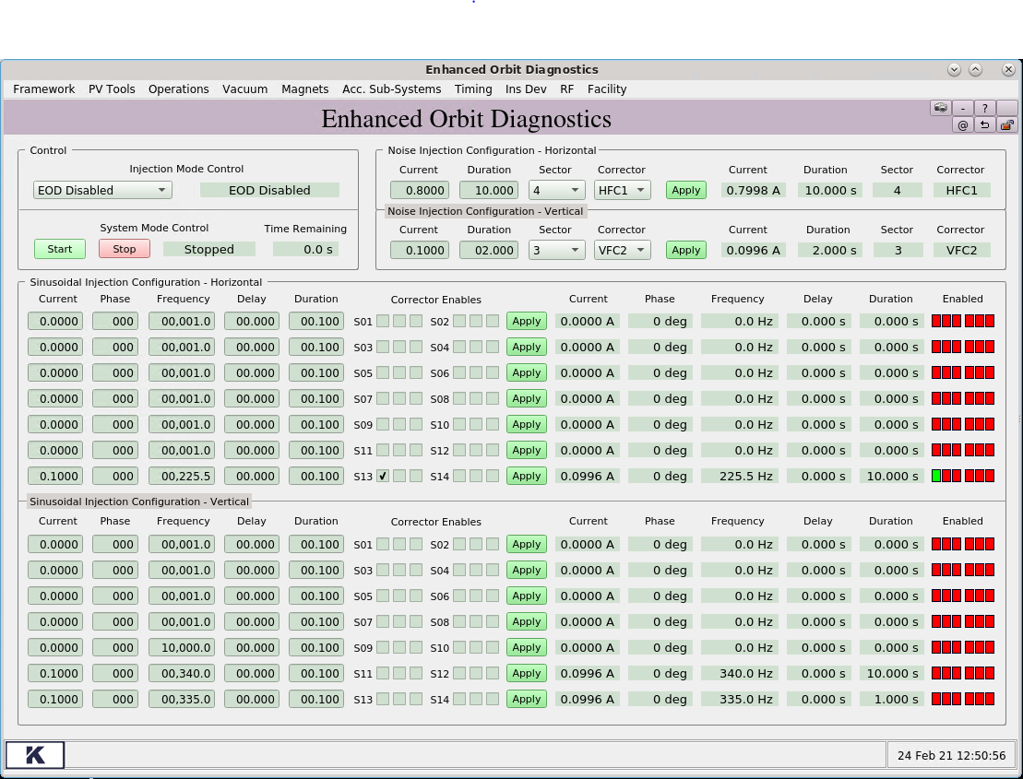
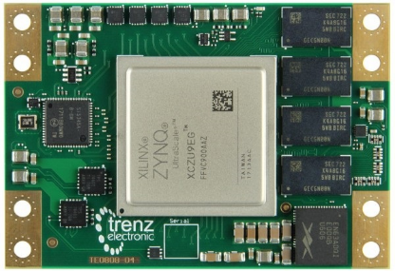
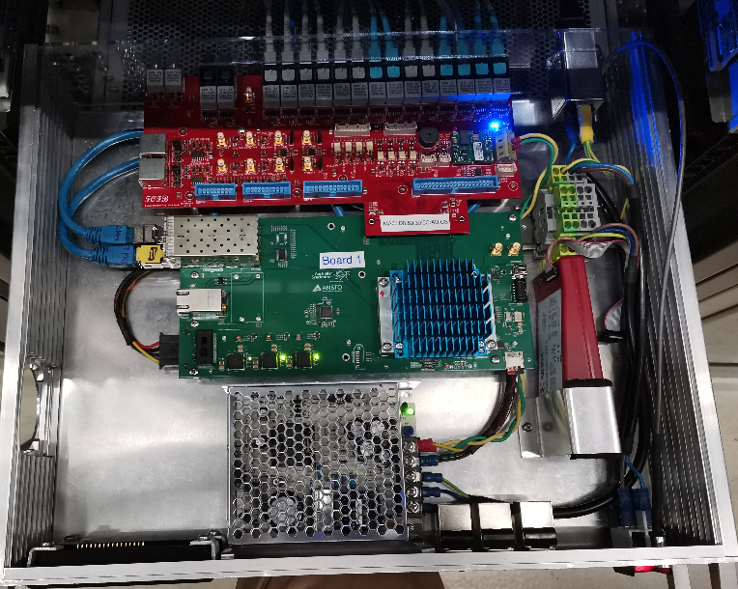
Project Hardware & Software
Optical transmitter daughter board (power supply communication)
Trenz TE0808 FPGA module
FOFB+EOD processor unit prototype
Notes:
The Trenz Electronics TE0808 system-on-module is selected to replace the legacy Xilinx Virtex 6 FPGA. This module is equipped with a Xilinx Zynq UltraScale+ FPGA and 4 G Bytes on-module DDR4 RAM for the embedded 4 cores CPUs. The FPGA portion of this chip is ~7 times larger than the replaced one. To save the project cost, the legacy FOFB optical transmitter daughter board is used.
The right hand side is the EOD EPICS GUI for the Synchrotron operators. The users are able to select the injection signal source, duration time, injection signal amplitude, frequency, phase, delay and injection targets.

Slide 5
System Performance
EOD System Capabilities and Performance
Parameter | Min | Max | Resolution
Amplitude | 0.5 mA | 1.0 A | 0.5 mA (PSU resolution)
Noise Duration | 0.1 s | 10 s | 0.001 s
Sinusoidal Duration | 0.1 s | 10 s | 0.001 s
Sinusoidal Amp Accuracy (std) | 0.5% | - | -
Sinusoidal Frequency | 1.0 Hz | 10 kHz | 0.001 Hz
Sinusoidal Freq Accuracy (std) | 0.005 Hz
Sinusoidal Phase | 0 deg | 360 deg | 1 deg
Sinusoidal Delay | 0 s | 10 s | 0.001 s
Optical transmitter daughter board (power supply communication)
Trenz TE0808 FPGA module
FOFB+EOD processor unit prototype
Notes:
The system is currently under test and has been operating according to its parameters as listed in the table. Spectral analysis has confirmed the efficacy of the pink noise generator and sinusoidal generator with a frequency stability of 5 mini-Hz on standard deviation. The system is capable of driving seven fast correctors simultaneously with the sinusoidal wave pattern.

Slide 6
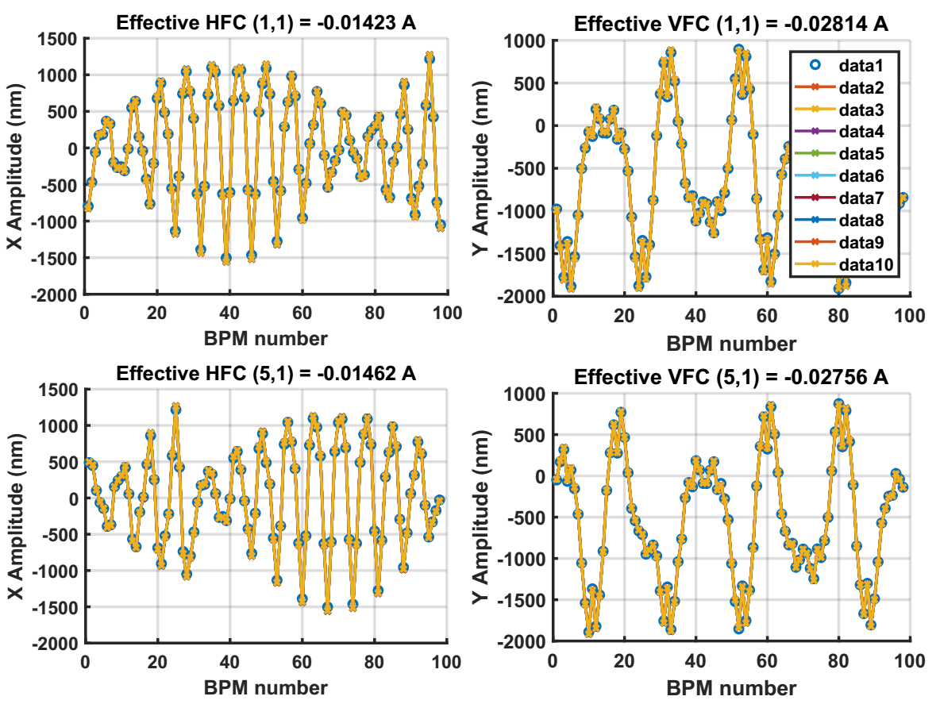
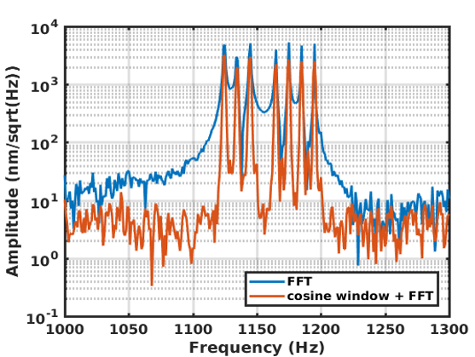
Data Processing
10 Hz
MartÃ­: IPAC2017-MOPAB102: Fast Orbit Response Matrix Measurements at ALBA
Optical transmitter daughter board (power supply communication)
Trenz TE0808 FPGA module
FOFB+EOD processor unit prototype
Notes:
In this example seven horizontal and seven vertical correctors were driven simultaneously at different frequencies ranging between 1100 Hz and 1200 Hz. This Figures show the spectral analysis of the beam position data at the horizontal axis. It shows that a frequency separation of 10 Hz is enough to distinguish individual corrector closed orbits,.
These 14 fast correctors were driven at 14 different frequencies. Using the position data and the algorithm from the ALBA paper we can extract the 14 different closed orbit patterns. This figure shows just 4 examples. The circle marker indicates the expected closed orbit pattern based on a simulation while the remaining data represents the extracted closed orbit data. From these 4 curves we can see that the estimation is quite accurate.

Slide 7
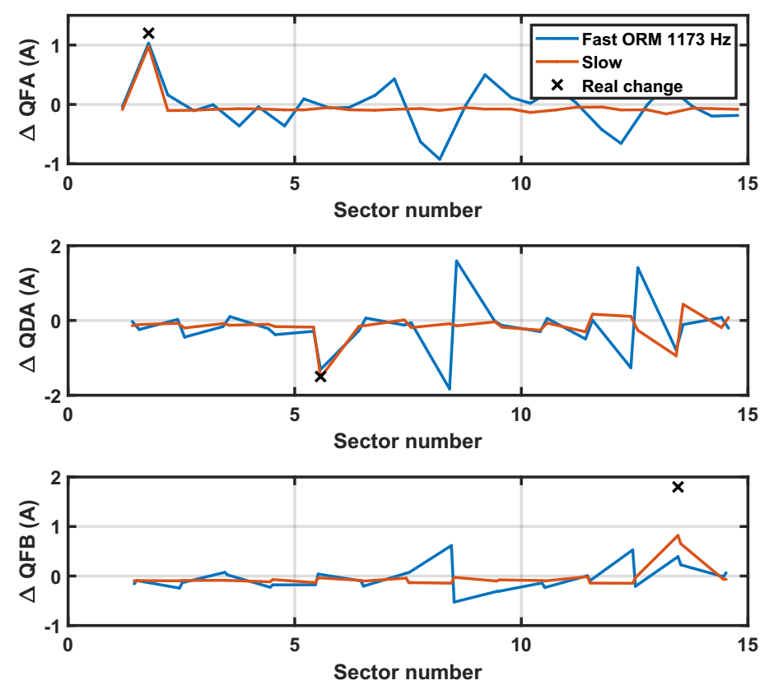
Comparison of Fast and Existing Methods
Optical transmitter daughter board (power supply communication)
Trenz TE0808 FPGA module
FOFB+EOD processor unit prototype
Notes:
A simple test was used to compare the performance of the new fast ORM measurement method and the existing slow method.
The two methods, fast and slow, were measured before and after changes to 3 quadrupoles in the storage ring. The figure shows the results of such a comparison. The current methods is able to detect the changes with an error of less than 10%. The fast method still produces a reasonable result however it is not as accurate as the existing one. It is possible that measuring at higher frequencies of 1173Hz introduce side effects. Works to improve fast ORM measurements are still in progressing.

