Slide 1
Automatic generation of Engineering GUIs
Instrumentation and Controls Meeting
Developed by Rosemary Waghorn, Zai Wang and Andrew Starritt
Presented by Andraz Pozar
28/05/2021

Slide 2
Background
9 new beamlines being built at the Australian Synchrotron
Standardisation is the name of the game (devices, controllers, cables, connectors, PCs, computer screens, OS, software, and engineering interfaces)
From standardisation comes reusability

Slide 3
The grand idea
“Wouldn’t it be amazing if we could, at a click of a button, automatically generate every GUI needed to commission and run a beamline?”
... click of a button ...
Someone needs to put in some effort somewhere
... automatically generate every GUI needed ...
Every beamline and their scientists are different

Slide 4
Information required to generate the GUIs
Existing:
Standardised controls component types - CSBS
Standard user interface (UI) files for each of those types – Qt Designer and QeFramework
Relationships between controls components on each beamline - CSBS
Component names so that the UI files can be instantiated with them – CSBS
New:
Linking of components and assemblies from CSBS to UI files created using Qt Designer - new Engineering GUIs web application
Script to combine all of the information end present it to users – Engineering GUIs generator

Slide 5
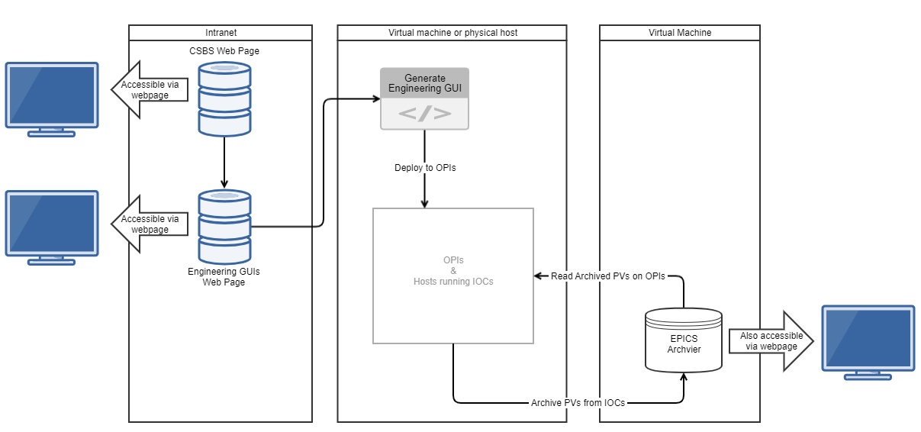
Building blocks

Slide 6
CSBS

Slide 7
Qt Designer + QeFramework
https://github.com/qtepics/qeframework

Slide 8
Engineering GUIs web page

Slide 9
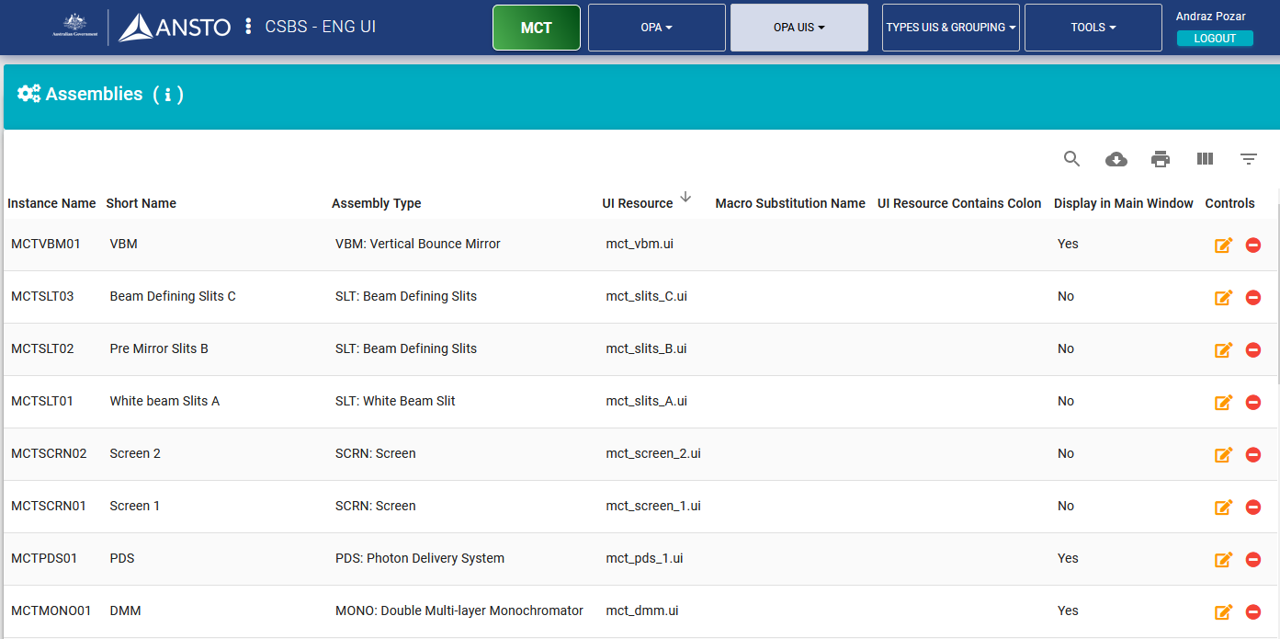
Custom assembly UI files

Slide 10
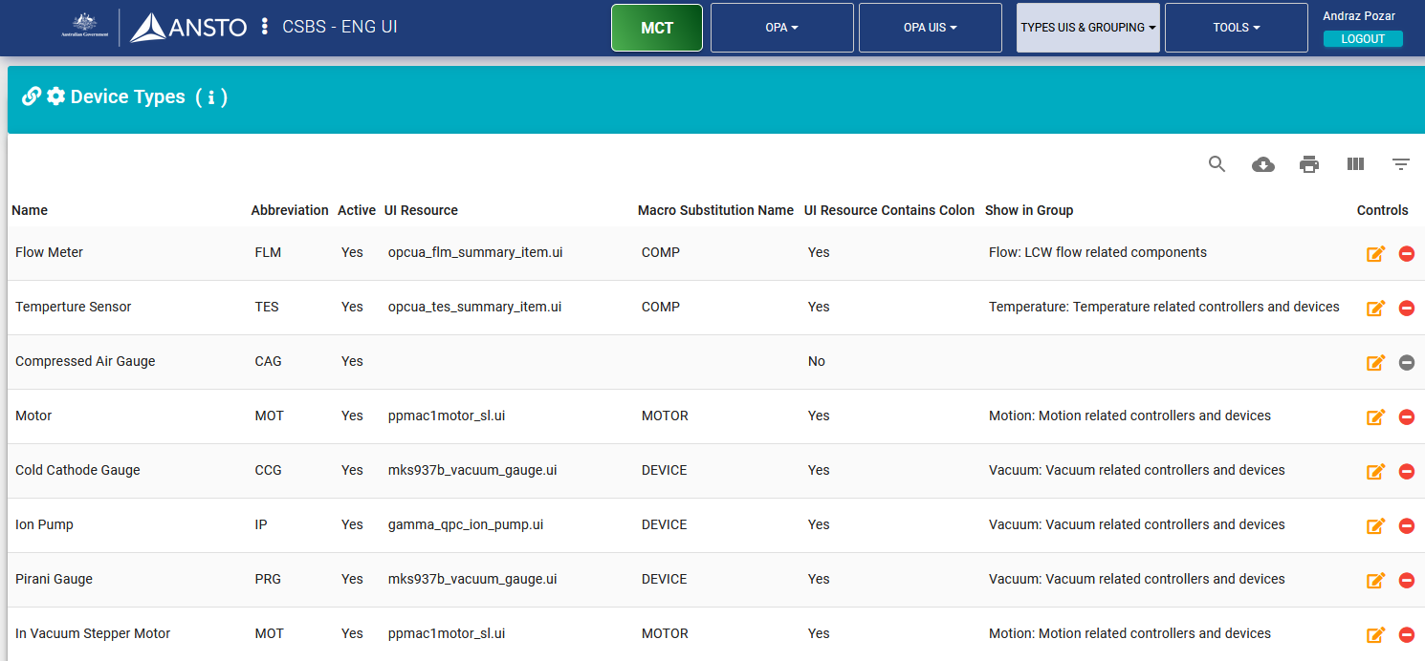
Common component types UI files

Slide 11
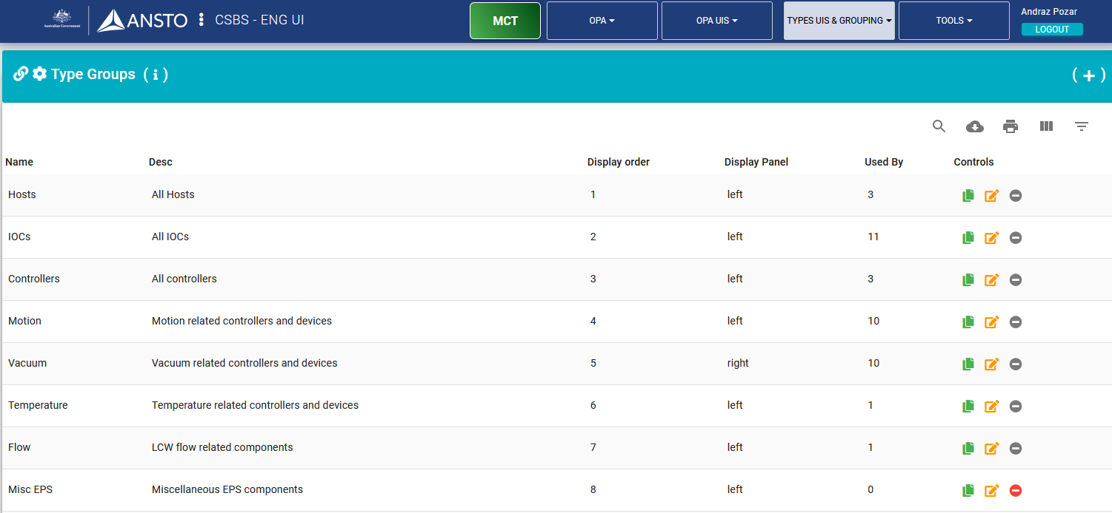
Common component type groups

Slide 12
Generating an Engineering GUI

Slide 13
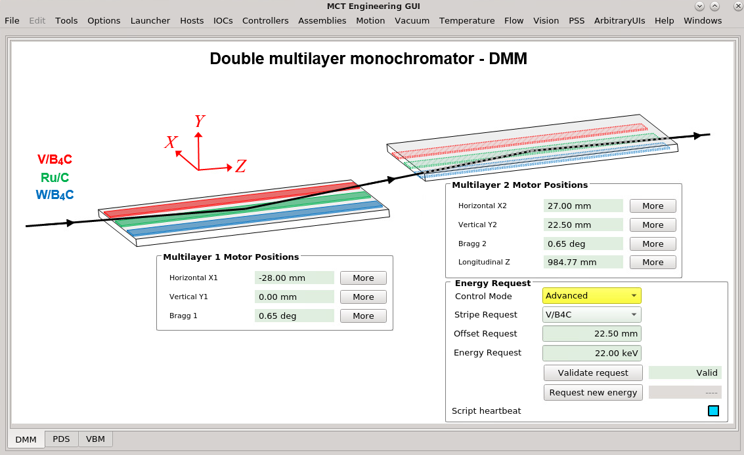
An Engineering GUI – main window

Slide 14
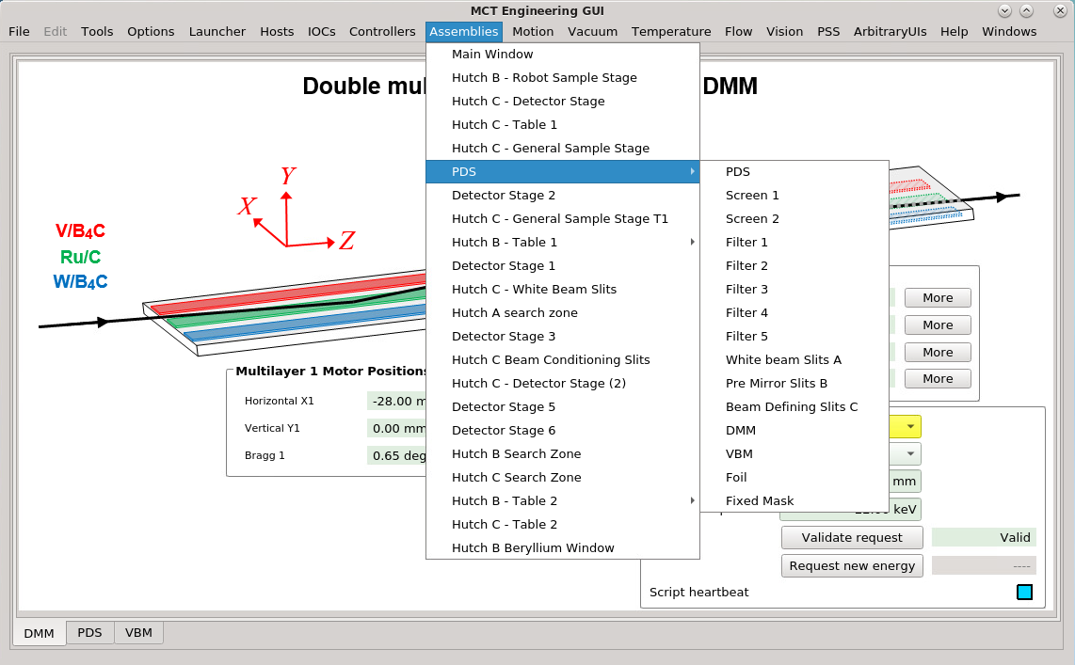
An Engineering GUI – assembly hierarchy

Slide 15
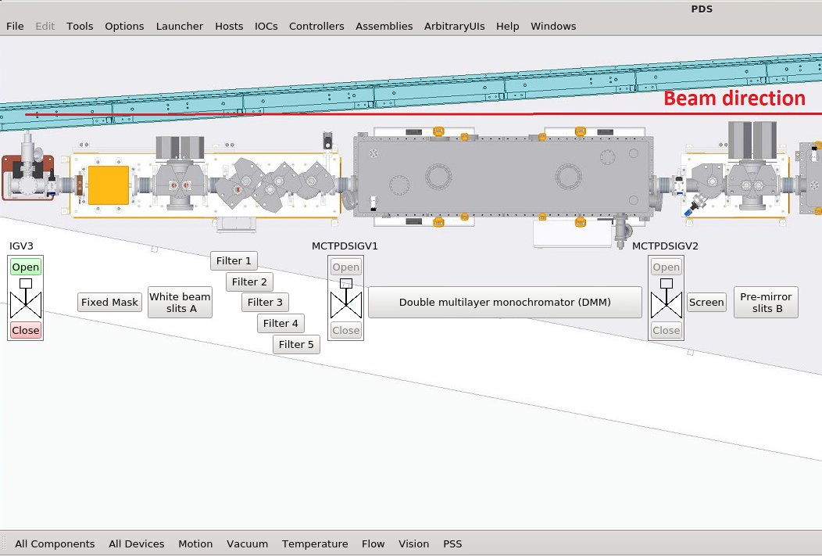
An Engineering GUI – assembly view

Slide 16
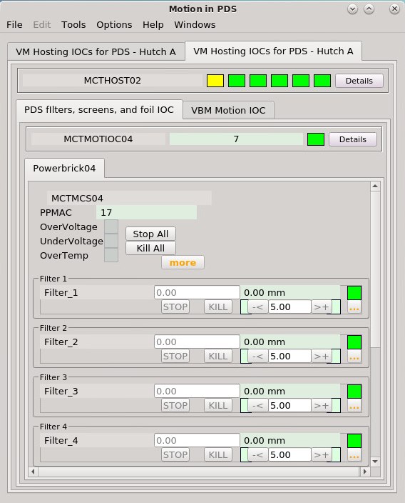
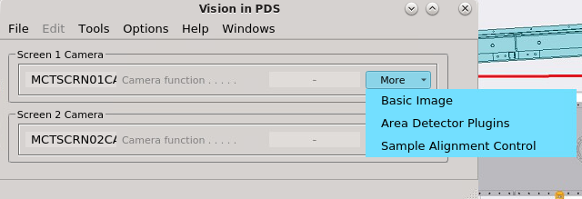
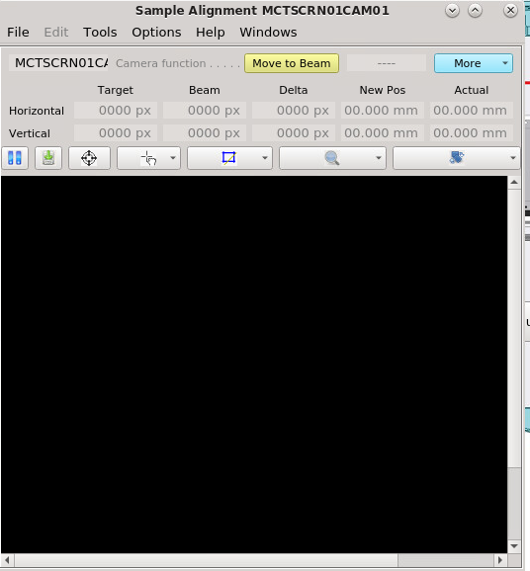
An Engineering GUI – controls hierarchy

Slide 17
Thank you

