Slide 1
Industrial photonuclear activation analysis of gold and other metals in mineral ores
Dr James Tickner | Australian Accelerator Technology Forum
October 2020

Slide 2
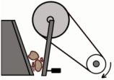
Assay in the gold industry
Large mine operation can generate > 1000 assays per day
Drivers
Delineation
Exploration
Resource development
Accuracy
Extraction
Grade control and extraction
Stockpiling
Crushing and blending
Timeliness
+
$
Processing
Cost
Milling
Separation
Tails monitoring
Metal balance
Slide 2 | Industrial photonuclear activation analysis of gold and other metals in mineral ores | James Tickner
2 |
Optimising the use of our Metal Resources | Dr James Tickner

Slide 3
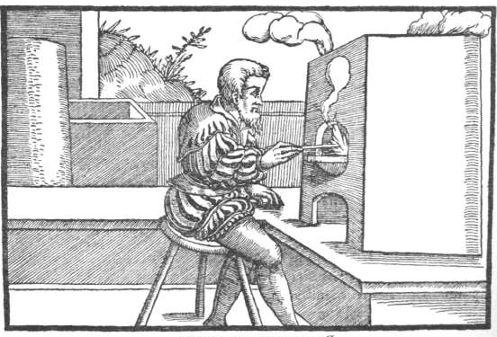
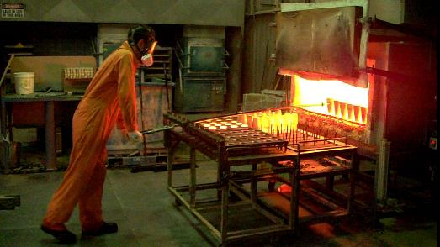
Traditional assay methods
Fire-assay has been the accepted analysis method for many centuries
Existing alternatives:
Aqua regia digest, cyanidation, neutron analysis
g
Turn-around
> 24 hours
Small sample
(10-50 g)
Extensive
prep
Skilled labour requirements
Hazardous process
Slide 3 | Industrial photonuclear activation analysis of gold and other metals in mineral ores | James Tickner

Slide 4
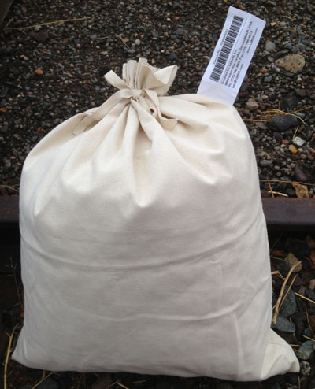
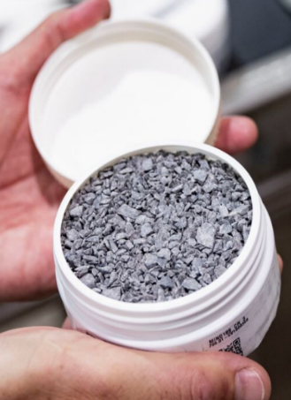
PhotonAssay technology
Photonuclear reaction
Au¹⁹⁷(γ, γ’)Au^{197M}
Crush to 2-3 mm
Split into jars
409.2 keV 11/2⁻
t_{½} = 7.73 sec
Assay process takes < 2 min
279.0 keV 5/2⁺
268.8 keV 3/2⁺
Robot
shuttle
279 keV γ emission
X-rays
Au
Au
77.4 keV 1/2⁺
Au
Au
0.0 3/2⁺
¹⁹⁷Au
8.5 MeV
8 kW
15 s irradiation
15 s measurement
Slide 4 | Industrial photonuclear activation analysis of gold and other metals in mineral ores | James Tickner

Slide 5
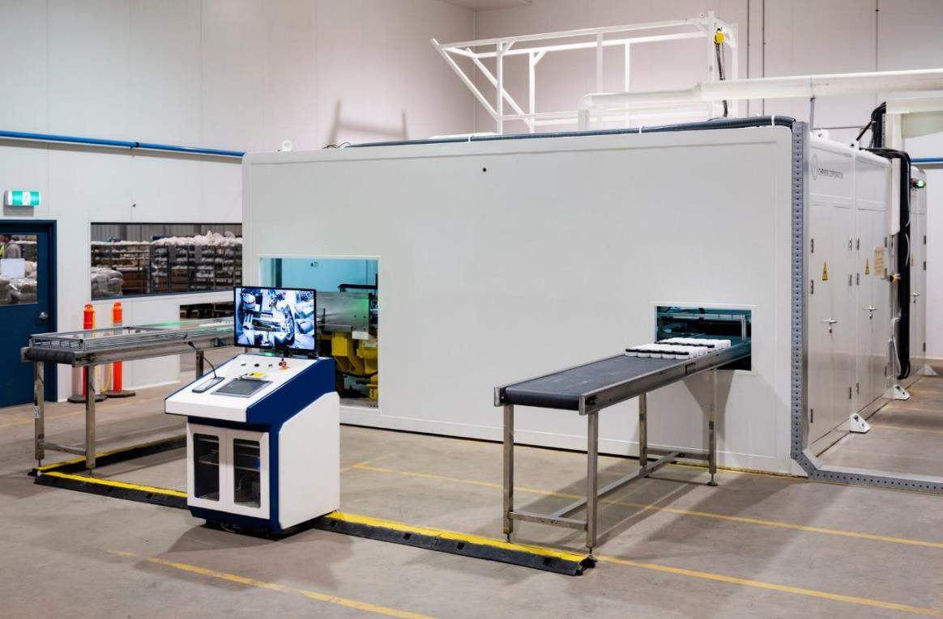
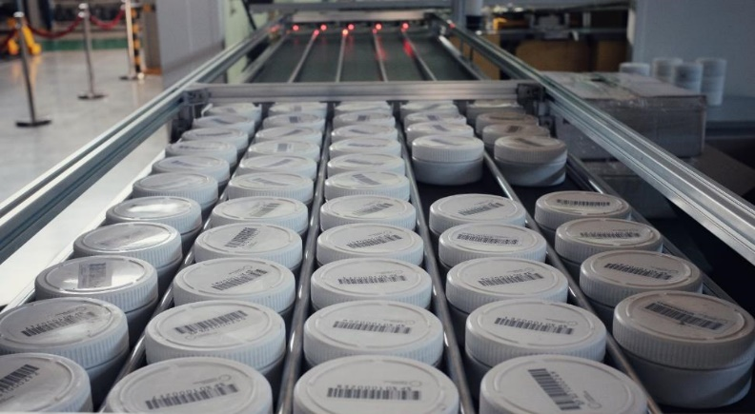
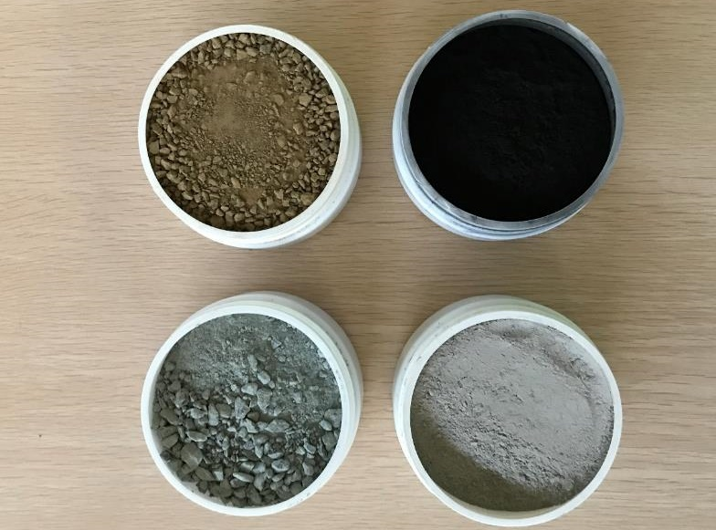
Installation
First installation – Canning Vale, Perth
Slide 5 | Industrial photonuclear activation analysis of gold and other metals in mineral ores | James Tickner

Slide 6
Accelerator design
Challenges
Custom electron linear accelerator manufactured by Nuctech Company Ltd (China)
7-14 MeV end-point energy range
8 kW maximum beam power
160 Gy/min @ 1 m @ 8.5 MeV
S-band Klystron RF source
Proprietary Bremsstrahlung conversion target
Challenging environment
Dust, temperature, remote location, spares availability
Continuous 24/7 operation
Turn-key operation
Dose and energy stability/monitoring
Radiation shielding
Slide 6 | Industrial photonuclear activation analysis of gold and other metals in mineral ores | James Tickner

Slide 7
Beam intensity/energy variations
Target gold measurement accuracy better than 1-2%
Requires excellent beam stability and/or monitoring
Rely on simultaneous activation of gold in sample and bromine (207 keV γ-ray emission) in reference disc
Fully corrects for beam power
Accurately corrects for beam energy
Slide 7 | Industrial photonuclear activation analysis of gold and other metals in mineral ores | James Tickner

Slide 8
Radiation protection
Challenges:
8.5 MeV X-ray source, 160 Gy/min, 24/7 operation
Compact shield in shipping container
Rapid sample access
Turn-key operation for users
Solutions:
Patented layered shield to manage X-ray, neutron and secondary gamma-ray emissions
Patented automated ‘plug’ to allow sample ingress/egress in < 1 s
Modular design to support service and maintenance access
Robust arming and interlock procedures
Slide 8 | Industrial photonuclear activation analysis of gold and other metals in mineral ores | James Tickner

Slide 9
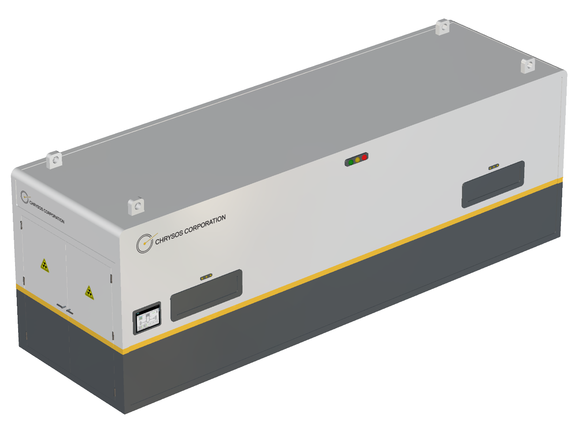
Future: mine-site deployment
On-site deployment could reduce assay
turn-around time to under 30 mins
Grade control
Process control
One-cabin mine unit under development
Smaller LINAC: 2 kW max power, 9 MeV max energy, magnetron RF source
More compact shielding
Fully automated internal monitoring and calibration
$
Accuracy
Timeliness
Cost
Slide 9 | Industrial photonuclear activation analysis of gold and other metals in mineral ores | James Tickner

Slide 10
Dr James Tickner
Chief Technology Officer
+61 409 828 456
james.tickner@chrysos.com.au

