Slide 1
Potential Facility Upgrades for the Next Generation Australian Synchrotron
Dr. Rohan Dowd
Manager, Accelerator Physics, Australian Synchrotron, ANSTO

Slide 2
Background of the Study
Long term strategy of Synchrotron Science to look at the options in the ~15 years time when facility is nearing end of life.
Main question that needs answering – “When the AS has reached end of life, should we upgrade or build an entirely new ring?”
CDR has explored the feasibility of a lattice upgrade using the existing infrastructure of the Australian Synchrotron as much as possible.
Another feasibility study on possible 600 and 450 metre ring options is currently being conducted.

Slide 3
Constraints and Assumptions
Base constraints for lattice upgrade:
  Reuse current tunnels and shielding
  Little or no change to the injector
  No existing Beamline is worse off (in flux and spectrum)
  Significant increase in brightness (factor ~10+)
  Beamline source points cannot move significantly
Constraints for new ring study
  Reuse injection system and existing infrastructure
  Situate on-site with minimal disruption to current ring operation.

Slide 4
Current state of play for Light Sources
4th generation LS implies an order of magnitude emittance decrease.
Multi Bend Achromat lattices.
Ring Circumference dictates minimum achievable emittance

Slide 5
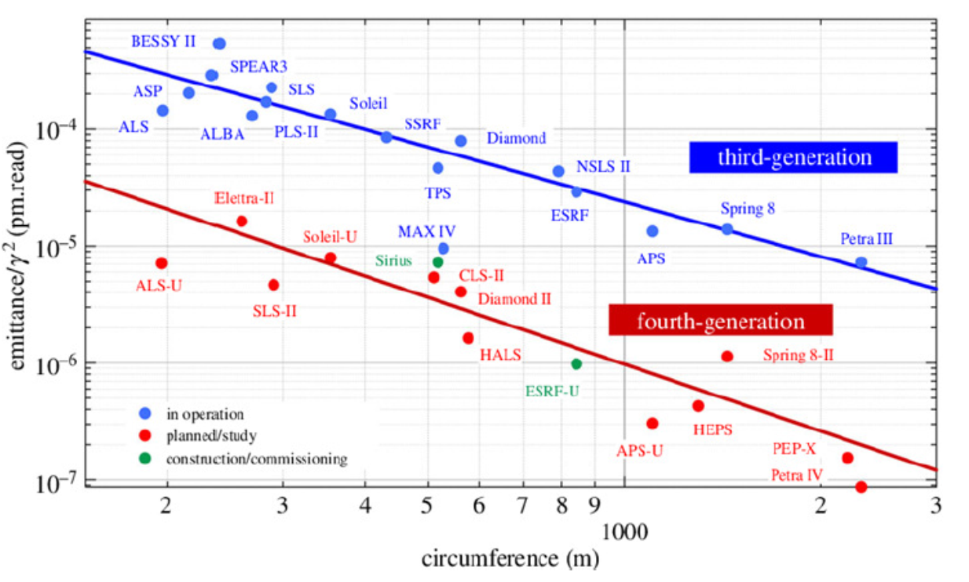
Lattice design – 4BA with reverse bends
Design follows SLS-2 approach and uses ‘reverse bends’ as well as gradient dipoles
Parameter | Current DBA | 4BA at 3.0 GeV | 4BA at 2.5 GeV
Hor. Emittance (nm.rad) | 10.5 | 0.308 | 0.214
E Loss Per Turn (KeV) | 932 | 1946 | 938
Energy Spread (%) | 0.1027 | 0.1624 | 0.1353
Bunch Length [ps] | 29.36 | 9.19 | 6.49
Tousheck Lifetime (hrs) | 22 | 16.7 | TBD
Coupling (%) | 1 | 5 | 6
Dipole Critical Energy (KeV) | 7.7424 | 16.6 | 9.7472
Straight σx [um] | 322.75 | 19.115 | 15.928
Straight σy [um] | 17.464 | 5.317 | 4.431
Straight Length (m) | 4.5 | 3.0 | 3.0

Slide 6
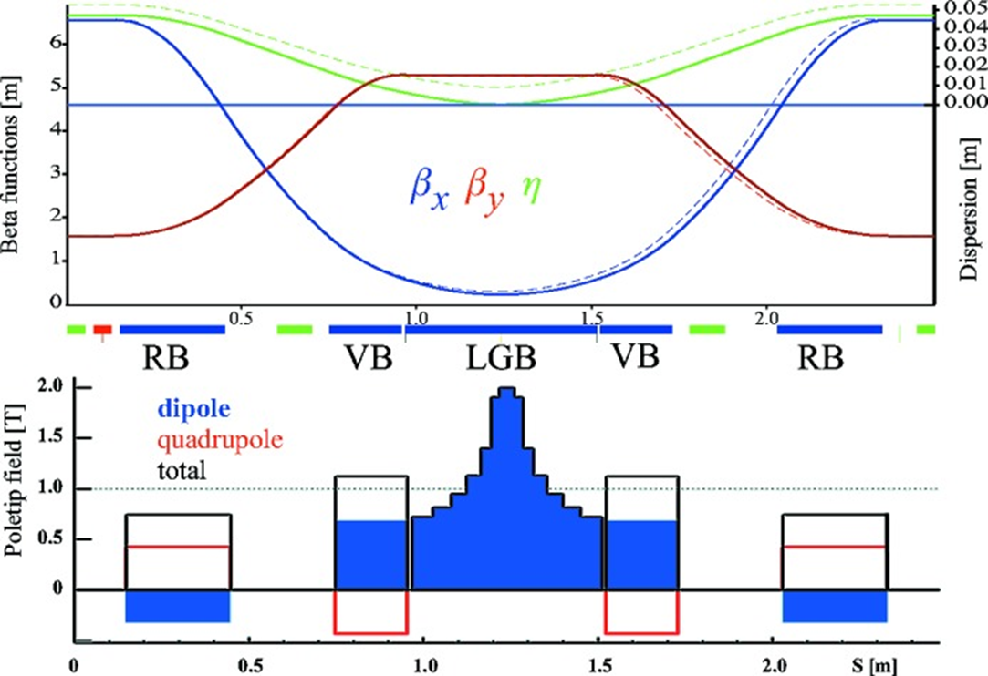
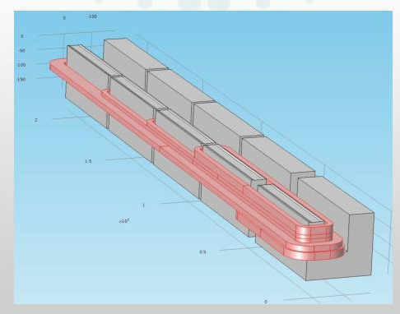
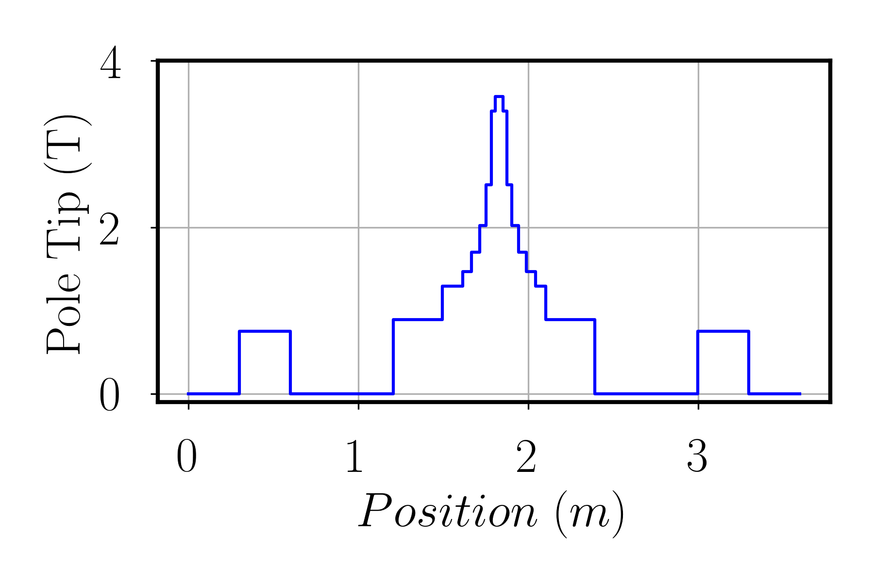
Longitudinal Gradient Dipoles
Bending field changes along the length of the magnet. Peak field almost 4 Tesla.
Will require some R&D to generate desired field.
Longitudinal gradient dipoles of the SLS design

Slide 7
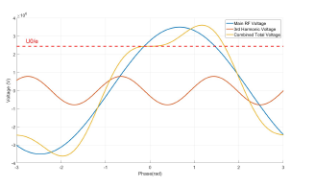
RF Systems
Re-use existing NC HOM damped cavities.
Power budget – Will be twice the current lattice for 3 GeV beam. Beam loading from 250kW -> 500kW
  Go from 4 to 6 Cavities, use 3 cavities in each RF straight 180 kW klystrons
  Need more LCW capacity and power infrastructure
Landau cavities
  Stretches the beam longitudinally for better stability and lifetime. Require an additional, 2x1m cavity systems.
Longitudinal kicker (Feedback system)
  Maintains longitudinal stability, requires additional kicker.

Slide 8
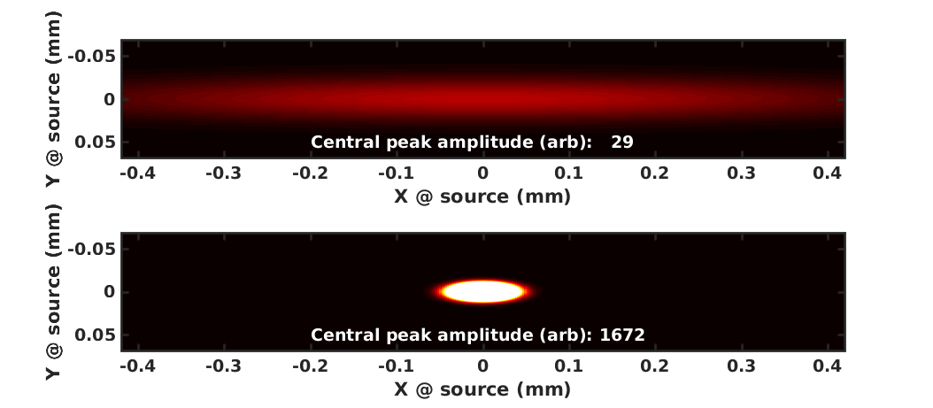
Benefit to Beamlines
Undulators, flux density and brightness.
Blue– AS, Red 3GeV AS-U, Green 2.5 GeV AS-U

Slide 9
Benefits to Beamlines
Wigglers Flux Density (largely driven by Beam energy):
  Blue – AS, Red 3GeV AS-U, Green 2.5 GeV AS-U
Dipoles flux density (largely driven by bend field):

Slide 10
Schedule and cost
Schedule assumes an increased workforce
Costs based on both current quotes and scaled costs from initial commissioning

Slide 11
Other Ring options
Assumptions:
  A new 4th generation storage ring light source is required
  We will have the ability to expand the site southward onto the current Monash university overflow carpark
  A beam energy of 3 GeV will be used in the new storage ring
  The existing facility will be refreshed to extend its operational lifetime
Constraints:
  Use as much existing infrastructure as possible, including the existing accelerator injector system.
  Minimise disturbance to the operation of the current facility and beamlines
  Have room for several new long beamlines (~150m) from the new ring
  Traffic and emergency access to existing site must be maintained.

Slide 12
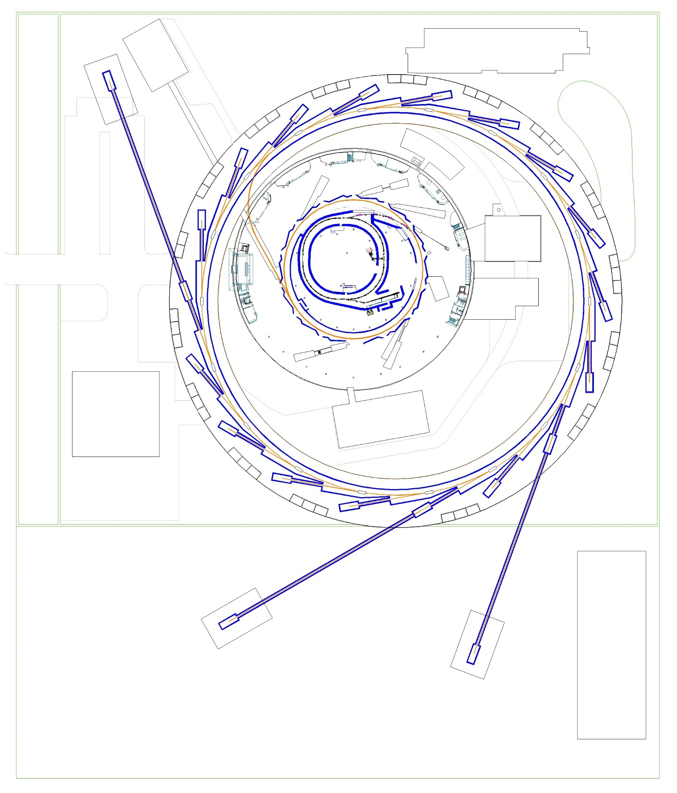
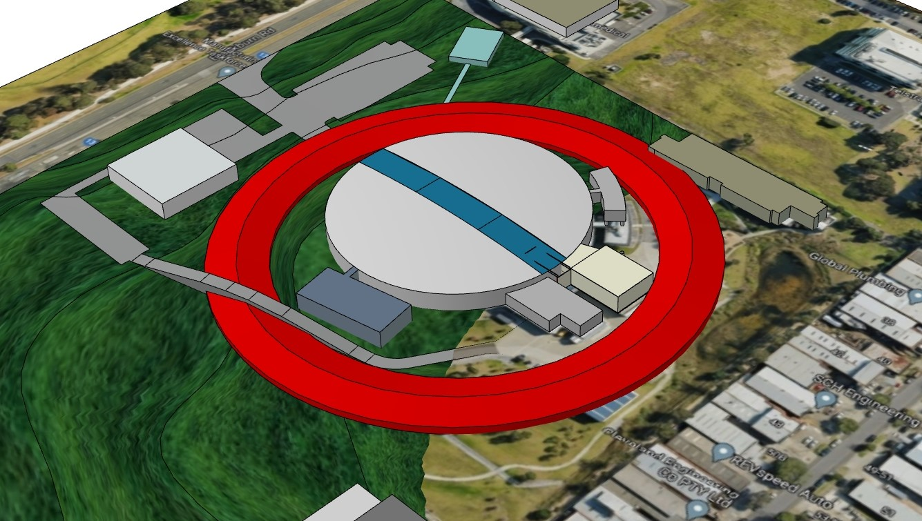
600m ‘Ring Around Ring’
9BA lattice using same design approach
  Can achieve very low emittance <0.05 nm.rad
  lower RF requirements.
  24 sectors, 6m straights
Retains most beamlines and existing buildings
Close proximity to existing infrastructure
Beamlines up to 200m long are possible
Overpasses or underpasses for site access
Long transfer line from existing storage ring.
Cuts across the path of existing and planned long beamlines.
Requires a large amount of excavation on the West side.
Preliminary cost estimate: $400m + $150m for 10 beamlines

Slide 13
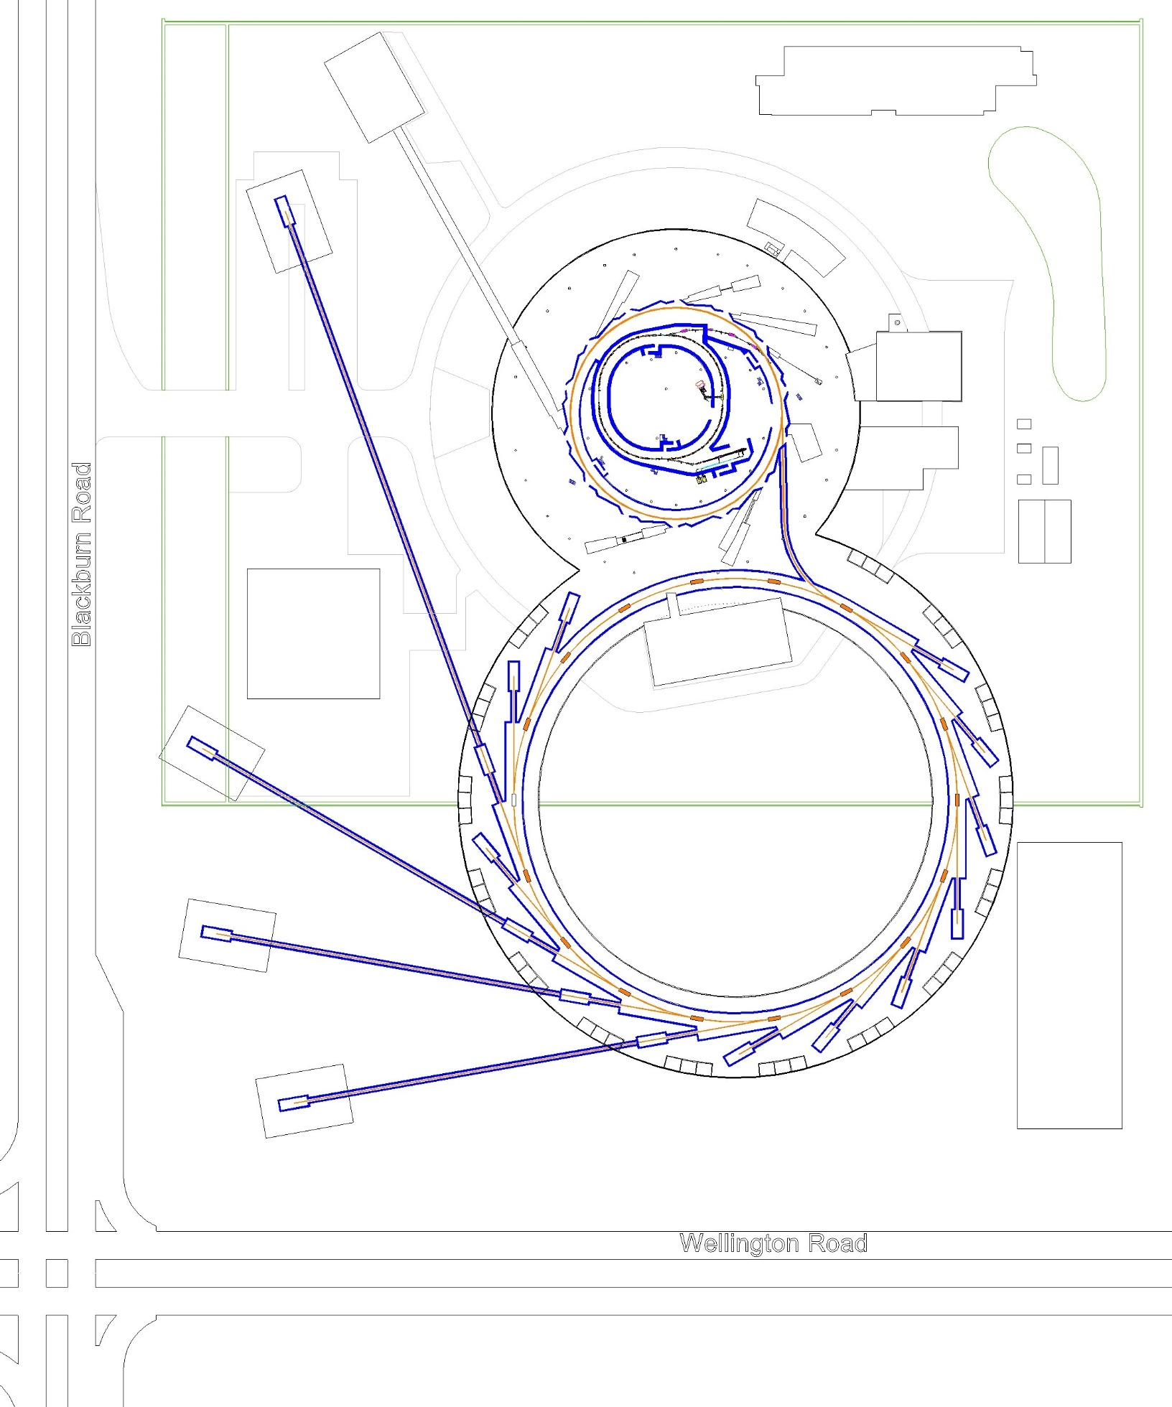
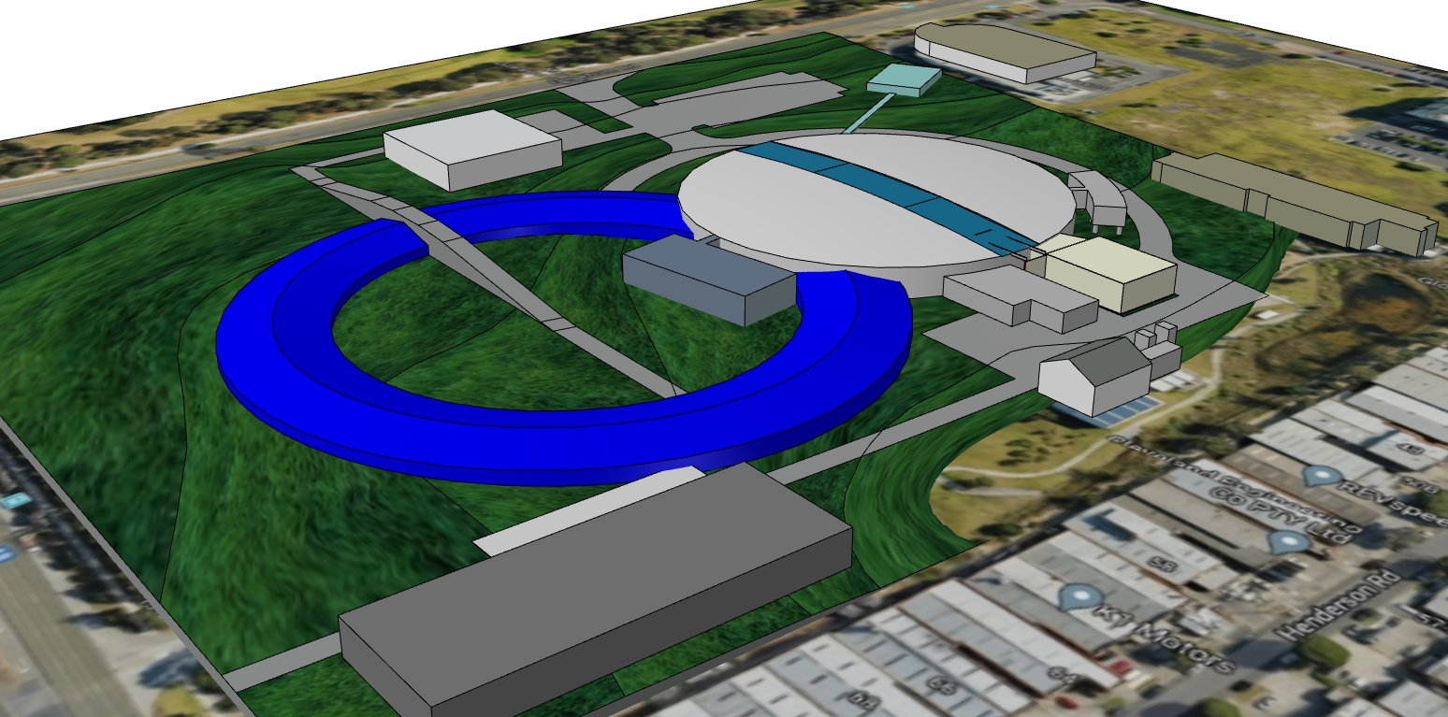
450m Ring Option
9BA lattice
  >0.1 nm.rad emmitance
  18 Sectors, 6m straights
  Similar RF requirements
Less impact to existing buildings
Encircles only one major building
Less excavation and impact to site drainage
Footprint extends into Monash University overflow carpark.
Over/underpass required for access to engineering
Proximity to Roads
  Length of new long beamlines restricted.
  Vibrations
Transfer line impact on exisiting beamlines.
Preliminary cost estimate: $300m + $150m for 10 beamlines

Slide 14
Summary
A ‘competitive’ design using our current ring tunnels appears possible
  however it comes at a much increased power cost unless we lower the beam energy.
Preliminary design and costings
  Detailed design reviews may result in compromises to the emittance achievable.
Two larger ring options have also been explored.
  Both have challenges but bring great benefits also.

