Slide 1
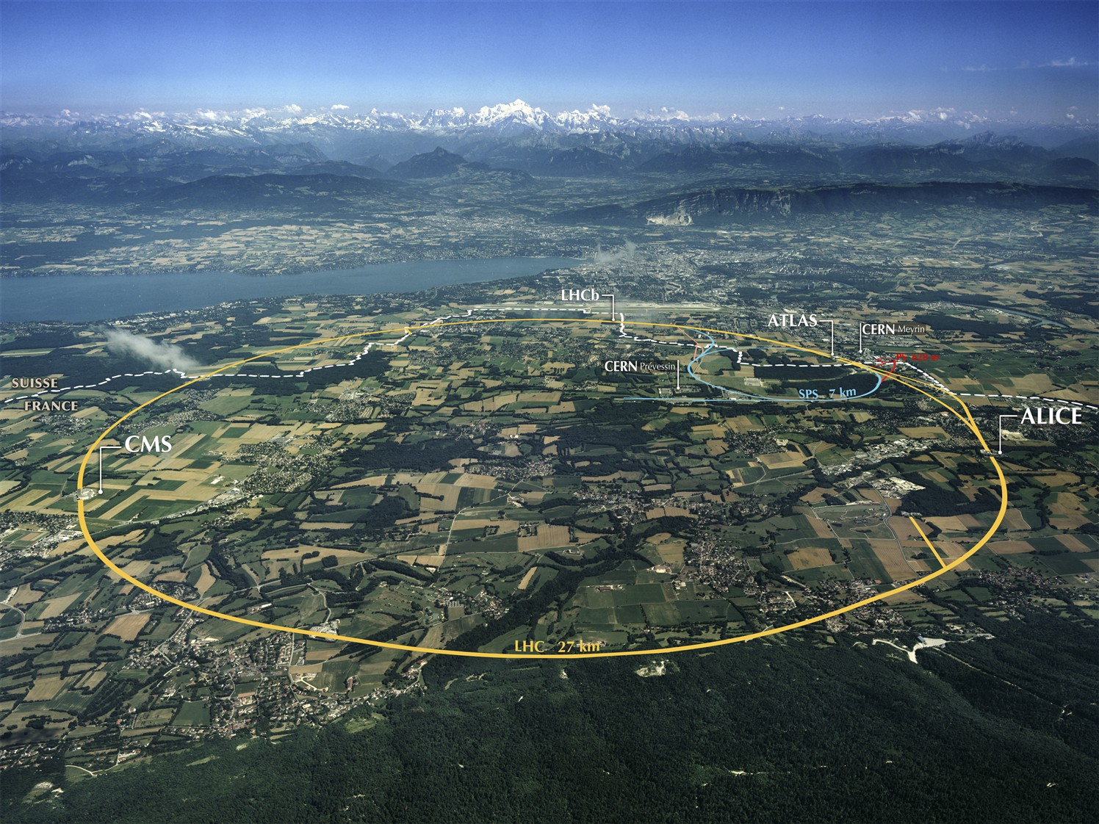
Collaboration in Accelerator Technologies Australia and CERN
Emmanuel Tsesmelis
CERN and University of Oxford
Australian Accelerator Technology Forum
27 October 2020
Accelerating Science and Innovation
Notes:
1

Slide 2
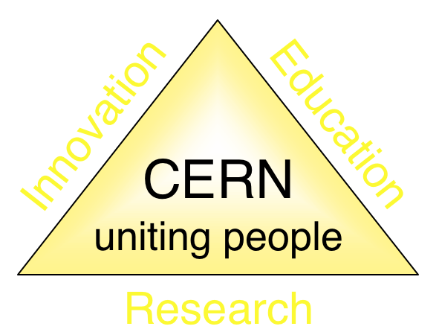
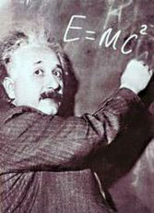
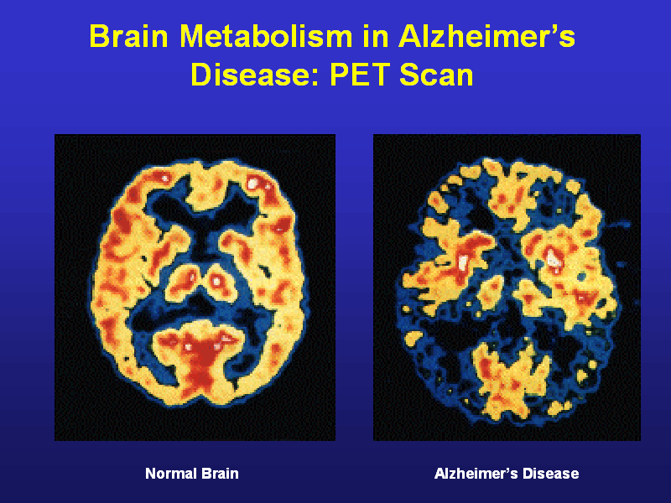
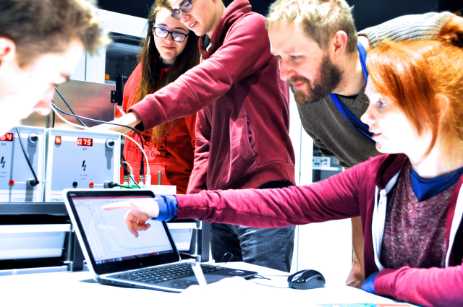
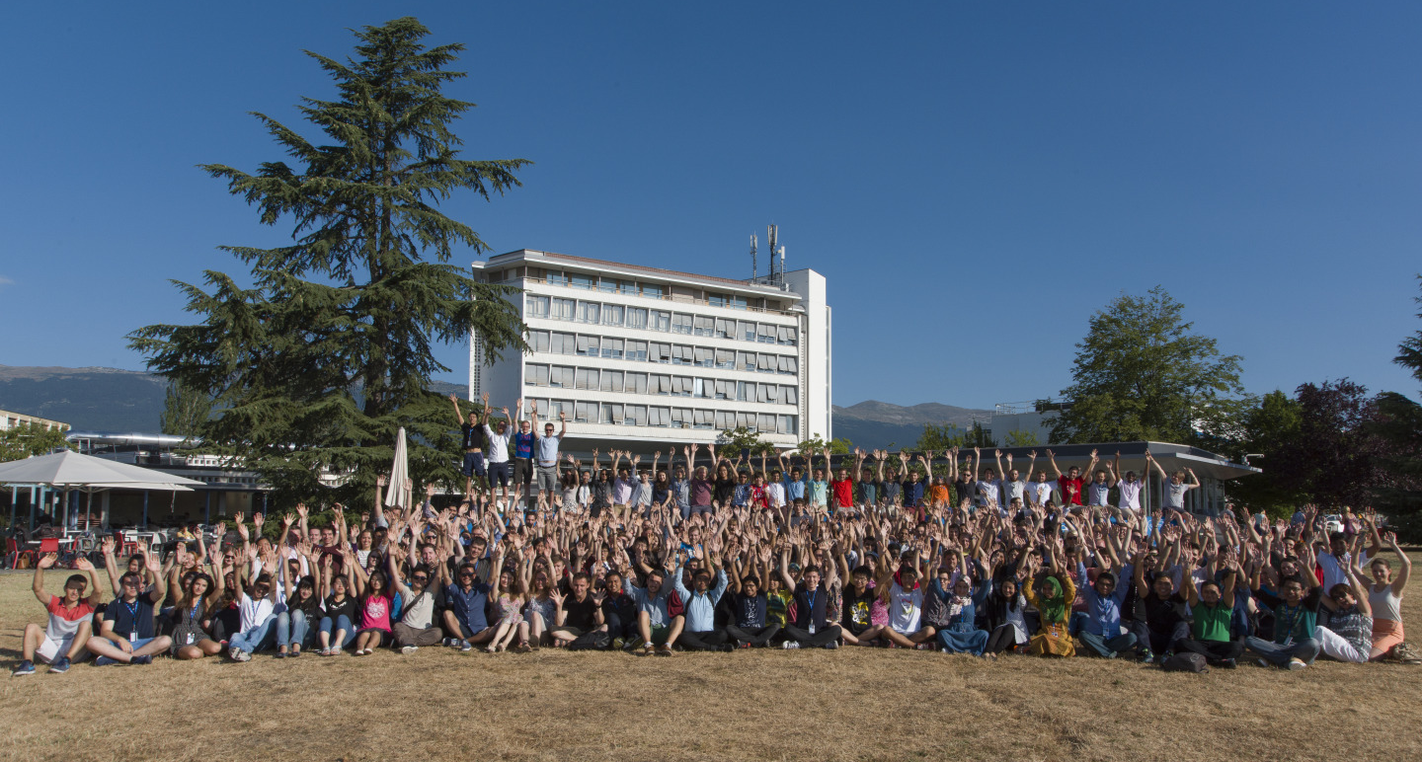
The Mission of CERN
Push back the frontiers of knowledge
E.g. the secrets of the Big Bang …what was the matter like within the first moments of the Universe’s existence?
Develop new technologies for accelerators and detectors
Information technology - the Web and the GRID
Medicine - diagnosis and therapy
Train scientists and engineers of tomorrow
Unite people from different countries and cultures
Notes:
2

Slide 3
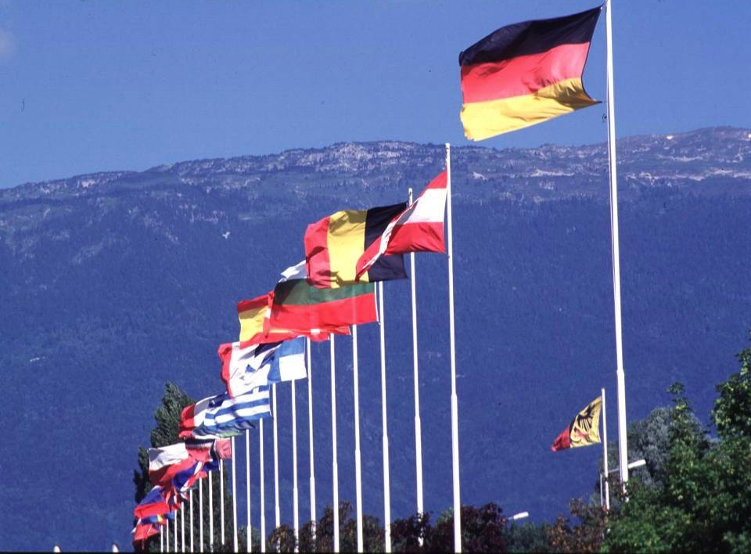
CERN: founded in 1954: 12 European States
“Science for Peace”
Today: 23 Member States
Employees: ~2 700 staff, 800 fellows
Associates: ~12 400 users, 1 300 others
Budget (2019) ~ 1 200 MCHF
Member States: Austria, Belgium, Bulgaria, Czech Republic, Denmark, Finland, France, Germany, Greece, Hungary, Israel, Italy, Netherlands, Norway, Poland, Portugal, Romania, Serbia, Slovak Republic, Spain, Sweden, Switzerland and United Kingdom
Associate Members in the Pre-Stage to Membership: Cyprus, Slovenia
Associate Member States: Croatia, India, Lithuania, Pakistan, Turkey, Ukraine
Applications for Membership or Associate Membership: Brazil, Estonia
Observers to Council: Japan, Russia, United States of America;
European Union, JINR and UNESCO
3
Notes:
3
----- Meeting Notes (09/01/2013 14:16) -----
nnn

Slide 4
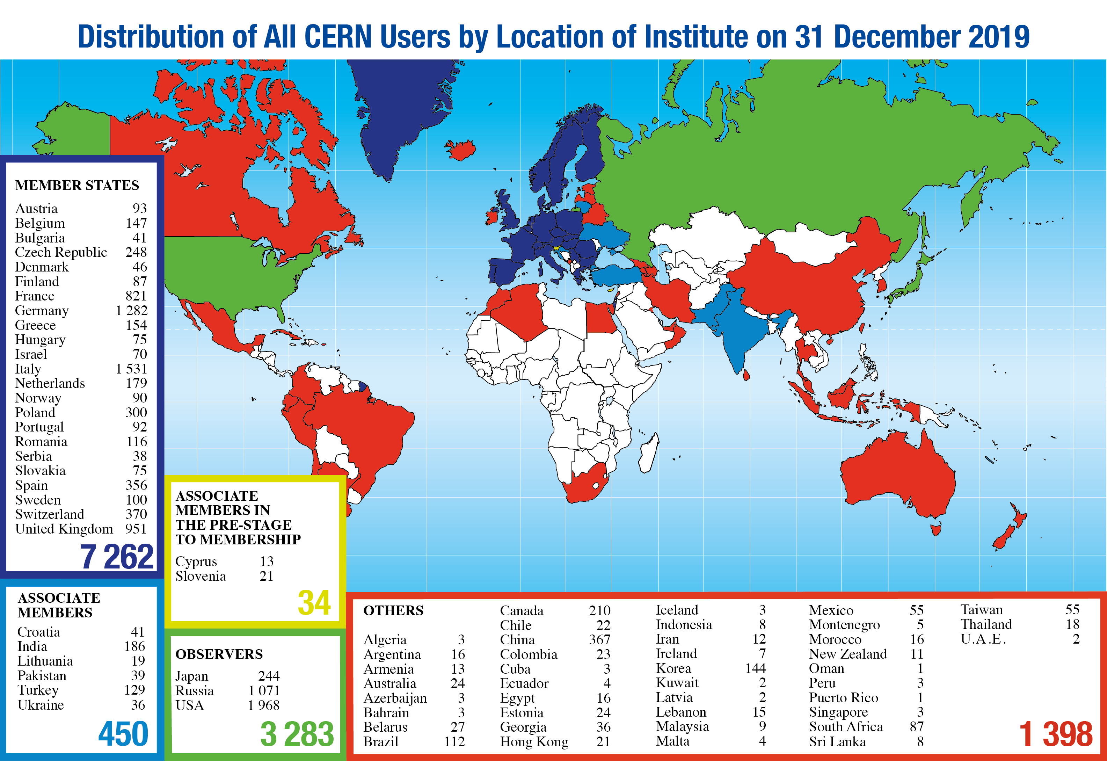
Science is getting more and more global
Notes:
4
4

Slide 5
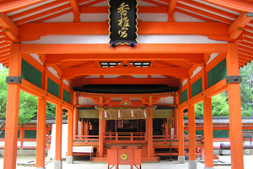
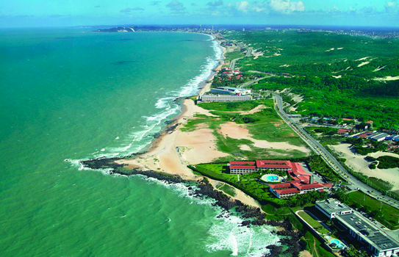
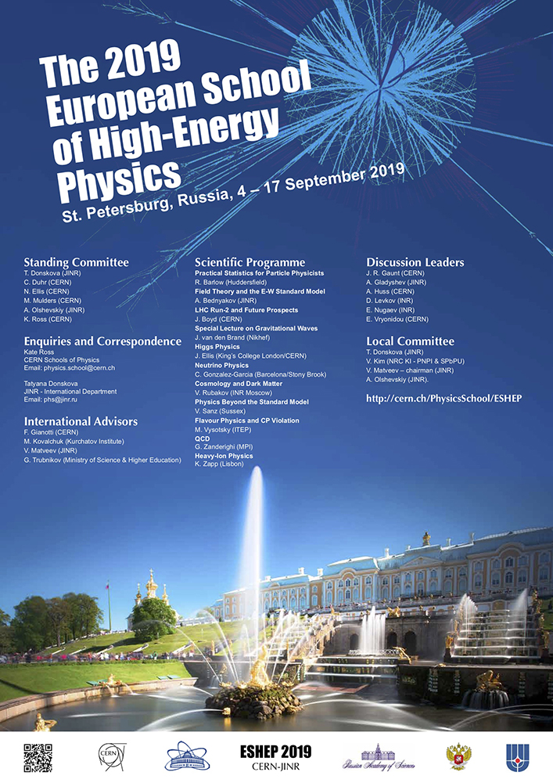
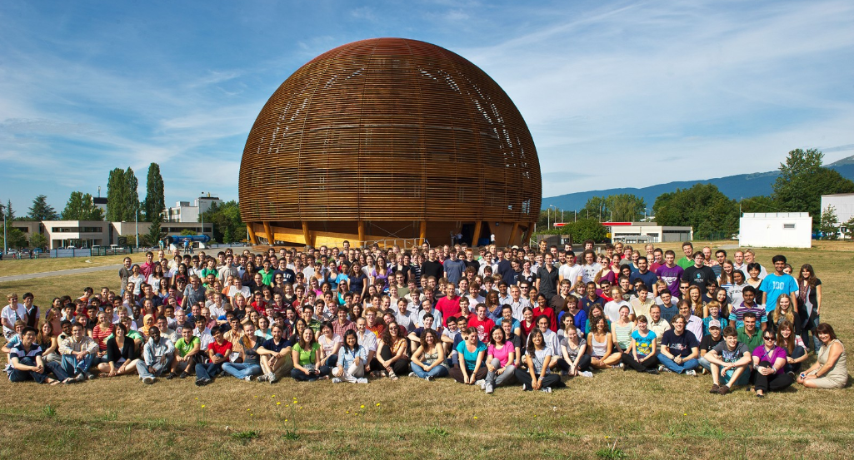
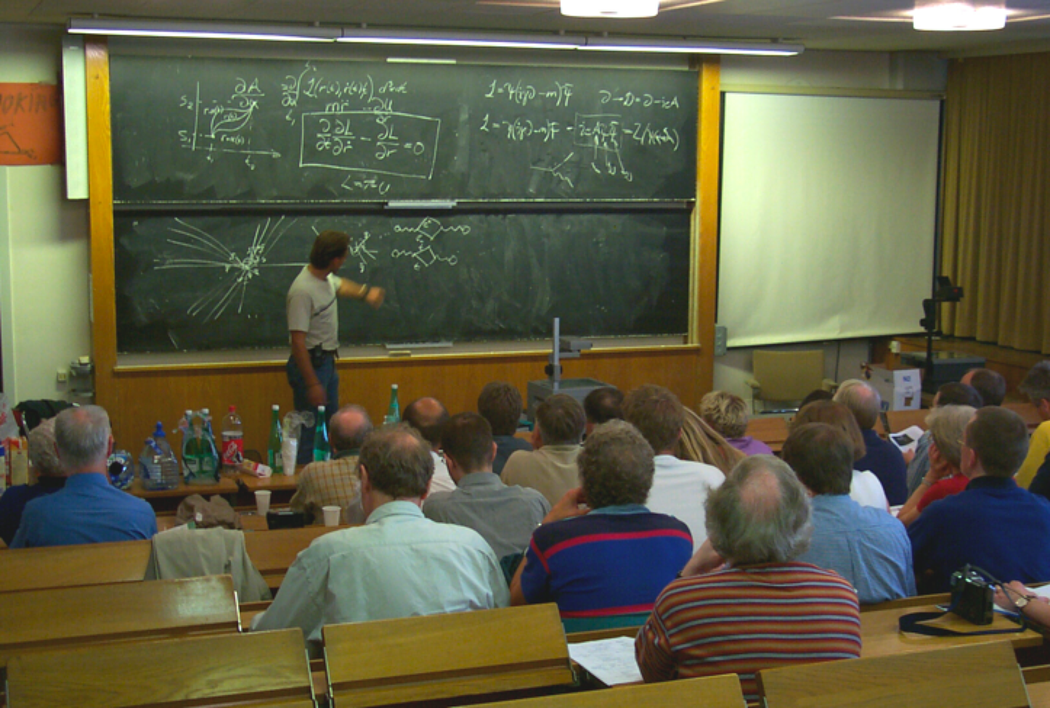
CERN Education Activities
Scientists at CERN
Academic Training Programme
Asia-Europe-Pacific School of High-Energy Physics
Fukuoka, Japan, 2012
Puri, India, 2014
2016 Beijing, China
2018 Quy Nhon, Vietnam
Latin American School of High-Energy Physics
Ibarra, Ecuador, 2015
San Juan del Rio, Mexico, 2017
Córdoba, Argentina 2019
Young Researchers
CERN School of High Energy Physics
CERN School of Computing
CERN Accelerator School
Undergraduates
Summer Students
Programme
CERN School of Physics Russia, September 2019
CERN Teacher Schools
International and National Programmes
Public visitors
150 thousand per year
NMS Doctoral Student Programme – New initiative

Slide 6
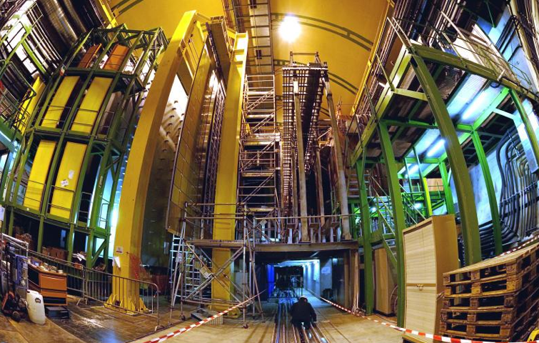
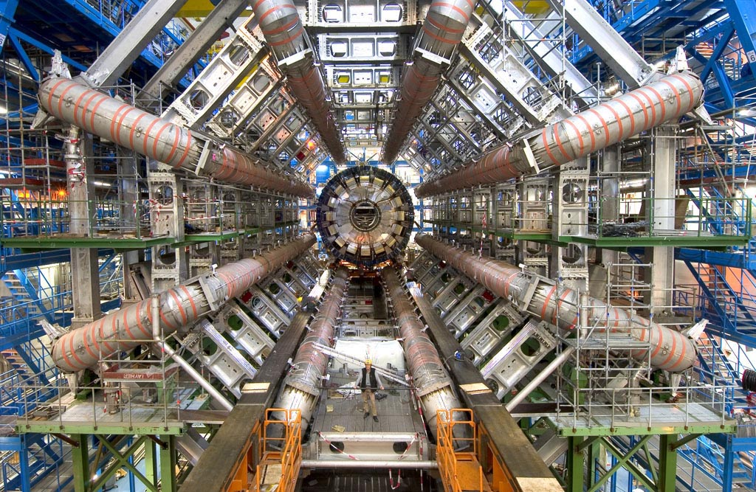
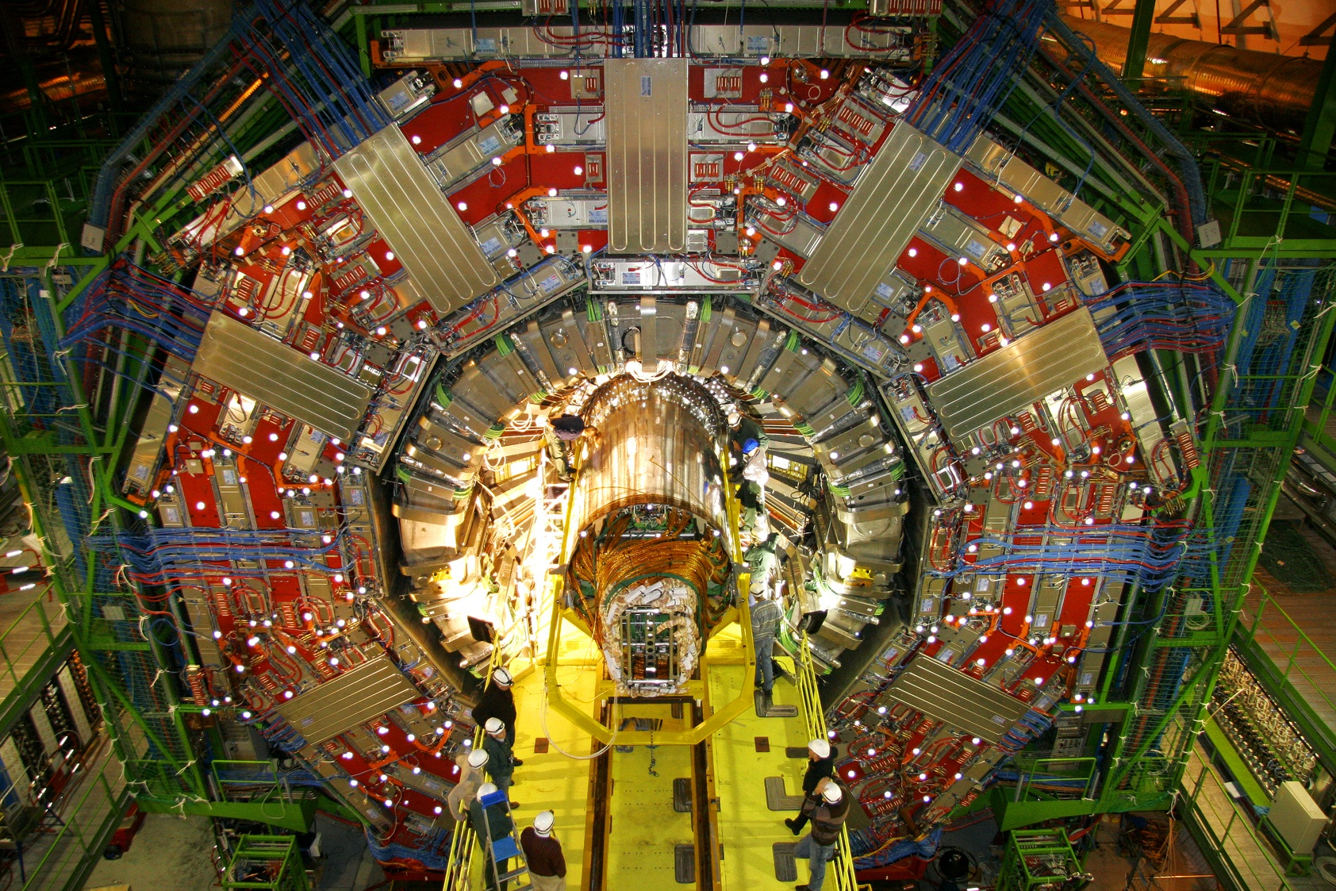
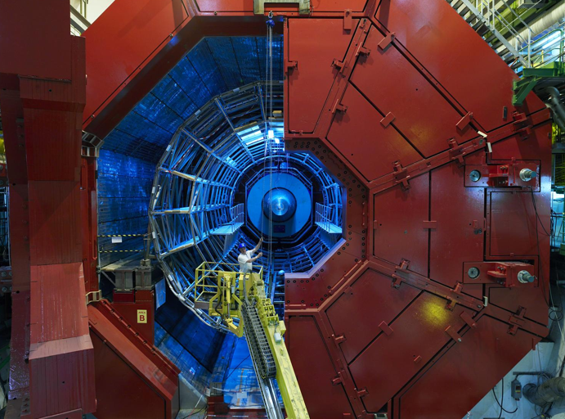
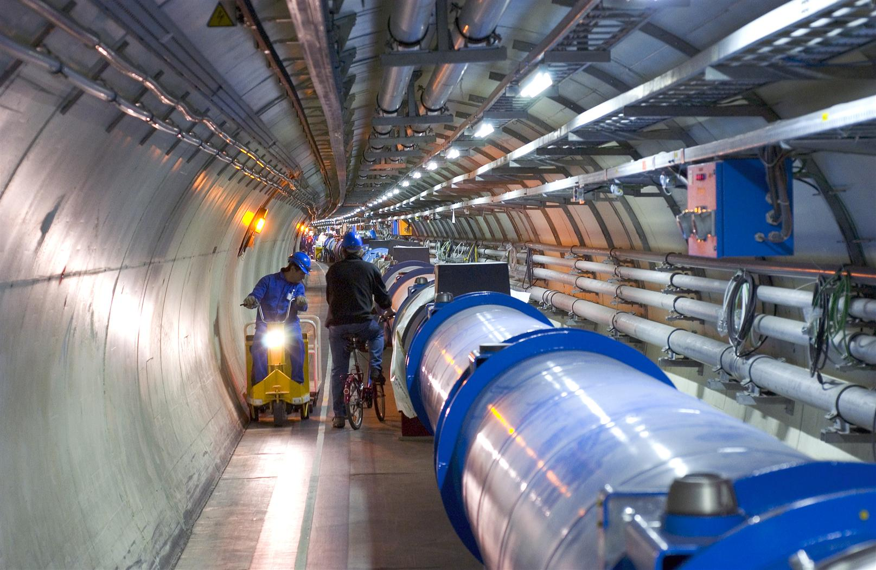
2010: a New Era in Fundamental Science
LHCb
CMS
ATLAS
Exploration of a new energy frontier
in p-p and Pb-Pb collisions
ALICE
LHC ring:
27 km circumference
Notes:
6

Slide 7
Future of Particle Physics at CERN
European Strategy for Particle Physics. Road map for particle physics, updated by CERN Council in June 2020.
Priorities include:
Full exploitation of LHC physics potential. Successful completion of high-luminosity upgrade of accelerators and experiments.
Electron-positron Higgs factory as highest priority next collider.
Ramping up R&D on advanced accelerator technologies.
Investigation of feasibility of a future 100 TeV hadron collider at CERN with electron-positron Higgs factory as possible first stage. Prepare plan for the next strategy update (~2026).
Support long-baseline neutrino projects in Japan and US, and high-impact Scientific Diversity Programme, complementary to high-energy colliders.

Slide 8
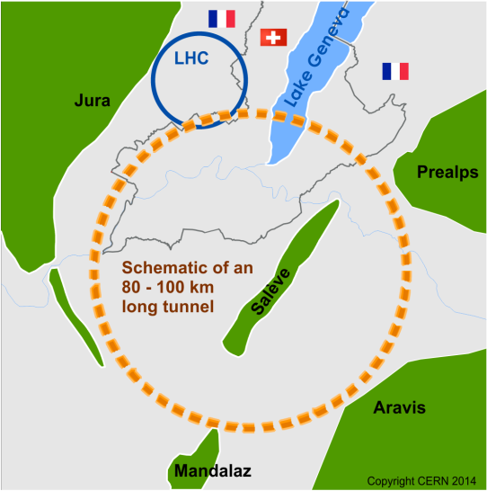
Future Circular Collider (FCC)
Forming an international collaboration to study:
pp-collider (FCC-hh) → defining infrastructure requirements
e⁺e⁻ collider (FCC-ee) as potential intermediate step
p-e (FCC-he) option
80-100 km infrastructure in Geneva area
~16 T ⇒ 100 TeV pp in 100 km
~20 T ⇒ 100 TeV pp in 80 km

Slide 9
From European Strategy 2020
Core sentence and main request “order of the further FCC study”:
“Europe, together with its international partners, should investigate the technical and financial feasibility of a future hadron collider at CERN with a centre-of-mass energy of at least 100 TeV and with an electron-positron Higgs and electroweak factory as a possible first stage. Such a feasibility study of the colliders and related infrastructure should be established as a global endeavour and be completed on the timescale of the next Strategy update.”

Slide 10
Future Circular Collider Innovation Study (FCCIS)
The FCCIS H2020 Design Study project a co-funding instrument and a “social promotion” instrument to engage the European Commission and a community of international partners contractually, including key host state services and offices.
Deliver design and implementation plan for a new research infrastructure.
European Commission co-funding of 2.9 MEuro (11/2020 – 10/2024)
1.8 MEuro for Host State related activities.
1.2 MEuro for FCC-ee optics and machine optimisation.
FCCIS follows the EuroCirCol H2020 Design Study that focused on FCC-hh design and technology (2015 – 2019).
FCCIS kick-off meeting 9-13 November 2020
https://indico.cern.ch/event/923801/

Slide 11
Status of Global FCC Collaboration
Increasing international collaboration as a prerequisite for success: links with science, research & development and high-tech industry will be essential to further advance and prepare the implementation of FCC
139
Institutes
30
Companies
34
Countries
EC
H2020

Slide 12
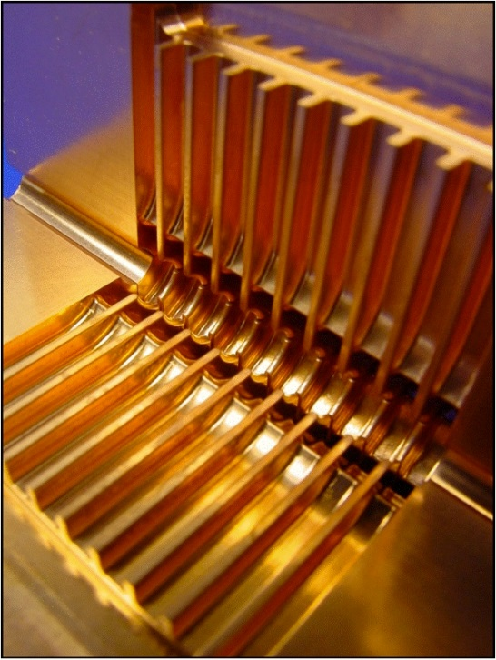
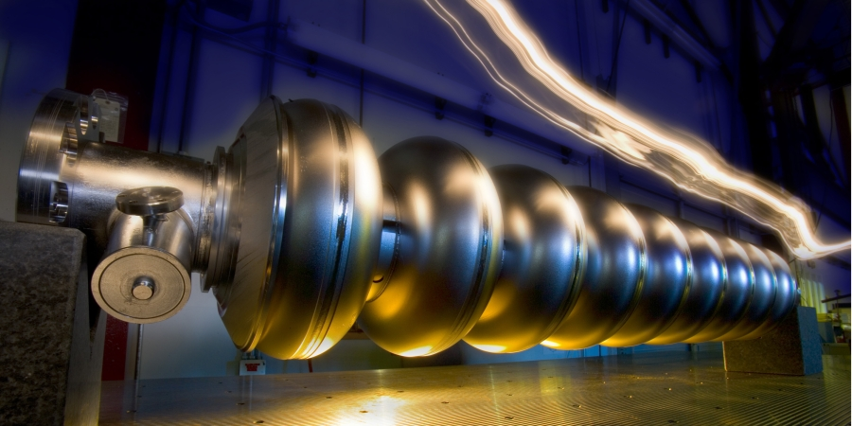
Linear Colliders
CLIC
Linear e⁺e⁻ colliders
Luminosities: few 10³⁴ cm⁻²s⁻¹
ILC
2-beam acceleration scheme at room temperature
Gradient 100 MV/m
√s up to 3 TeV
Physics + Detector studies for 350 GeV - 3 TeV
Superconducting RF cavities (like XFEL)
Gradient 32 MV/m
√s ≤ 500 GeV (1 TeV upgrade option)
Focus on ≤ 500 GeV, with physics studies also for 1 TeV

Slide 13
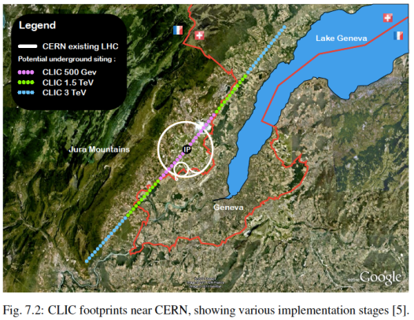
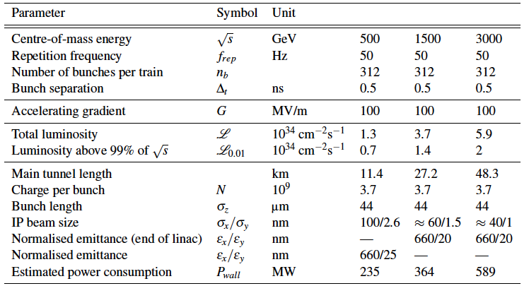
CLIC Implementation at CERN
⬅ Possible lay-out near CERN
⬇ CLIC parameters
Note: the design is currently being re-optmised, e.g. to include 350 GeV as the first stage

Slide 14
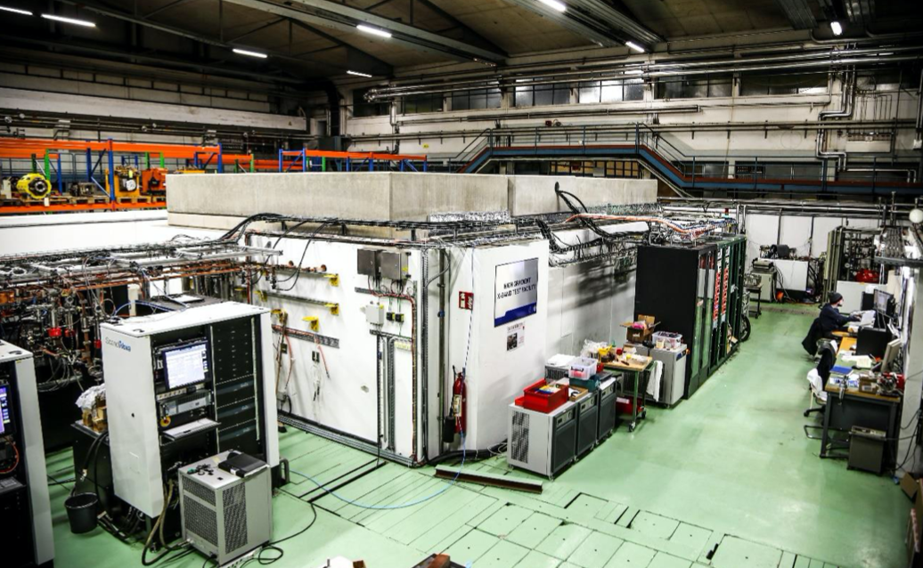
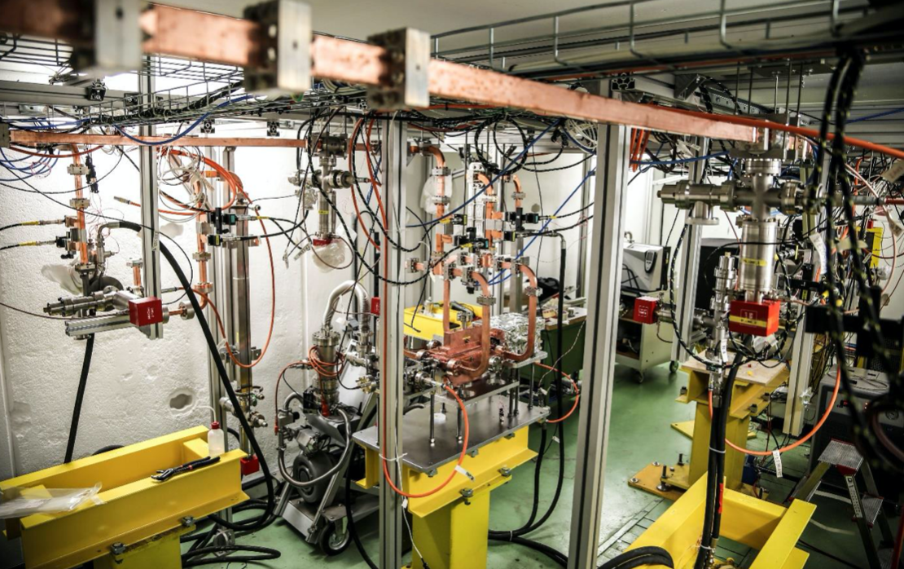
CLIC X-band RF Test Stand (XBOX3)
A very high capacity X-band RF test stand
Test performance at high peak power & short pulse width RF
CERN
CERN
University of Melbourne setting up laboratory to host XBOX3.
Aims to prove performance of these high-gradient accelerating structures.
XBOX3 arrives in Melbourne in November 2020 with installation, commissioning & operation expected from 2021.
See talks by G. Taylor & M. Volpi

Slide 15
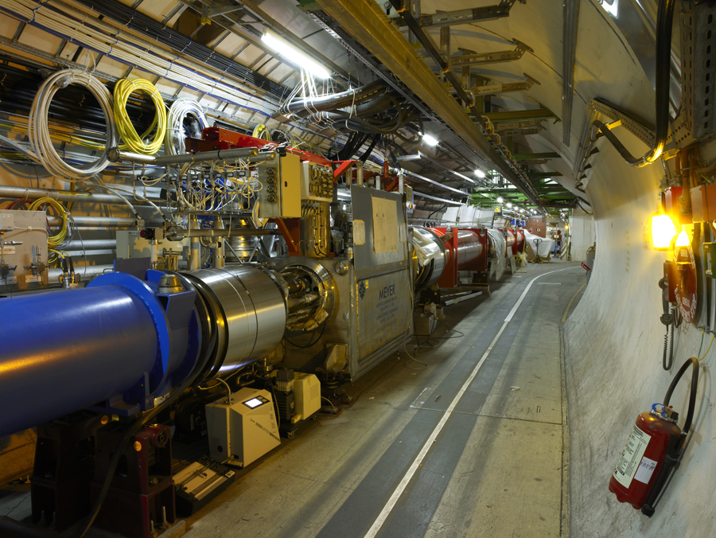
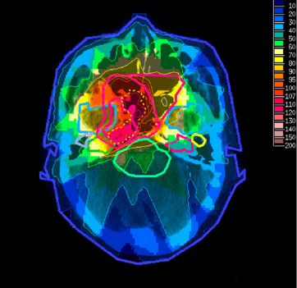
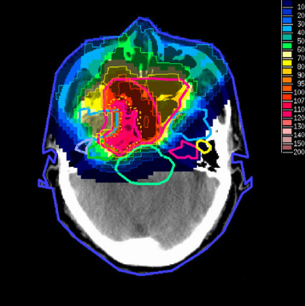
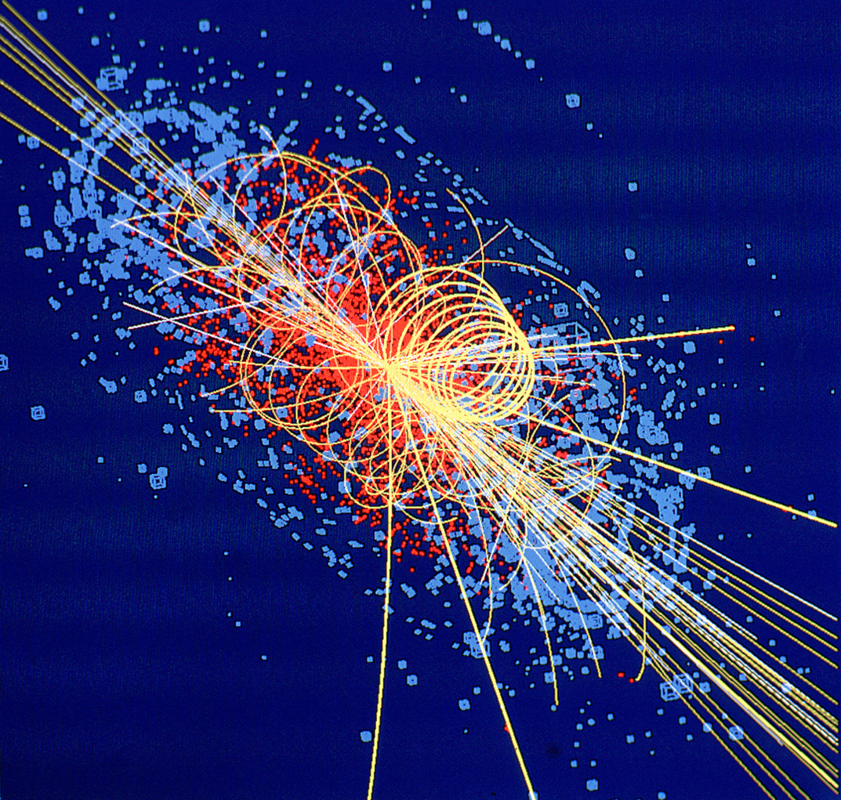
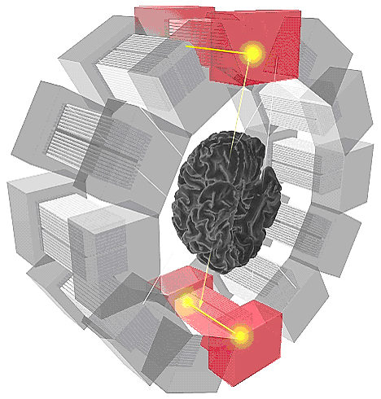
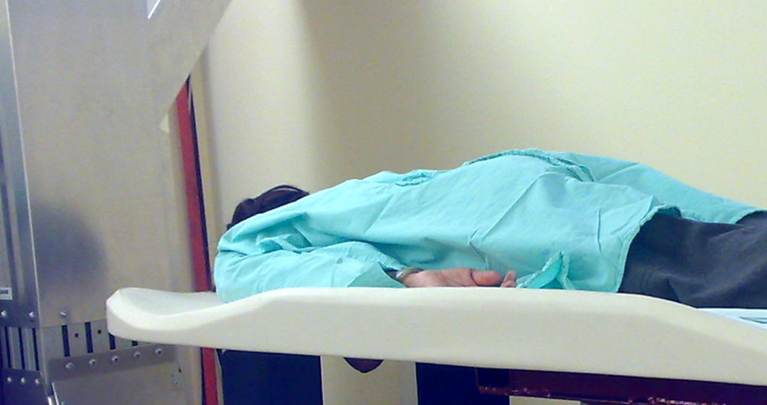
Medical Application as an Example of Particle Physics Spin-off
Combining Physics, ICT, Biology and Medicine to fight cancer
Hadron Therapy
Tumour Target
Leadership in Ion Beam Therapy now in Europe and Japan
Protons
light ions
Accelerating particle beams
~30’000 accelerators worldwide
~17’000 used for medicine
X-ray
protons
>100’000 patients treated worldwide (>45 facilities)
>50’000 patients treated in Europe (>14 facilities)
Imaging
PET Scanner
Clinical trial in Portugal, France and Italy for new breast imaging system (ClearPEM)
Detecting particles
Notes:
15

Slide 16
Next Ion Medical Machine Study (NIMMS)
Instead of fully developing two alternative accelerator designs (linac & synchrotron), concentrate CERN funding on development of few key technologies corresponding to CERN core competences.
As soon as one of the two alternative accelerator designs appear superior in terms of cost & footprint, it will concentrate the project resources.
Efficient use of CERN contribution: a) to provide matching resources needed to attract funding from external sources, and b) to develop strategic components where CERN could have a scientific or industrial return.
Strategy:
Toolbox will be filled with time with more instruments and tools.
At any moment an external project (or industry) can step in and take the elements that they want – accordingly to their goals, their schedule and their budget.

Slide 17
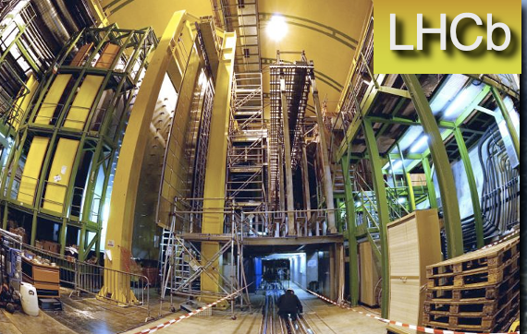
Australia and CERN
International Co-operation Agreement was signed between Australian Government & CERN in 1991.
Australian physicists participated in UA2 & NOMAD experiments. Presently, substantial involvement in ATLAS and LHCb experiments at LHC.
Collaboration on accelerator science & related technologies: → MoU signed with Australian Synchrotron (2007);
→ Australian Collaboration on Accelerator Science (ACAS) is member of CLIC/CTF3 Collaboration (since 2010).
Joint Statement of Intent signed with Australian Nuclear Science and Technology Organisation (ANSTO) to foster collaboration in nuclear physics, accelerator & material science (2010).
Melbourne hosted the International Conference on High Energy Physics 2012 and the International Particle Accelerator Conference 2019.
The Australian National University joined the Neutron Time-of-Flight (nTOF) Collaboration at CERN in 2014.
ATLAS

Slide 18
Australia and CERN
His Excellency General the Honourable Sir Peter Cosgrove AK MC Governor-General
26 February 2018
Notes:
18

Slide 19
CERN Geographical Enlargement Policy 2010
Membership open to all States, irrespective of geographical location
Associate Membership open to all States, irrespective of geographical location
Regular Associate Membership
Associate Membership as the pre-stage to full Membership
Full Membership only to be granted to States once they have completed at least two years of Associate Membership
No limitation on duration of Associate Membership; review every five years
Particle physics is becoming increasingly global and the opportunities available require coordination and collaboration, as well as competition > enlargement is an important component in this environment

Slide 20
Thank You!
Accelerating Science and Innovation
Notes:
20

