Slide 1
microbeam radiotherapy VERSUS conventional radiotherapy FOR Diffuse Intrinsic Pontine Glioma
L M Smyth, P A Rogers, J C Crosbie & J F Donoghue

Slide 2
Clinical Radiotherapy
50% of cancer patients would benefit from RT (RANZCR 2015)
Curative vs Palliative
External vs Internal vs Systemic

Slide 3
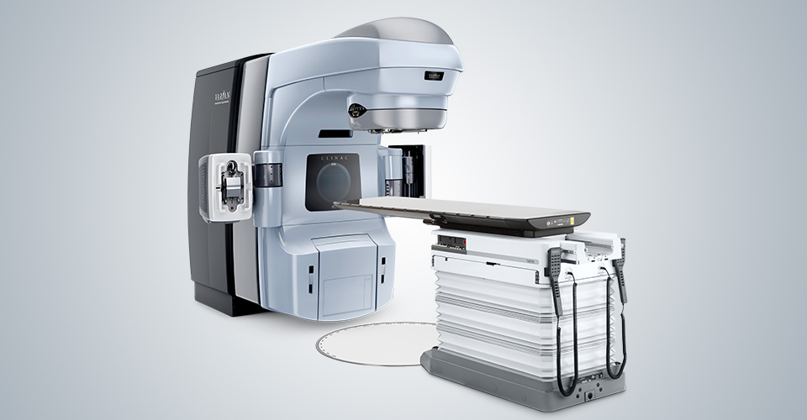
Clinical Radiotherapy
External beam vs Internal vs Systemic

Slide 4
Clinical Radiotherapy
Temporal fractionation
t=0

Slide 5
Clinical Radiotherapy
Temporal fractionation
t=0
t=30

Slide 6
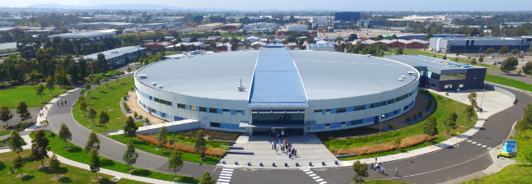
Synchrotron MICROBEAM Radiotherapy (MRT)
Australian Synchrotron – Imaging and Medical Beamline
Hutch 2B

Slide 7
Microbeam RT vs Conventional RT
 | Conventional RT | MRT
Source | LINAC | Synchrotron
Typical radical doses | 40-70 Gy | 100-1000 Gy (Peak)
Dose Rate | ~0.1 Gy/second | ~300 Gy/second
Beam energy | Megavoltage | Kilovoltage
Fractionation | Temporal | Spatial
Dose Profile (cross section)
Notes:
Comb analogy

Slide 8
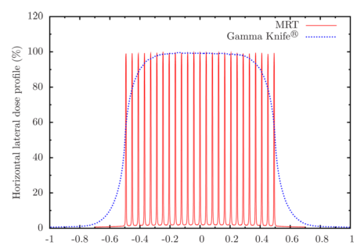
MRT
Parallel planar beams
25-50µm wide
200-400µm spacing
Normal tissue tolerance & tumour control
Image reproduced from Martinez-Rovira et al. (2012)
Notes:
PVDR – depends on field size and depth in tissue. Decreases with bigger fields, and with depth due to effects of lateral and forward scatter in tissue. Typically valley = 10 Gy, Peak = 100 Gy, and this is what we anticipate this is in our therapeutic window.
Despite the highly inhomogenous fields, tumour control can be achieved
Radiobiology is extremely different to CRT – differential activation of gene pathway, and differential response of the immune system

Slide 9
“What are equivalent doses??”
Notes:
This is a key question! In terms of tumour control and normal tissue toxicity

Slide 10
Why?
Improvements are still needed!
Advanced Lung Cancer
Pancreatic Cancer
DIPG (Grotzer et al. 2015)

Slide 11
Diffuse Intrinsic pontine glioma (dipg)
Most deadly paediatric brain tumour, infiltrates brainstem
5-10 y/o - Loss of body control, cranial nerve palsies
Radiotherapy is the mainstay
8-14 months survival
Could MRT be an alternative?
Notes:
- Due to location and diffuse/infiltrative nature of disease, surgery is not an option, and brainstem limits dose that can be delivered
- Despite changes to fractionation and addition of chemo, survival HAS NOT CHANGED significantly in the past 30 years.

Slide 12
Aim & Methods
Determine dose-equivalence between MRT and Conventional RT (CRT)
Compare the radio sensitivity of two DIPG cell lines
Notes:
Ie. Which cell lines might be a good candidate for MRT??

Slide 13
Method
Two DIPG cell lines (JHH and SF7761)
Dose escalation
CRT: 2 – 12 Gy
MRT: 112 – 1180 Gy
Clonogenic Assay (Ibahim et al. 2014)
Apoptosis and Cell Cycle Assays

Slide 14
Method - dosimetry
Table 1. Peak and valley doses at increasing depth in water for a 140 mm x 30 mm field size
Depth | Surface |  | 5mm
PVDR | 23.7 |  | 17.3
 | PD (Gy) | VD (Gy) | PD (Gy) | VD (Gy)
 | 112.0 | 4.7 | 105.2 | 6.1
 | 250.0 | 10.6 | 234.7 | 13.5
 | 560.0 | 23.6 | 525.8 | 30.3
PVDR; Peak to valley dose ratio, PD; Peak dose, VD; Valley dose
Notes:
PVDR – ratio of peak to valley dose. Decreases with increased field size and depth (due to scatter) ~ 24 for our experiments (140 x 30mm field size).
Verified MRT doses using HDV2 Gafchromic film, against a series of calibration films produced at 20mm depth and 20x20mm field size
Mean energy of MRT – 95KeV; 300 Gy/Sec in beam
CRT – Cobalt 60 ~1.3MeV; 2 Gy /minute

Slide 15
Results
SF7761 cell line more sensitive to MRT & CRT
Fit these curves to linear quadratic model
Interpolated equivalent doses
* p<0.05, ** p<0.01
Notes:
14 day clonogenic assay
What we did was calculate equivalent doses using the linear quadratic dose-response model, which is accepted for radiotherapy, and non-linear regression.

Slide 16
Results
Table 1. Interpolated equivalent CRT doses for increasing MRT doses
 | Equivalent CRT doses (Gy)
Cell Line | 112 Gy MRT | 250 Gy MRT | 560 Gy MRT
SF7761 | 3.2 ± 0.3 | 6.8 ± 0.4 | 9.1
JHH | 2.5 ± 0.1 | 6.1 ± 0.2 | 9.3 ± 0.3

Slide 17
Results - apoptosis
*p<0.05, **p<0.01
Notes:
No Clear trend for JHH – CRT marginally higher than MRT but not significant at any point. MRT clearly higher for each equivalent dose for SF7761, with significance at 560 Gy versus 9 Gy – WHY!!!!???

Slide 18
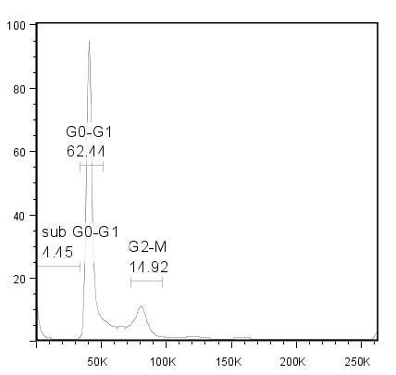
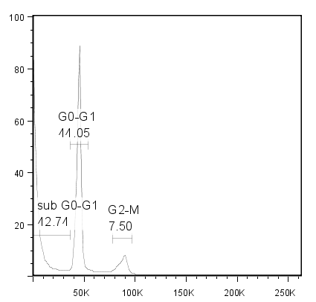
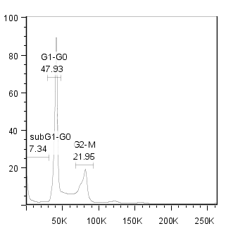
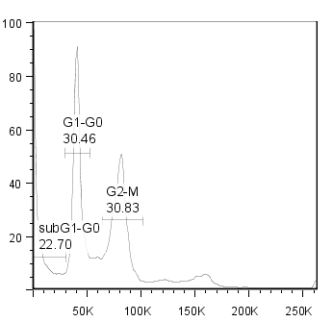
Results – cell cycle
Control
250 Gy
SF7761
No Polyploidy
Percentage of Cells
JHH
Polyploidy
Propidium Iodide

Slide 19
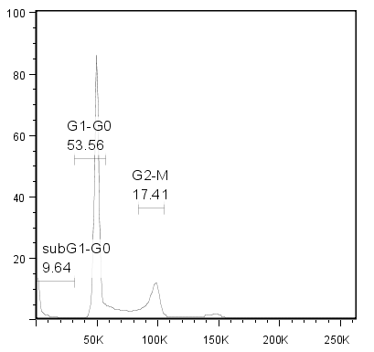
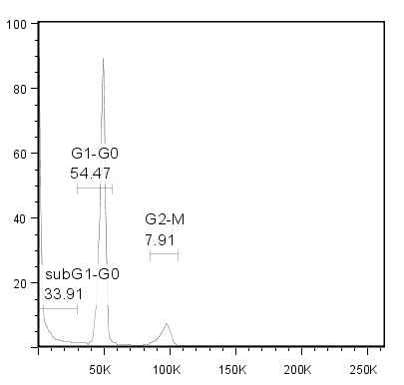
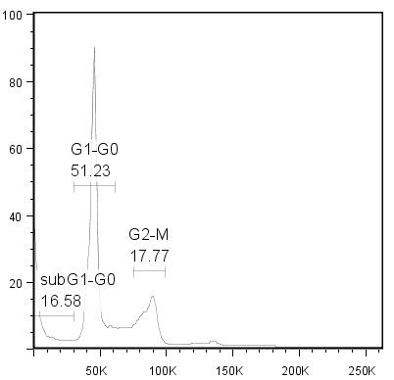
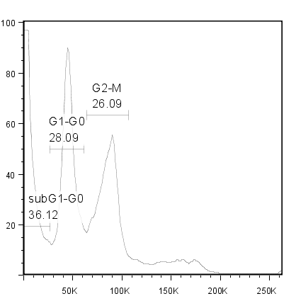
Results – cell cycle
A
Control
6 Gy
SF7761
No Polyploidy
Percentage of Cells
JHH
Polyploidy
Propidium Iodide

Slide 20
DISCUSSION
Polyploidy an important factor in treatment resistance (Coward et al. 2014, Erenpreisa et al. 2013)
JHH came from patient previously treated with chemo-radiotherapy → Evolution of treatment resistance?
Notes:
JHH has mutant p53

Slide 21
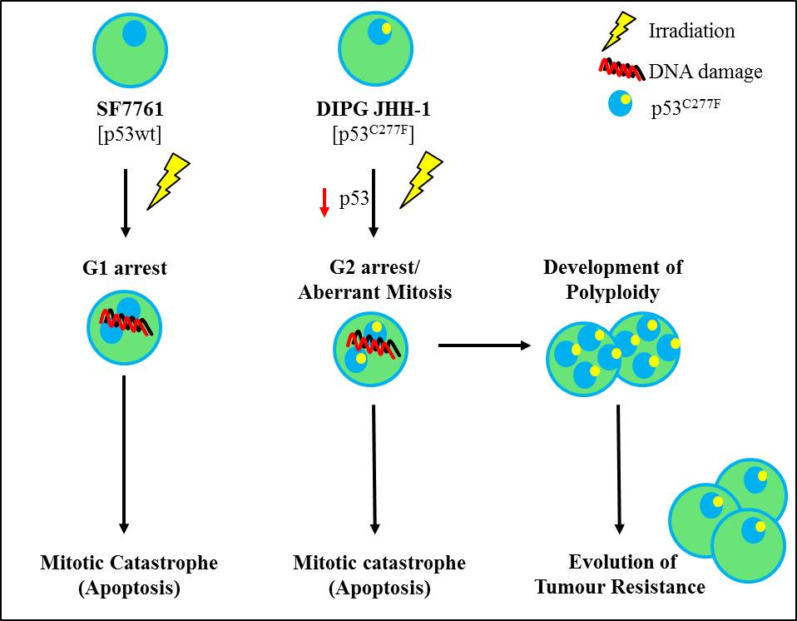
DISCUSSION

Slide 22
Conclusion
Calculated dose-equivalence using DIPG cell lines
JHH → polyploidy → radio-resistance
MRT a possible alternative for radiosensitive DIPG types (SF7761)
In vivo normal tissue toxicity – next frontier in CRT-MRT dose-equivalence and progress to clinical trials
Notes:
Our next step is to see if at equivalent doses for tumour kill (ie the doses in this study), there is less normal tissue toxicity for MRT

Slide 23
Conclusion
Supervisors
Prof Peter Rogers
Dr Jeffrey Crosbie
Dr Jacqueline Donoghue
Australian Synchrotron - Imaging and Medical Beamline
Jayde Livingstone
Andrew Stevenson

