Slide 1
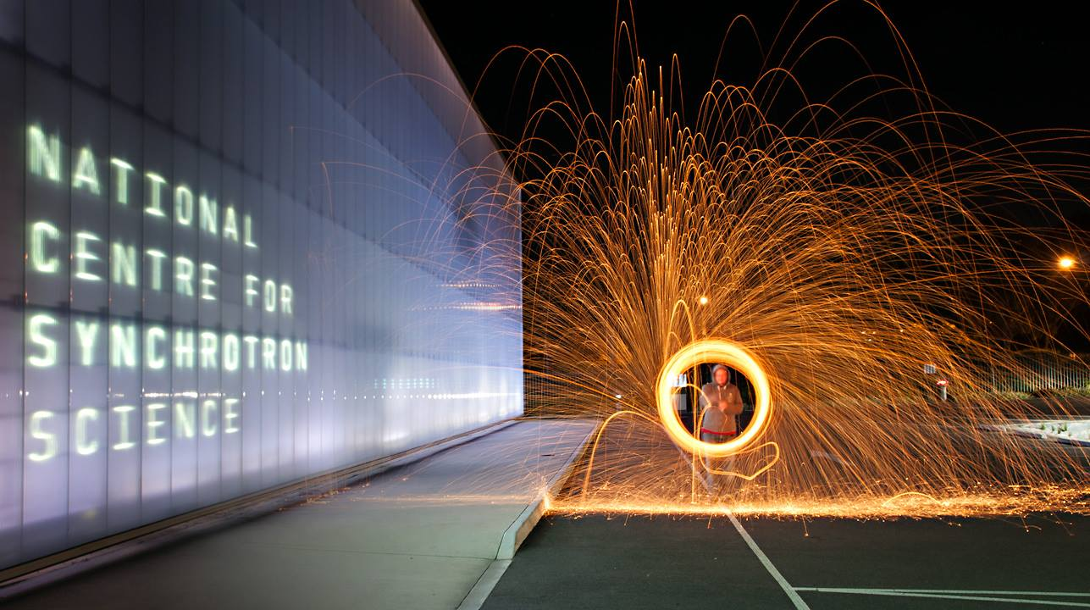
CHEMICAL CRYSTALLOGRAPHY AT THE AUSTRALIAN SYNCHROTRON MACROMOLECULAR BEAMLINES
Jason Price Scientist – MX

Slide 2
Vibrant and productive User community:
MX and CX community large, active and productive.
526 scientists, producing 143 peer-reviewed publications in 2013. 171 in 2014.
>1000 PDB depositions to date.
Currently almost 40% of publications are from CX community.
 | 2008 | 2009 | 2010 | 2011 | 2012 | 2013 | 2014 | 2015
Total | 7 | 34 | 62 | 102 | 118 | 153 | 171 | 161
CX | 1 | 9 | 19 | 34 | 44 | 52 | 67 | 63
PX | 6 | 25 | 43 | 68 | 74 | 101 | 104 | 98
% CX | 14.3% | 26.5% | 30.6% | 33.3% | 37.3% | 34.0% | 39.2% | 39.1%

Slide 3
Publication Metrics - CX and PX
 | 2008 | 2009 | 2010 | 2011 | 2012 | 2013 | 2014 | 2015
Total | 7 | 34 | 62 | 102 | 118 | 153 | 171 | 161
CX | 1 | 9 | 19 | 34 | 44 | 52 | 67 | 63
PX | 6 | 25 | 43 | 68 | 74 | 101 | 104 | 98
% CX | 14.3% | 26.5% | 30.6% | 33.3% | 37.3% | 34.0% | 39.2% | 39.1%

Slide 4
CX highlight from 2015

Slide 5
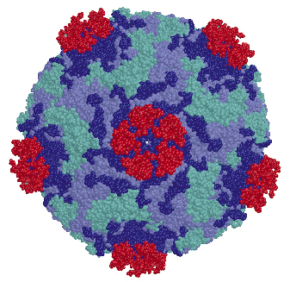
Resolution CX vs. PX
Examples
Charge density < 0.4 Å
Standard CX < 0.8 Å
Challenging CX > 0.8 Å
Very High quality PX < 1.0 Å
Average PX ~ 2.5 Å
Secondary only PX < 4 Å
Virus ~ 3 Å
~3 Å
~300 Å

Slide 6
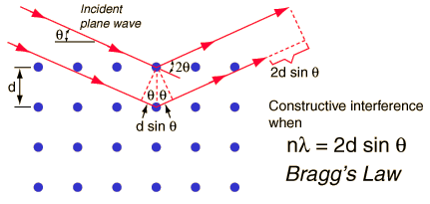
WAVELENGTH AND RESOLUTION
For Mo K_{α1}
124.9°0.4 Å
52.6° 0.8 Å
X-rays
10.2° 4 Å
 | Wavelength (Å) | Energy (keV) | 2θ at 4Å(°) | 2θ at 2Å(°) | 2θ at 1.5Å(°) | 2θ at 0.8Å(°) | 2θ at 0.4Å(°)
Cu(K_{α1}) | 1.54 | 8.05 | 22.2 | 45.3 | 61.8 | 148.7 | -
Mo(K_{α1}) | 0.71 | 17.48 | 10.2 | 20.4 | 27.4 | 52.6 | 124.9
Ag(K_{α1}) | 0.56 | 22.16 | 8.0 | 16.1 | 21.5 | 40.9 | 88.8
‘Standard PX’ | 0.95 | 13.00 | 13.7 | 27.6 | 37.1 | 73.2 | -

Slide 7
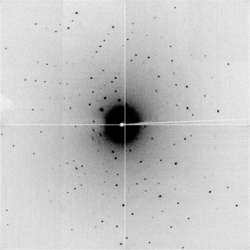
Resolution CX vs. PX
0.76 Å (17.444 keV, 72 mm)
1.76 Å (13.0 keV, 171 mm)

Slide 8
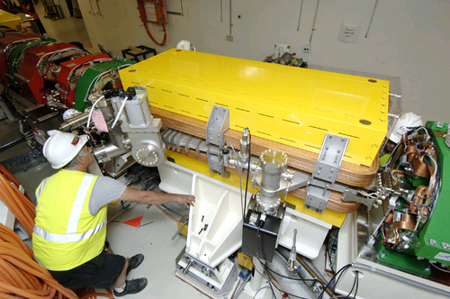
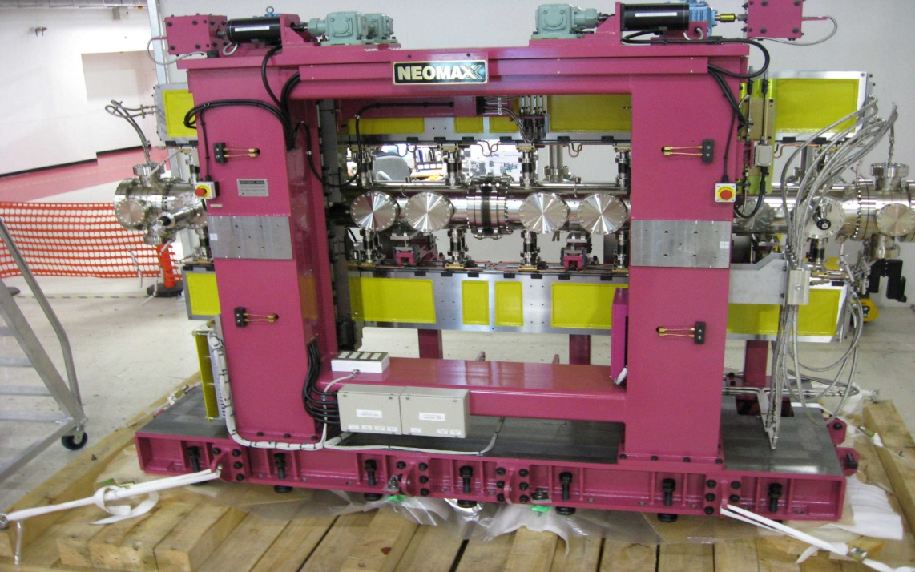
MX at the Australian Synchrotron
3BM1: High throughput – MX1
Beam ~ 250 µm x 200 µm
3ID1: Microfocus (Undulator) – MX2
Beam ~ 20 µm x 10 µm
Very bright
(4,000x flux density of 3BM1)

Slide 9
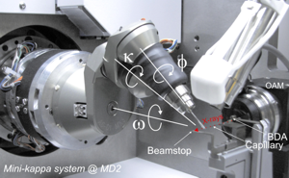
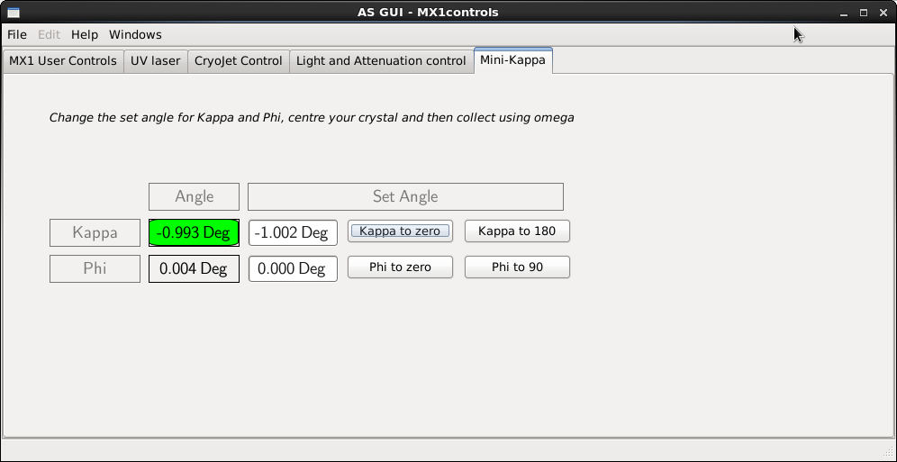
Mini-Kappa deployed on MX1, operating from January
In situ rearrangement of the crystal at the sample position to give full coverage for low symmetry space groups.
Run | omega(ω) | kappa(κ) | phi(φ)
1 | 0-360 | 0 | 0
2 | 0-180 | 180 | 0
3 | 0-180 | 180 | 90

Slide 10
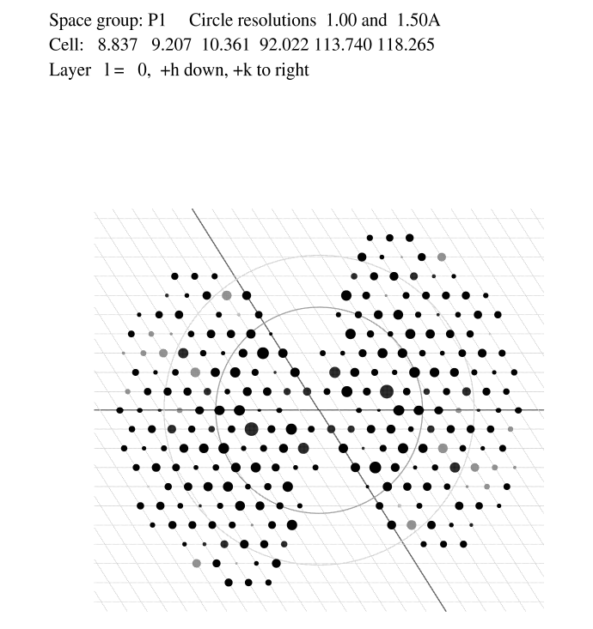
The Importance of Complete Data
Resolution Inf - 0.76Å %Complete 99.7
Resolution Inf - 0.76Å %Complete 89.7

Slide 11
MX at the Australian Synchrotron
3BM1: High throughput – MX1
Beam ~ 250 µm x 200 µm
3ID1: Microfocus (Undulator) – MX2
Beam ~ 20 µm x 10 µm
Very bright
(4,000x flux density of 3BM1)

Slide 12
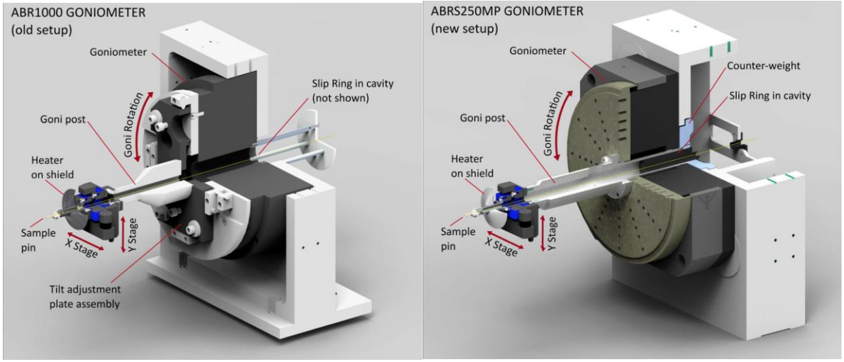
MX2 Goniometer, Emergency Replacement

Slide 13
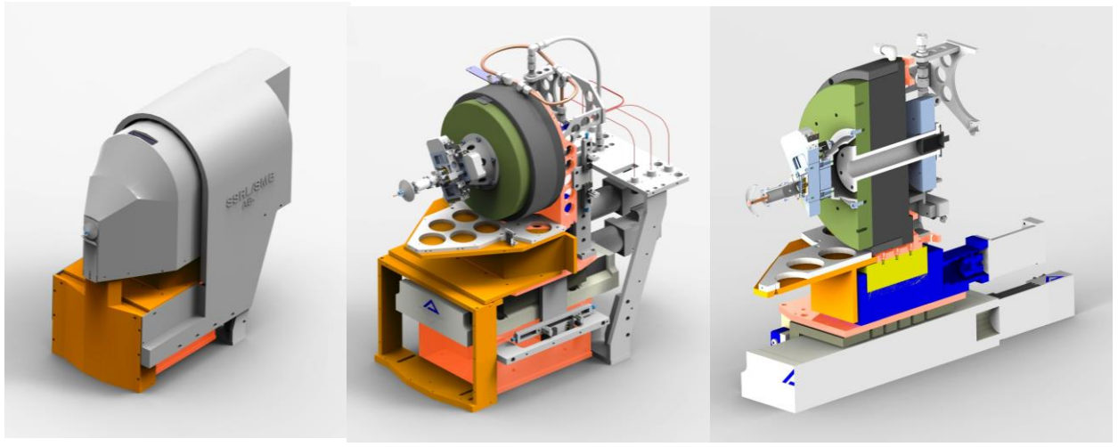
MX2 Goniometer, Upgrade project

Slide 14
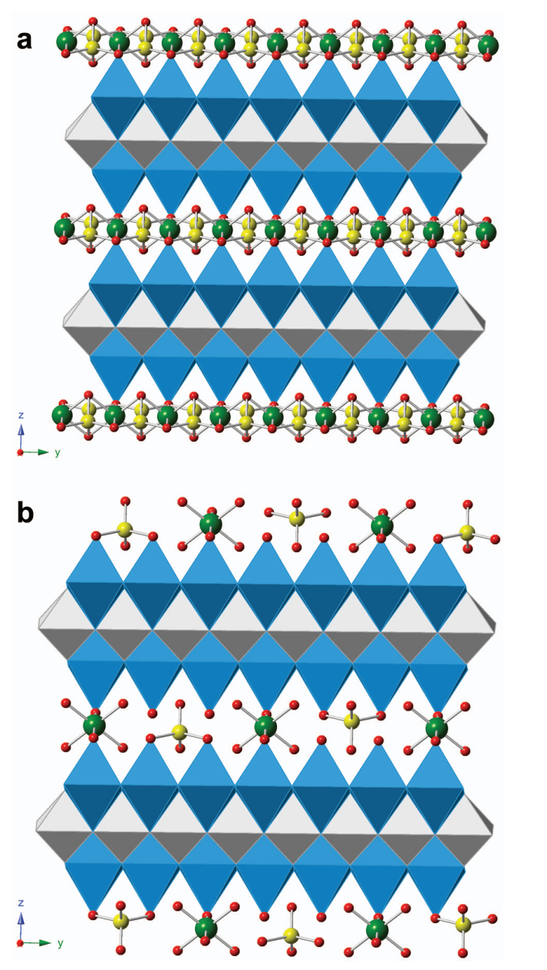
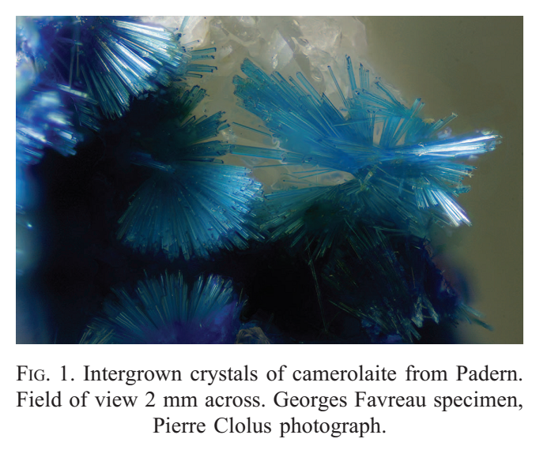
Mineralogy on micro crystals

Slide 15
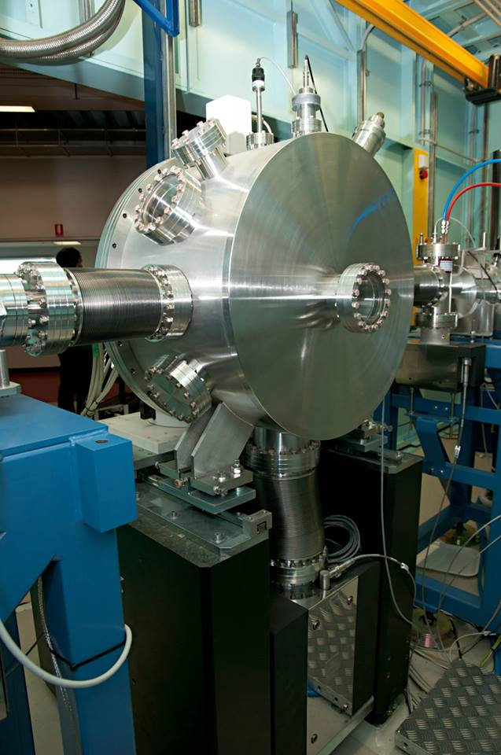
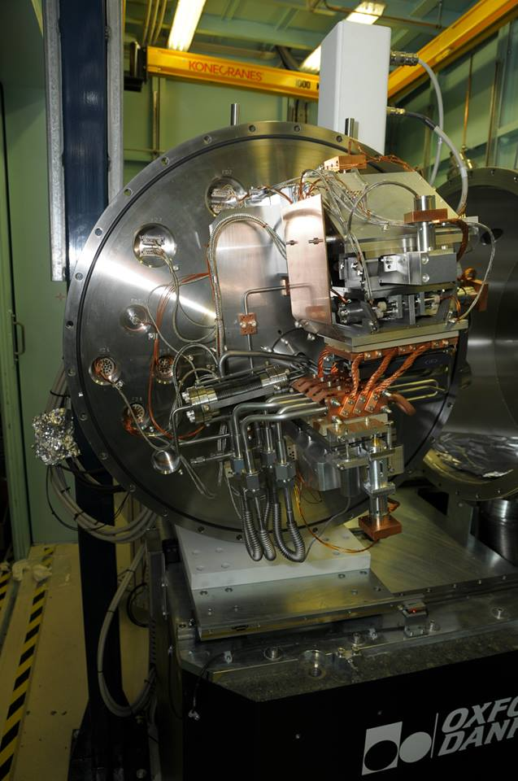
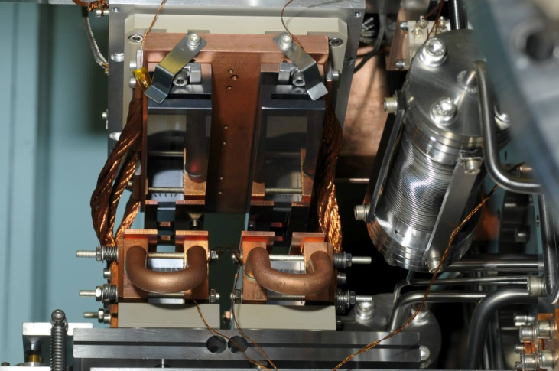
MX2 DCM: DCM modifications.
Two main changes:
1. Stable Si111 twin crystal set.
Low beam vibration
high quality data
able to measure anomalous data
Changeable energy
Channel-cut.
“Super-stable” fixed-energy beam
Needed for micro-beam work
Fast/easy for staff to set up

Slide 16
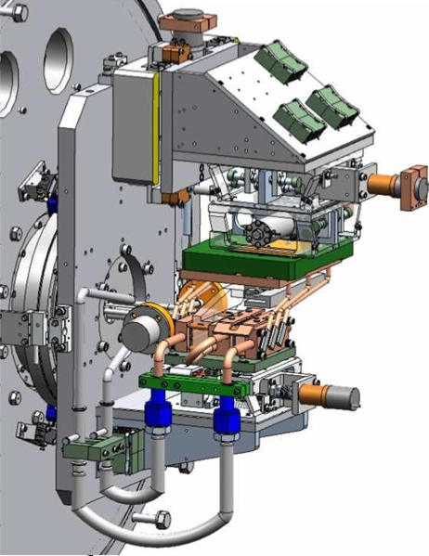
Development: MX2 DCM upgrade.
Remove water warming circuit and replace with electrical heating
Replace LN2 feedthrough with low vibration lines
New roll1 stage
Modified first crystal mounts
Channel-cut Si111 crystal

Slide 17
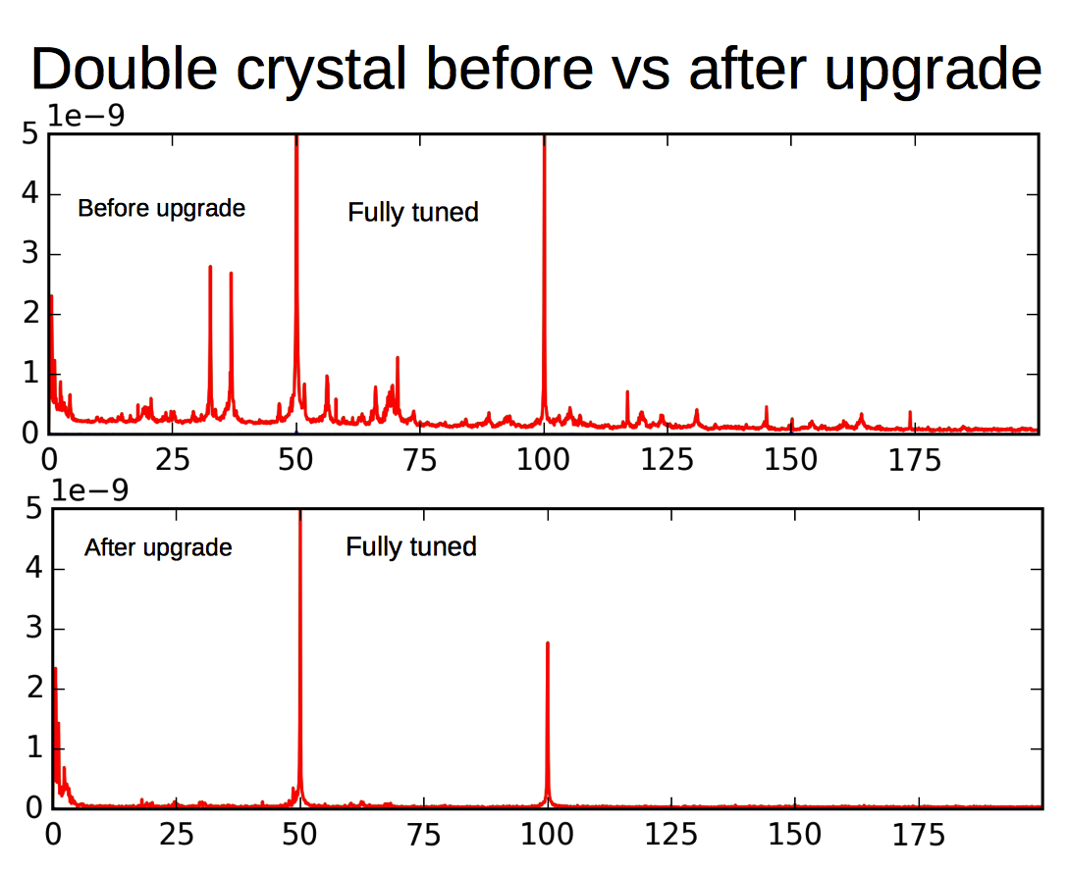
Development: MX2 DCM upgrade.
Remove water warming circuit and replace with electrical heating
Replace LN2 feedthrough with low vibration lines
New roll1 stage
Modified first crystal mounts

Slide 18
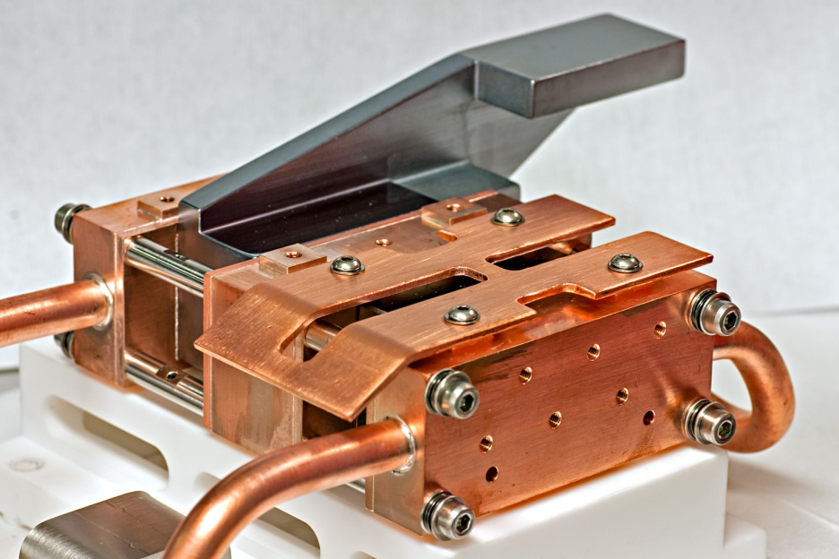
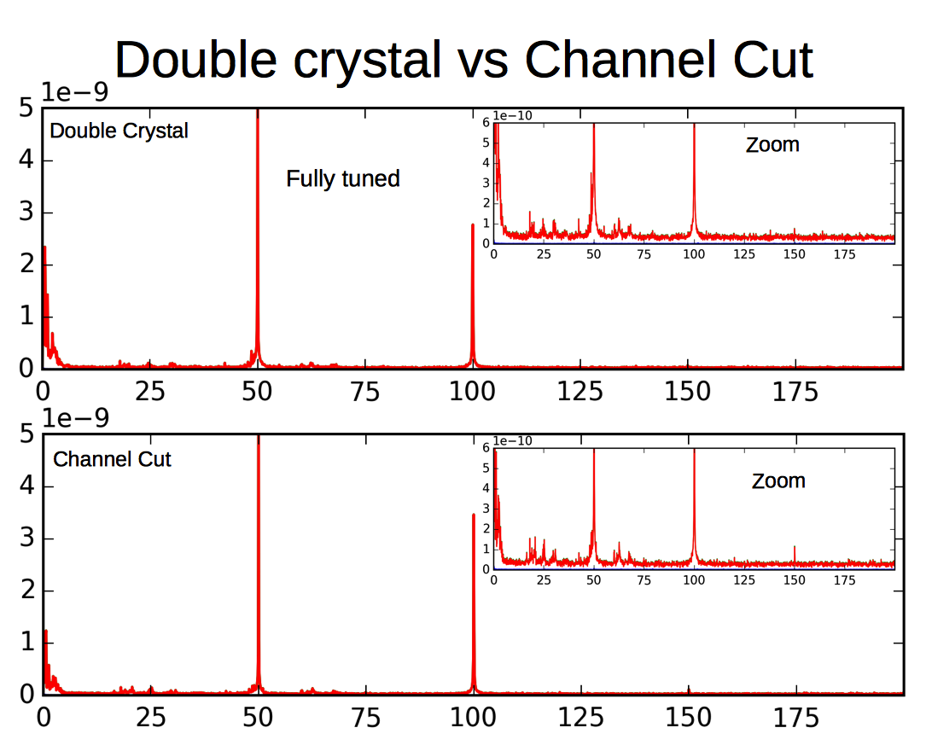
Development: MX2 DCM upgrade.

Slide 19
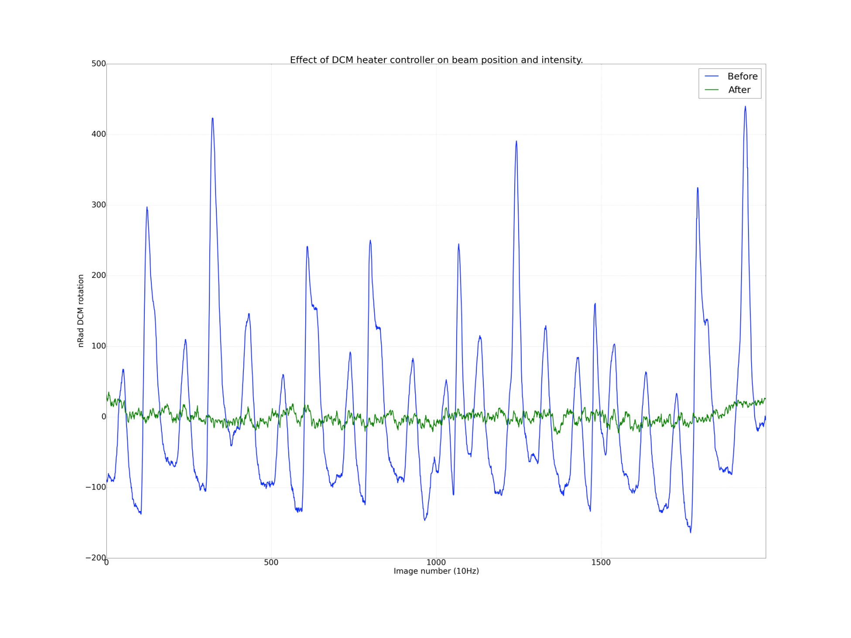
MX2 DCM Upgrade – Temperature Cycling

Slide 20
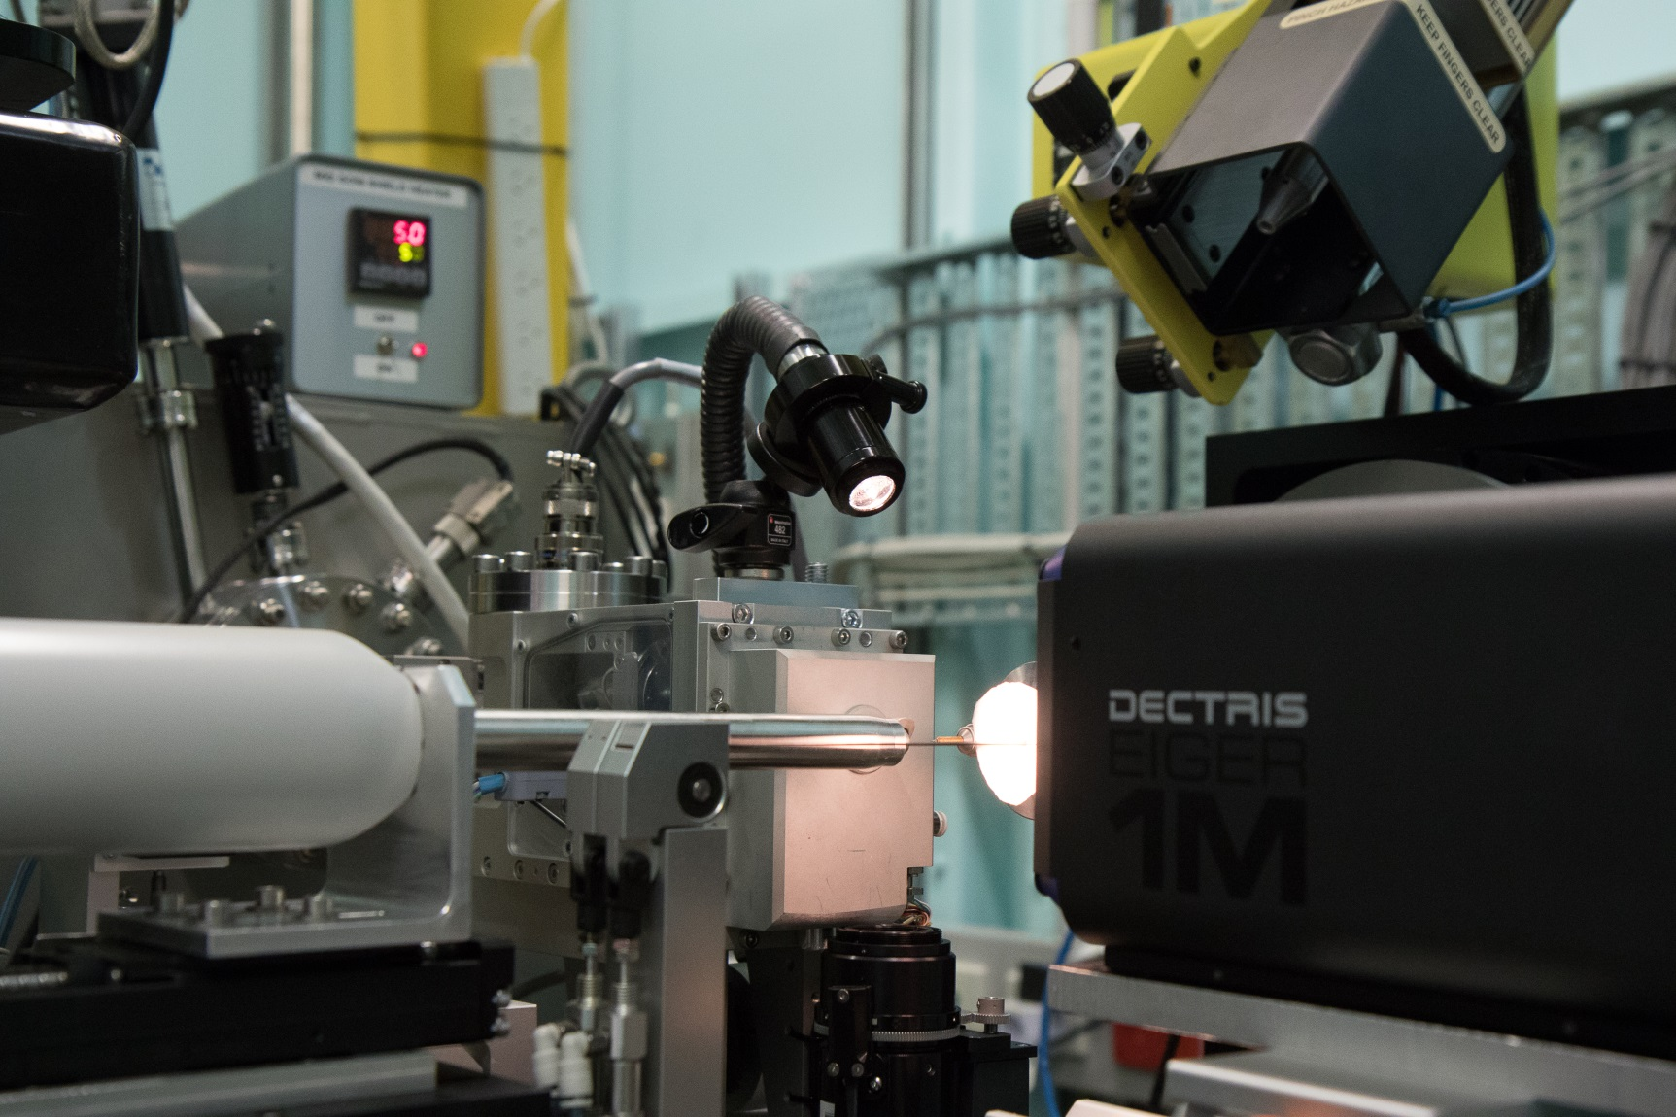
What next?

Slide 21
The MX Team Tom Caradoc-Davies – Principal Scientist Jason Price
Alan Riboldi-Tunnicliffe
Daniel Eriksson
Stephen Harrop Rachel Williamson Santosh Panjikar David Aragao Sofia Macedo
Jun Aishima
Engineering Mark Clift – Controls Engineer
Robbie Clarken – Controls Engineer Hima Cherukuvada – Mechanical Engineer

