Slide 1
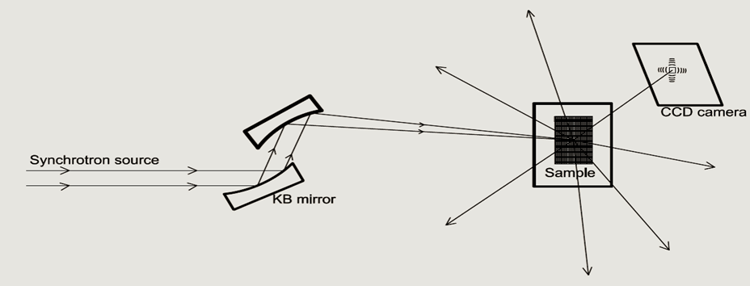
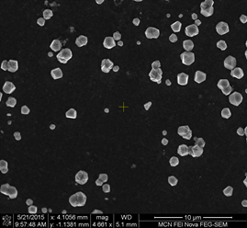
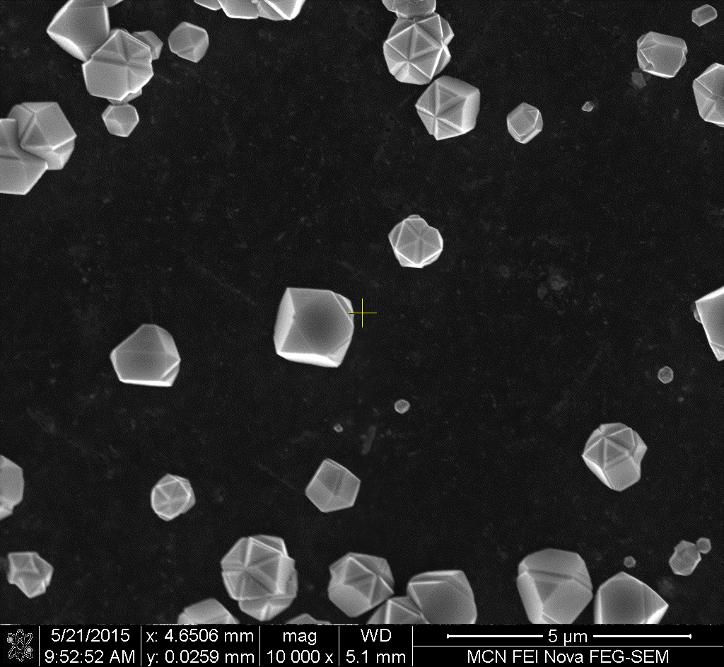
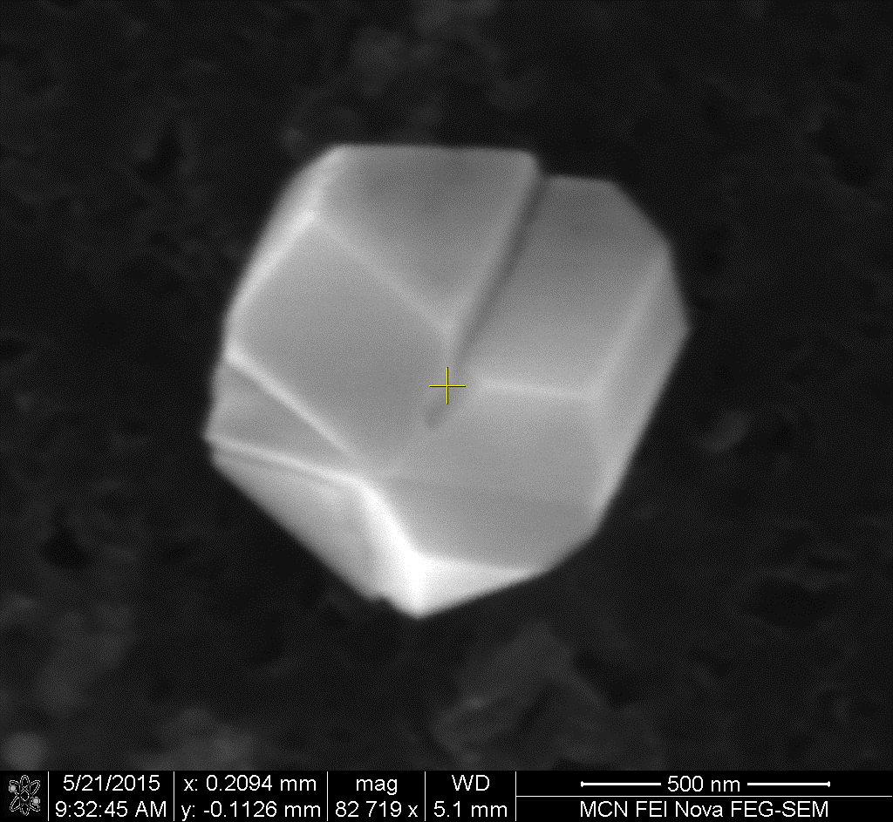
Quantitative 3D Strain Mapping in NDs using Bragg Coherent Diffractive Imaging (BCDI) Presented By: Muhammad Salman Maqbool
Fig 1. Schematic illustration of BCDI
Fig 2. SEM images of CVD-grown NDs
(a)
(b)
(c)
Fig 3. 3D view of (a) electronic density, (b) strain, and (c) internal strain state
Poster Board: IM - 13
y
x
z

