Slide 1
Laser Photolysis at the Australian Synchrotron, THz Beamline

Slide 2
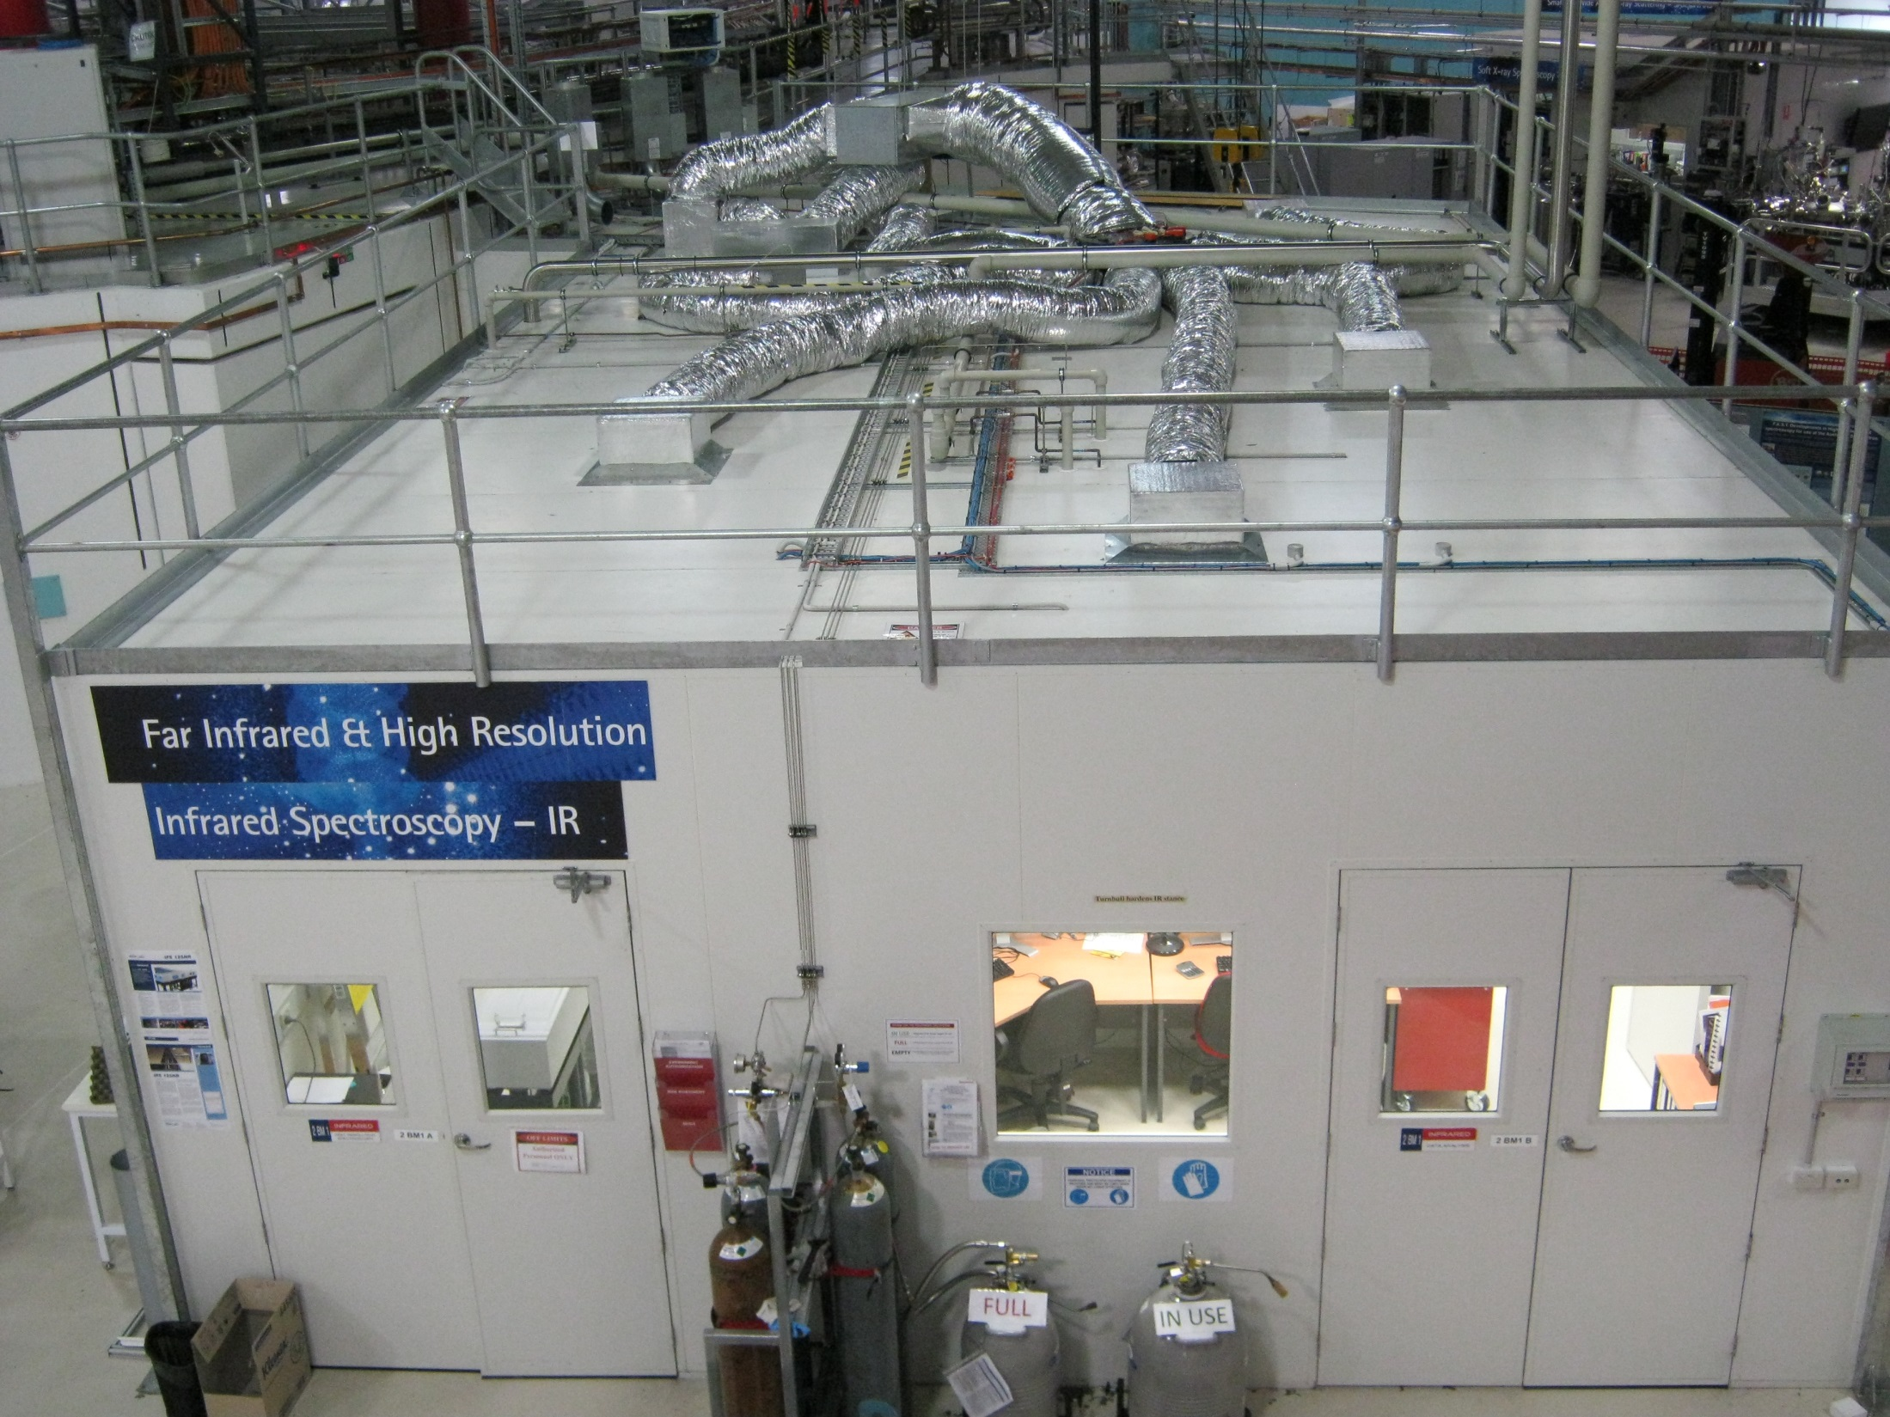

Slide 3
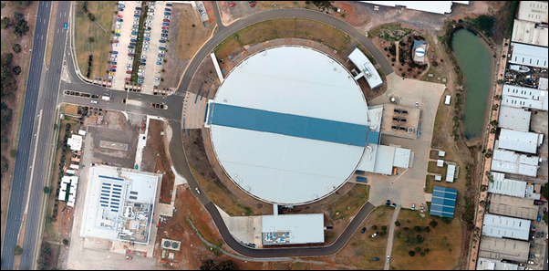
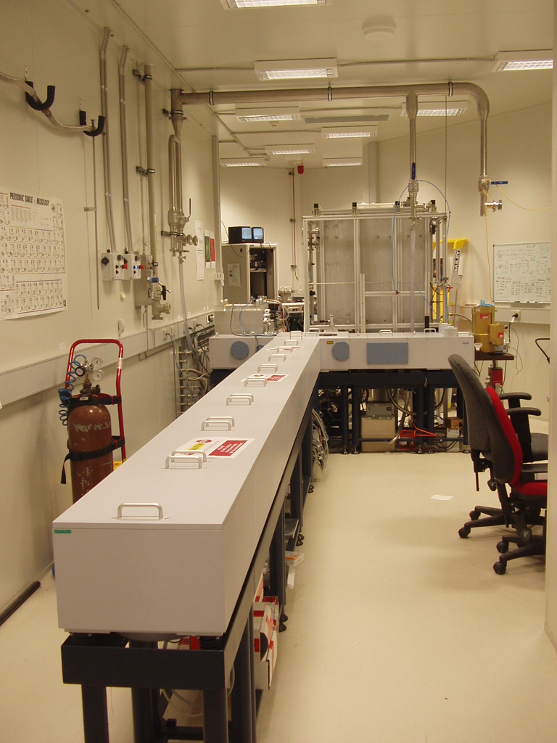
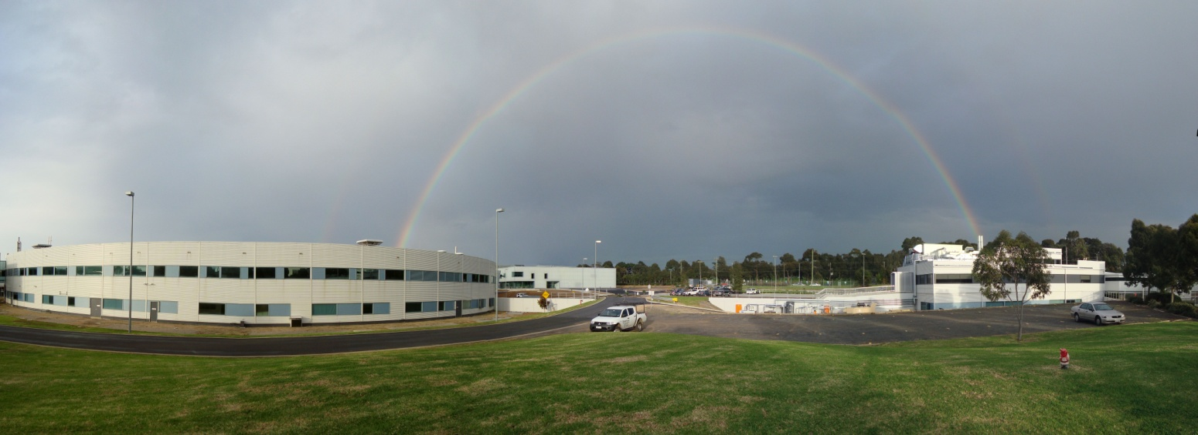
The Far-IR beamline at the Australian Synchrotron
The IFS125hr offers an unapodized resolution of 0.603/L cm-1 where L=947 cm (max OPD) ~ 0.00064 cm-1
www.synchrotron.org.au
Beamsplitters
Multi/Mylar
Ge/KBr
25 – 40 & 30 – 630 cm⁻¹
450 – 4 800 cm⁻¹
IR Detectors
Si bolometer
Si:B bolometer
DTGS
MCT_{N}
MCT_{M}
10 – 370 cm⁻¹
300 – 1850 cm⁻¹
100 – 3000 cm⁻¹
700 – 5 000 cm⁻¹
600 – 5 000 cm⁻¹
Sources
Synchrotron
Hg-Arc lamp
Globar
mw – vis
5 – 1 000 cm⁻¹
10 – 13 000 cm⁻¹
Apertures
Optical Filters
series of narrow band
pass IR filters
0.5 – 12.5 mm

Slide 4
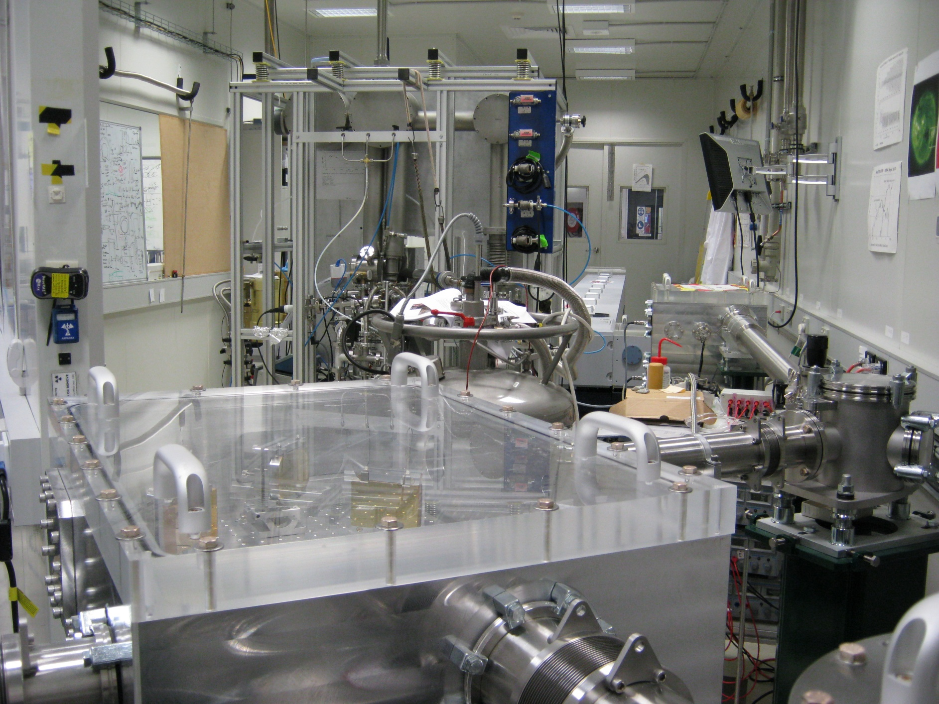
THz Beamline
THz/FarIR
Notes:
Infra-red has 2 beamlines – microspecstroscopy (mid-IR, low-res), and HRIR.

Slide 5
Observed Performance
Bolometer / 6μm Mylar
Si:B / KBr
MCT_{n} / KBr
40
20
II
1.15mm
I
2.0 mm
III
1.3 mm
SR /GB
4
30
SR / Hg
15
SR
Ratio of Intensities
3
SR /GB
20
SR
10
2
SR
10
5
1
GB
5
Hg
GB
100
200
300
500
600
700
800
900
1000

Slide 6
Use of the new laser system

Slide 7
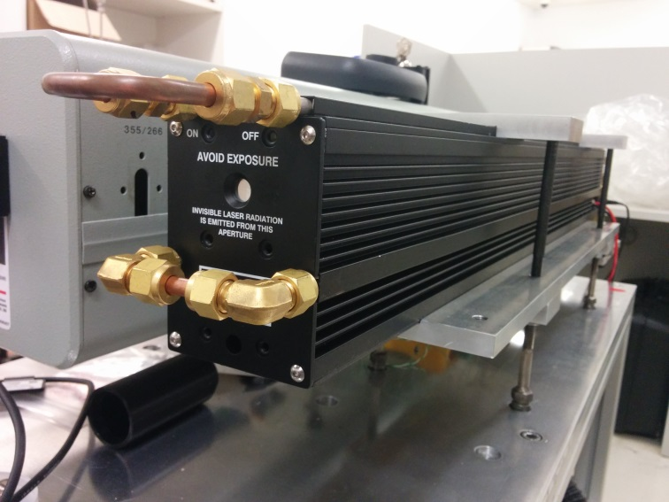
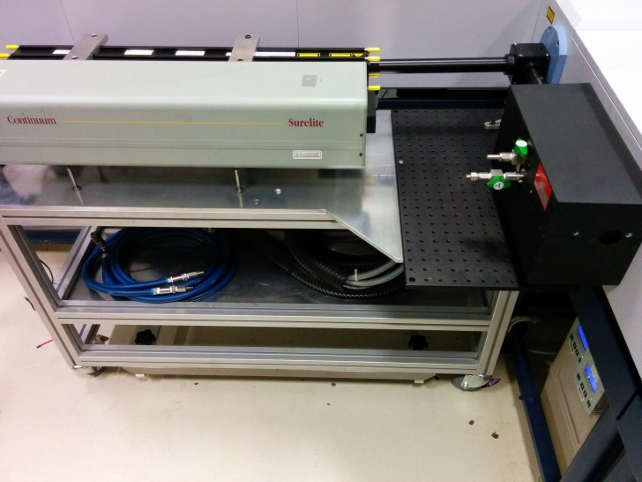
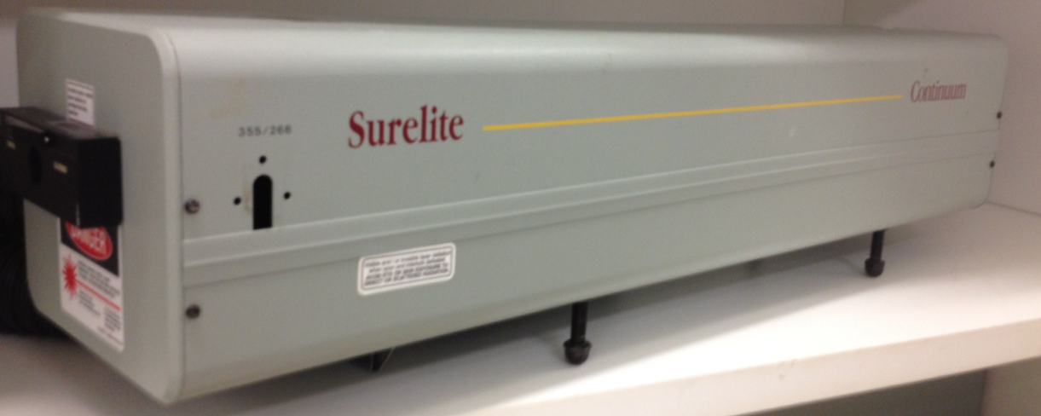
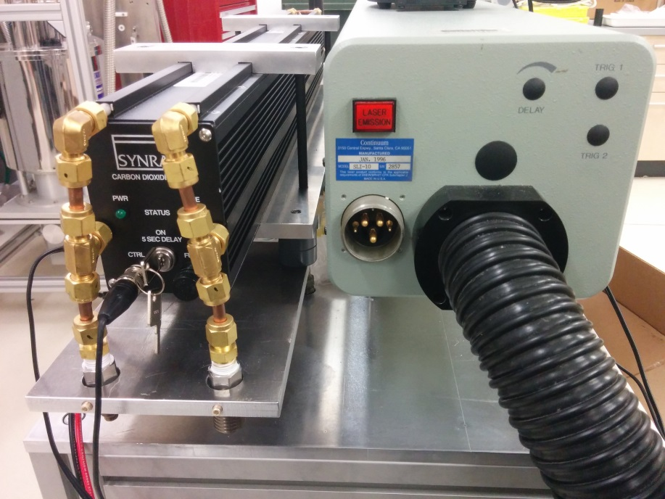
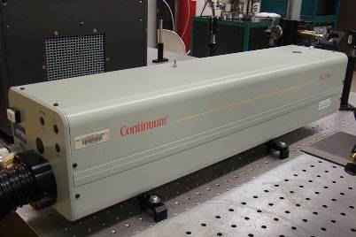
Available Lasers
We currently have a Synrad, Class 4, 10.6µm, 40W, cw, CO₂ laser for use.
We also have a Surelite YAG laser available.
It is Class 4, 4W, 10 pulses per second, and can operate at 1064nm, 532nm, 355nm and 266nm.
Notes:
Laser types Introduction
Laser photolysis is a new capability that is presently being added to the THz/Far-IR beamline. This technique will allow scientists to perform pioneering spectroscopic studies at ultra-high spectral resolution on gaseous molecules of astrophysical interest; it would also enable scientists to study photochemical changes in condensed-phase, solid and biological systems after or during laser irradiation. On the long run, this may also lay the foundation for pump/probe studies which would require a different spectrometer however

Slide 8
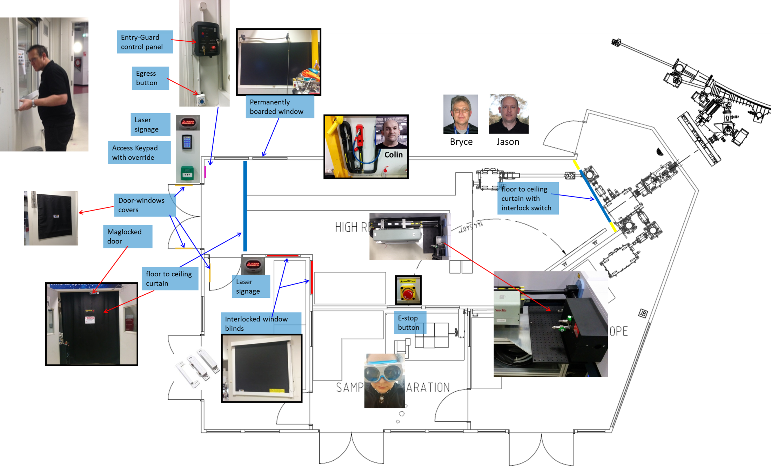
Laser Safety
Notes:
taking into account the relevant Australian Laser Safety Standards (ALSS), ARPANSA¥ documents, and any existing Australian Synchrotron WHS requirements (e.g. risk rating standards), a plan for how to fit-out the room was devised (see schematic in Figure 1), and approved by the Radiation Safety Advisory Committee (RSAC).
During operation, low power (< 10 mW) will first be used while the lasers are being aligned; Class 4 laser rated curtains and blinds, and anodized aluminum window covers will prevent any stray laser-beams and thus, protect anyone outside of the THz hutch. To further protect users and staff during experiments, the beam will be completely enclosed inside a beam enclosure, effectively making it a Class 1 product for use.
¥ Australian Radiation Protection and Nuclear Safety Agency

Slide 9
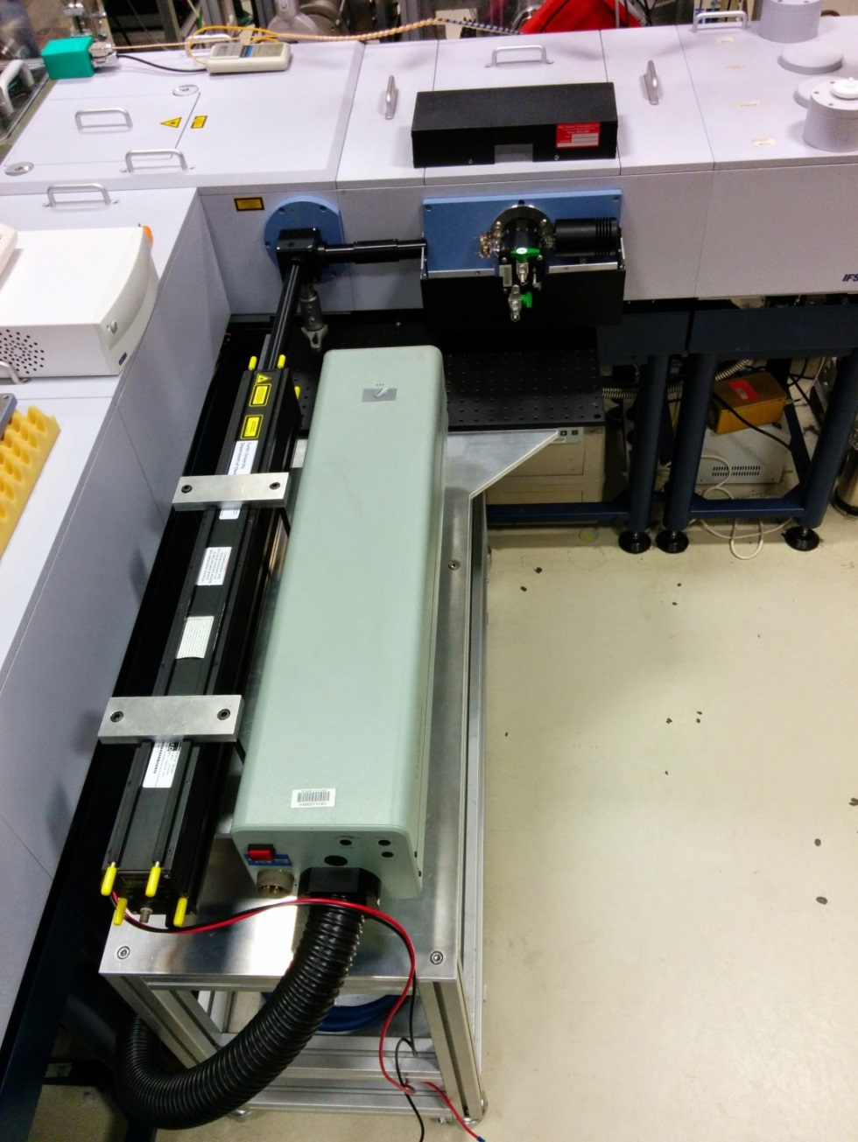
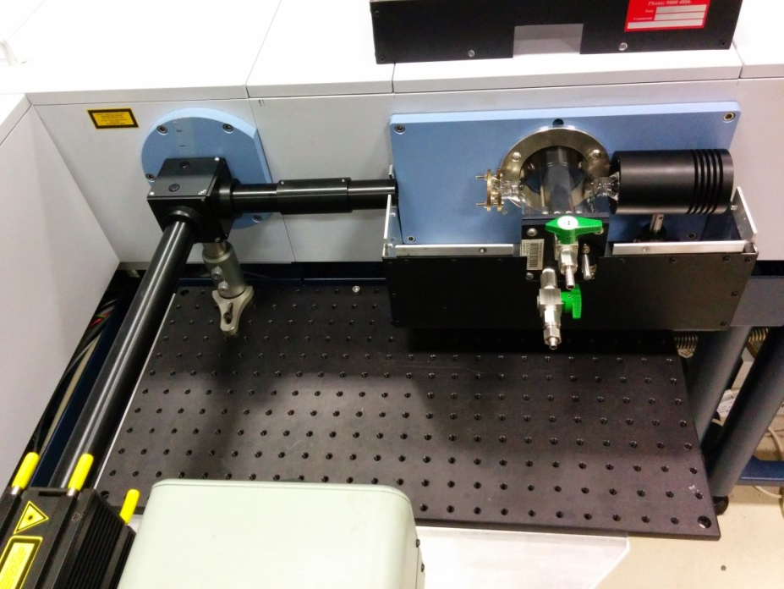
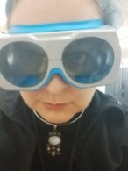

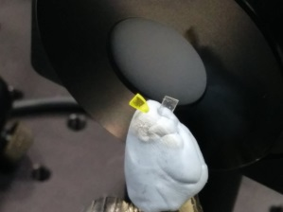
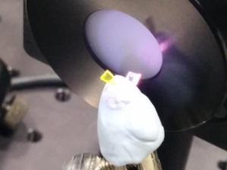
Laser Photolysis
The beam paths are completely enclosed, making the laser safe for use.
Notes:
Talk about safety here – the trolley and enclosed beam path

Slide 10
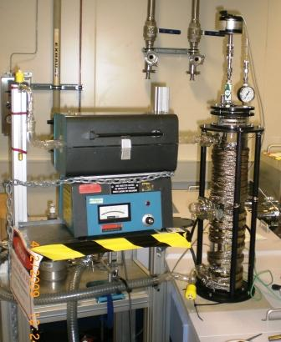
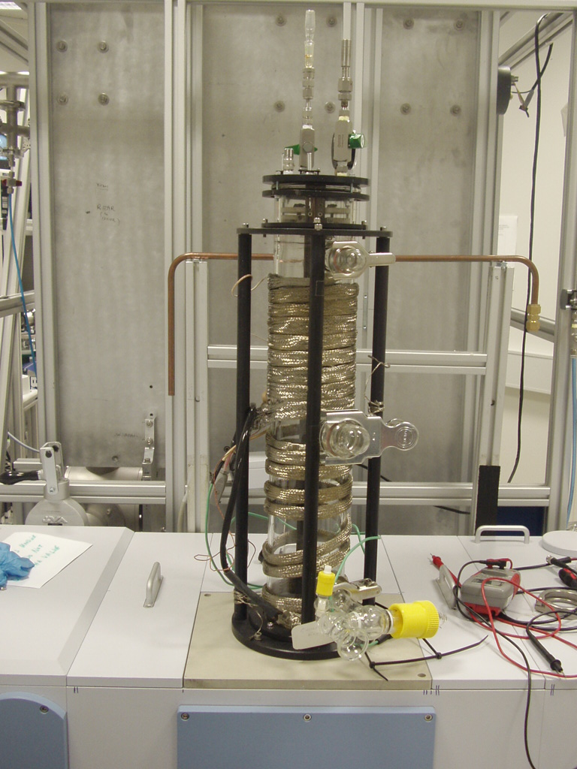
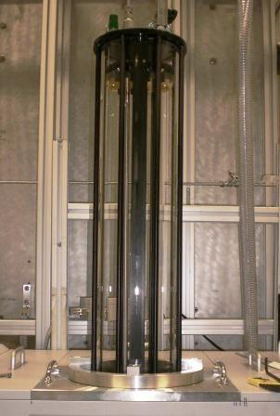
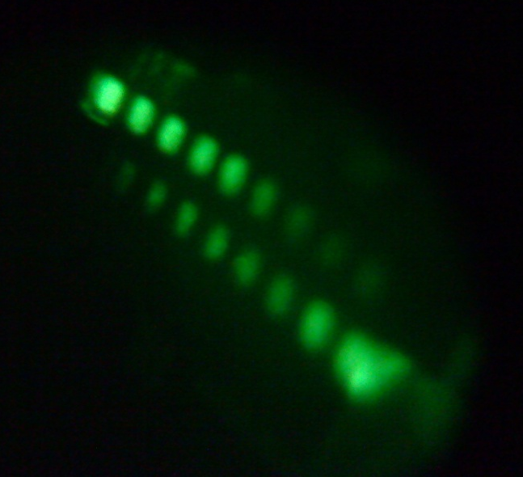
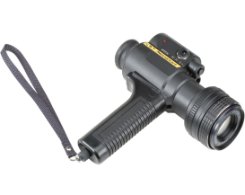
Gas phase Experiments
Up to 24 m path length
60 cm Multipass Glass Cell for reactive species. The cell has three inlet/outlet ports and can be attached to a ventilation exhaust system. Here the cell is shown wrapped in heating-tape and can be heated to temperatures of 80°C.
In the past, pyrolysis has been performed using furnaces

Slide 11
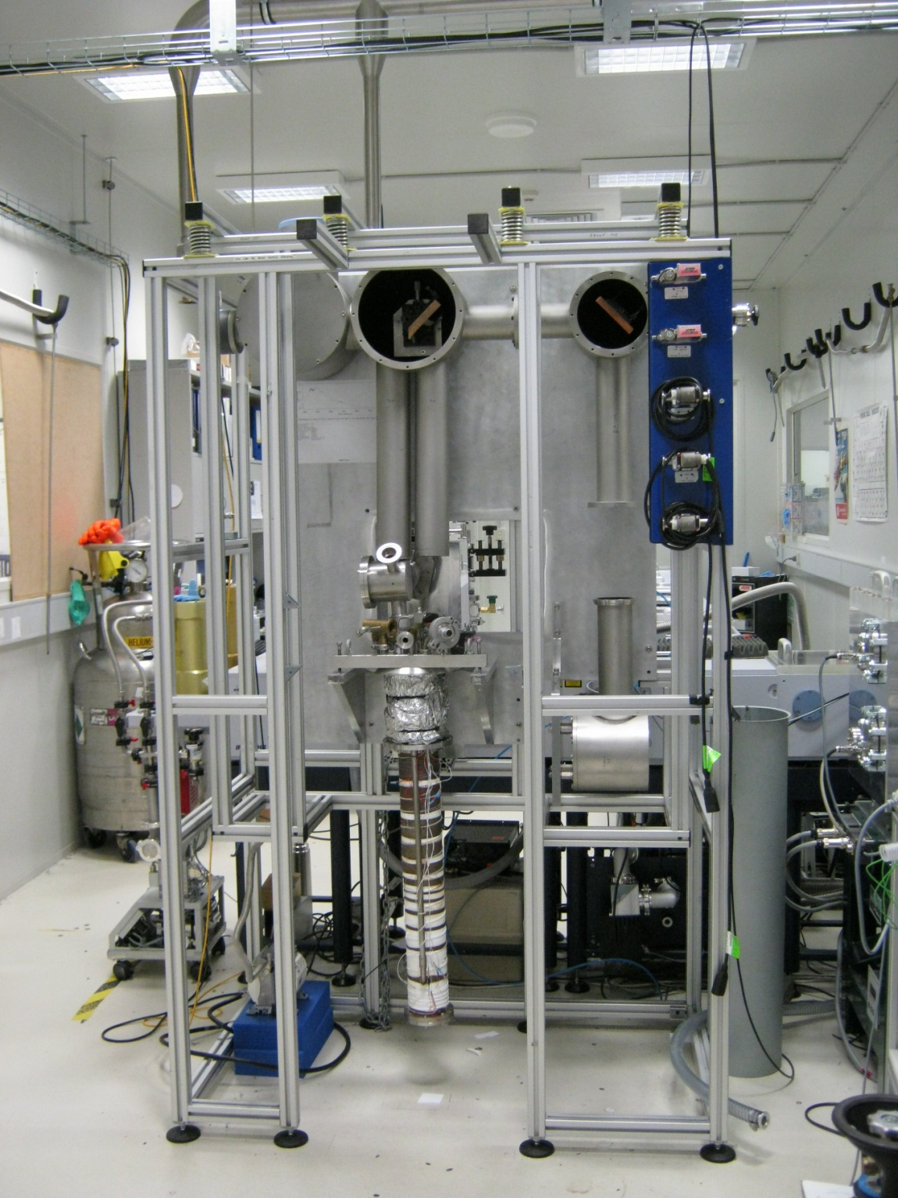
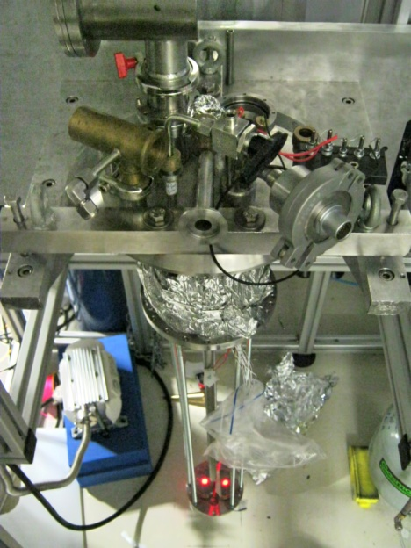
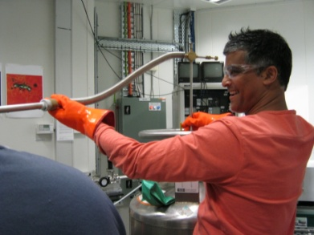
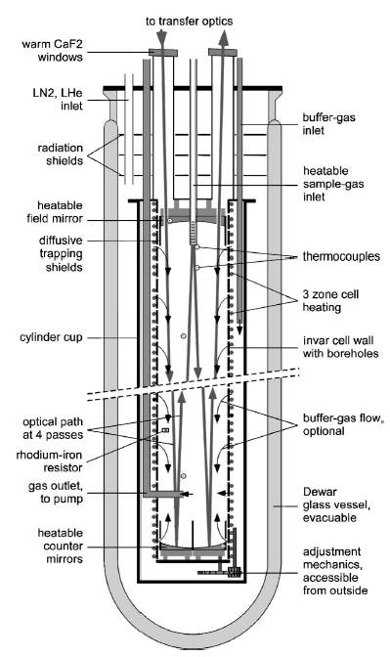
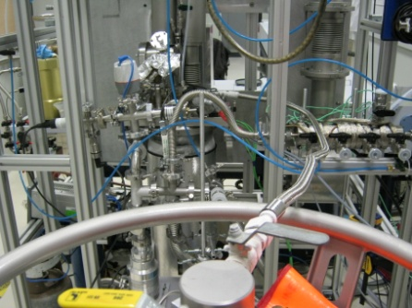
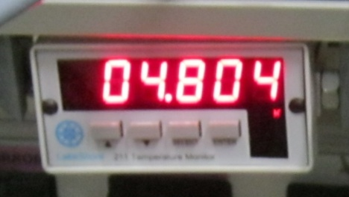
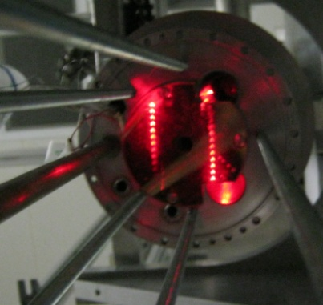
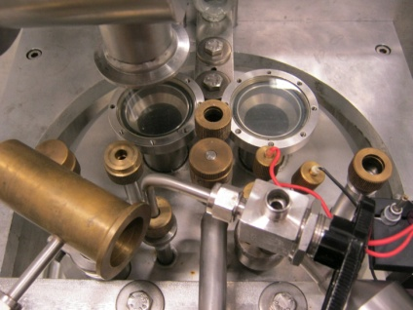
Enclosive Flow Cooling multipass cell for gas-phase studies at cryogenic temperatures.
Notes:
We have an Enclosive Flow Cooling (EFC) cell which is also a White type cell with a base OPL of 625 mm, but can be tuned to make different path lengths depending on your sample. A White cell is a type of long path gas phase spectroscopy cell that is commonly used to measure low-concentration components in gases. The EFC cell can be cooled either with liquid helium or liquid nitrogen (limit ~4K *point out pic of temp*), or can be operated at up to 400 K with a temperature stability of ±1 K per day. It is usually operated under vacuum (~10⁻⁵ mbar) but can be pressurized up to 2000 mbar. A future development of the EFC cell involves coupling it to a 35 W CO₂ laser to produce supercooled short-lived gases (free radicals).
Here you can see the EFC during an alignment, with the beam following this path *gesture*, and tuned to multiple passes.

Slide 12
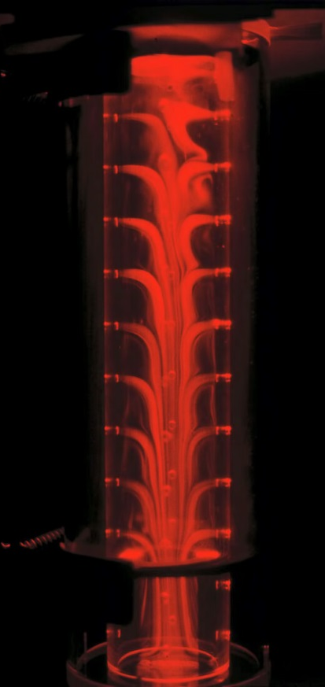
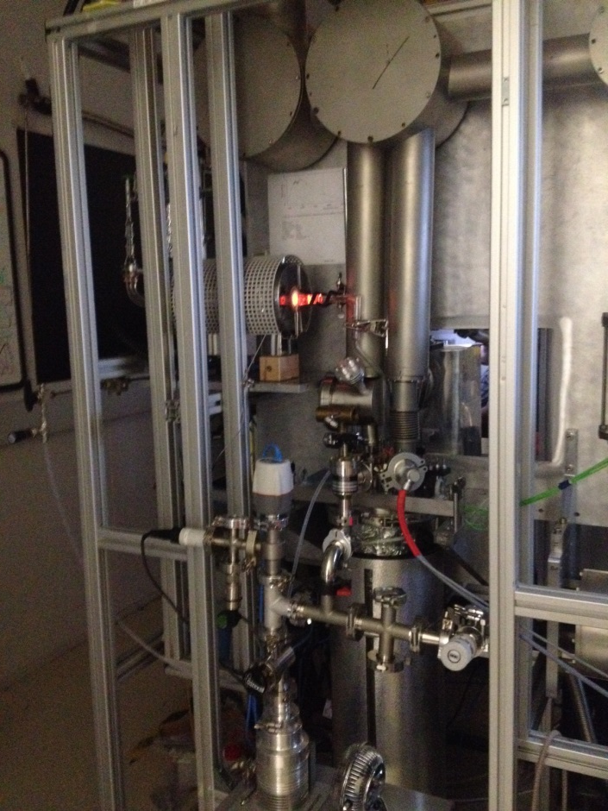
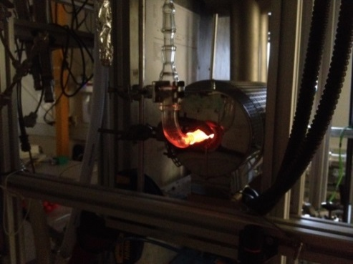
Additional technique for Radical studies
Pyrolysis in a cold environment increases the lifetime of cold radicals for study

Slide 13
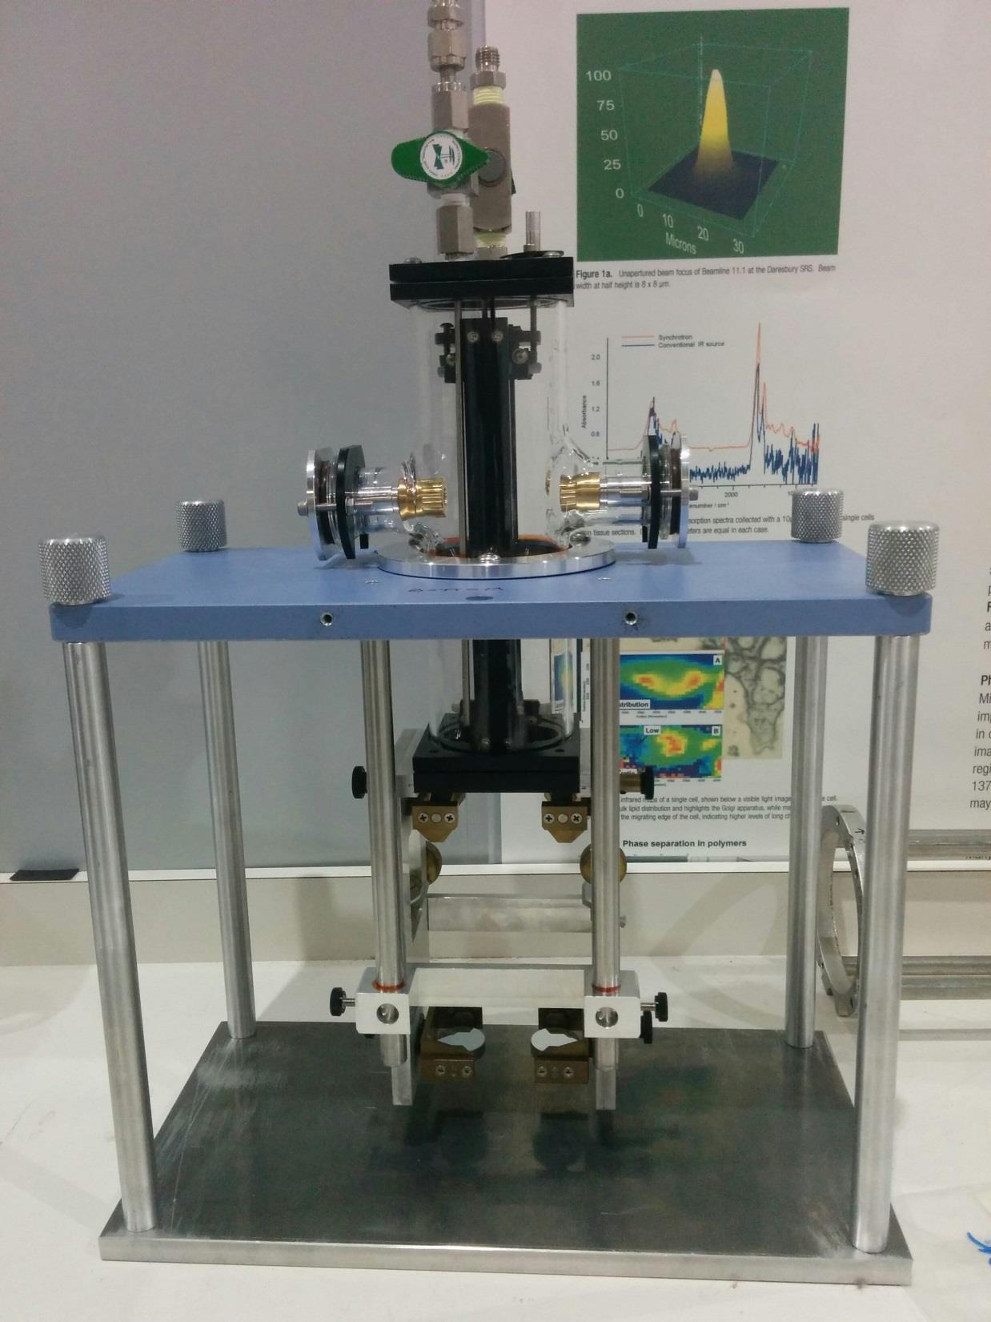
White Type cell configuration
D Mirror
Laser
T Mirror
THz Beam
D Mirror
T Mirror
Notes:
Show white type cell configuration and pic of new small cell

Slide 14
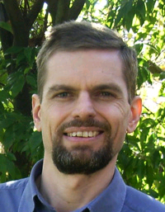

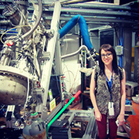
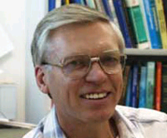
Gas Phase Spectroscopy group, Monash/LaTrobe University
Preliminary laser photolysis experiments have been carried out by some of our expert users.
Dr Courtney Ennis
LaTrobe
University
Prof Don McNaughton
Monash
University
Dr Evan Robertson
LaTrobe
University
Ms Rebbeca Auchettl Latrobe
University
Areas of Research
Atmospheric: CFC’s,HFC’s, HCFC’s
Chemical dynamics: Radicals
Astrophysics: Hydrocarbons, Radicals

Slide 15
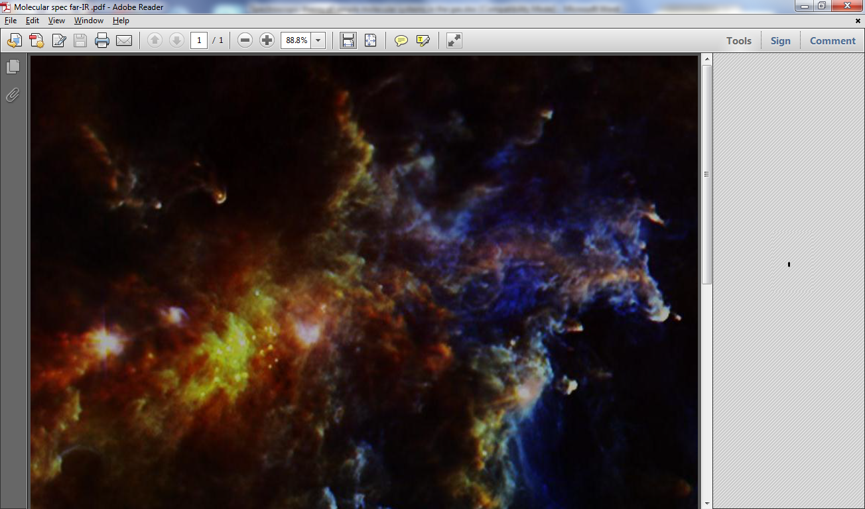
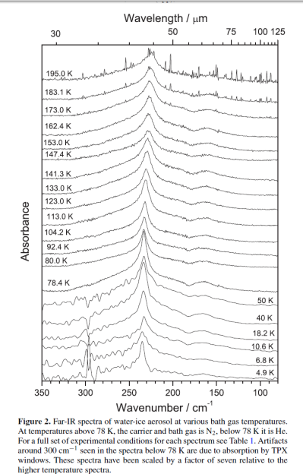
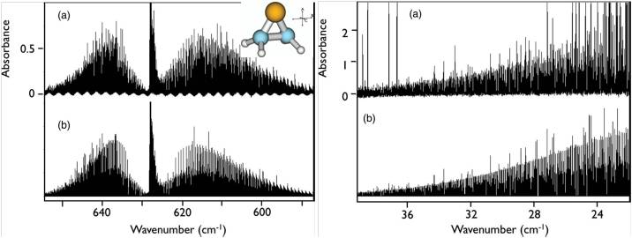
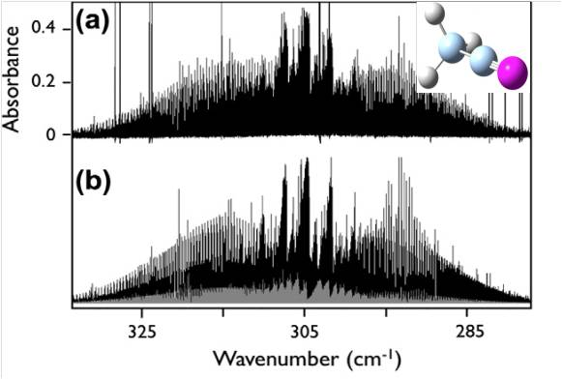
Study of Gases/Aerosols of Astrophysical interest
360
380
400
420
420
GHz
Notes:
Water Aerosol/Ice, Ketenemine,Thirane

Slide 16
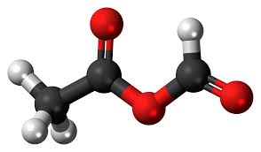
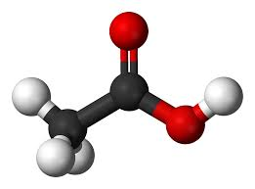
Experiment
Add the Acetic Anhydride
Turn on the laser
0.35
Laser
0.35
0.35
0.30
0.30
0.30
0.25
0.25
0.25
0.20
0.20
0.20
Single channel
Single channel
Single channel
0.15
0.15
0.15
0.10
0.10
0.10
SR THz Beam
0.05
C₆₀
0.05
0.05
600
800
1000
1200
1400
1600
1800
600
800
1000
1200
1400
1600
1800
600
800
1000
1200
1400
1600
1800
Wavenumber cm-1
Wavenumber cm-1
Wavenumber cm-1
Formation of acetic acid
Add the SF₆ photosensitiser

Slide 17
The future…

Slide 18
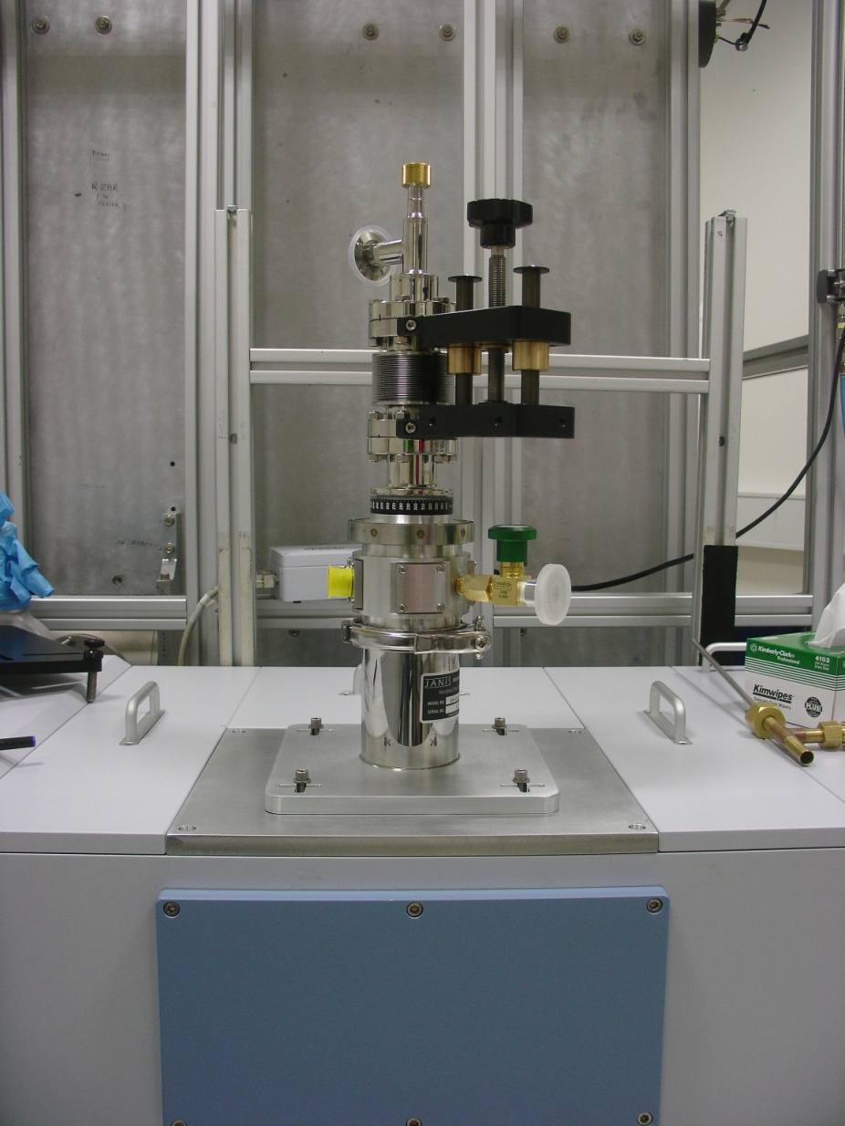
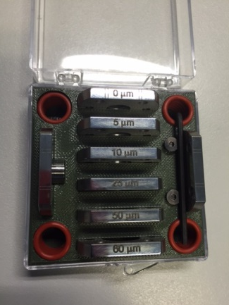
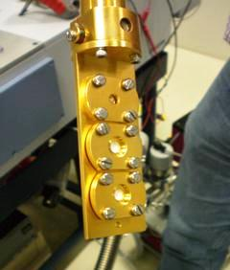
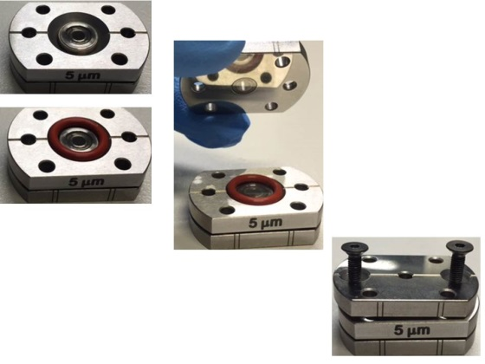
Cryostat
We have a Janis Research cryogen-cooled Cryostat, which has a Triple Sample Holder for Transmission (Vertical) Spectroscopic studies. The sample holder is equipped for discs ≤ 5 mm in diameter.
Liquid cryogen (Helium or Nitrogen) cooled. Can achieve near liquid helium temperatures (4.2K). Can also be used at room temperature.
Ideal for the study of phonon modes in cryogenically-cooled crystals.
Can be used in conjunction with the new liquid cell.

Slide 19
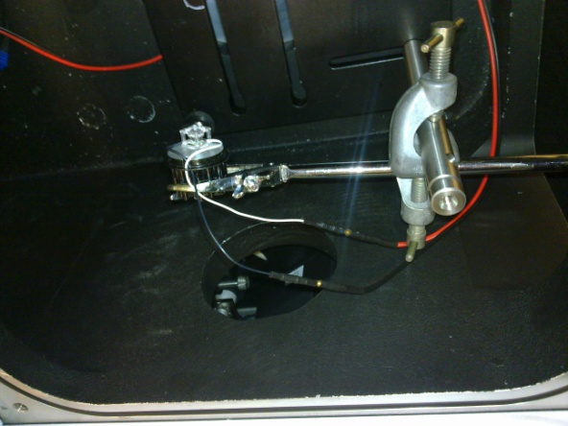

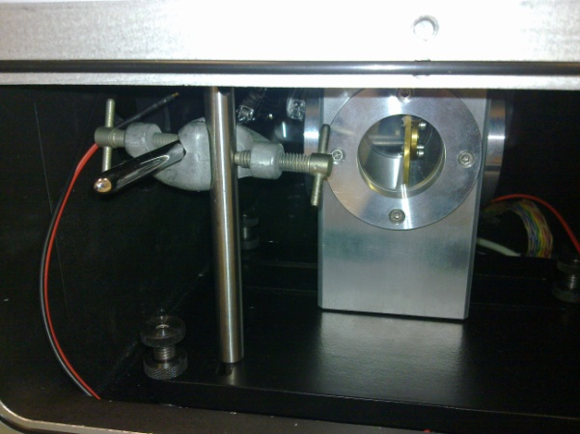
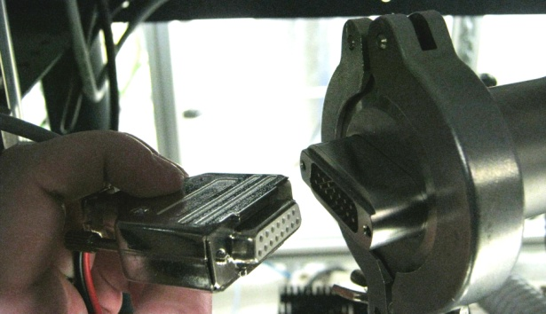
Solid state pump/probe experiment
To the left is an example of a user designed experiment. In conjunction with the cryostat, a user has made use of the vacuum electrical feed-through, to make a secondary light source within the sample compartment for pump/probe experiments. We will be installing optics such that we will be able to perform the same experiments with the new laser setup
Top View
Side View

Slide 20
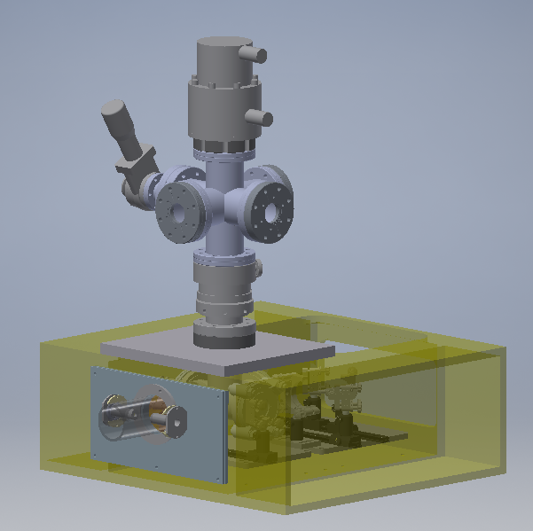
Solid-State Astrochemistry at the THz/Far-IR Beamline
Simulation of astrophysical ice surfaces by vapour deposition of molecular component onto a reflective substrate or optical window cooled to 10 K.
Compressed He Cryocooler.
High vacuum chamber (ca. 10⁻⁹ mbar).
Transmission Matrix Isolation or RAIRS configuration.
Insertion into beamline FTIR sample compartment; internal and synchrotron source (50 - 5,000 cm⁻¹).
Coupled onto Nd-YAG photolysis system to generate and trap reactive intermediates or can be used for direct surface irradiation.
Infrared signatures for qualitative ice composition analysis.
Integrated absorption bands for quantitative analysis (using thin-film A-values)
Looped FTIR spectra collection for kinetic studies.
THz region for ice morphology analysis; lattice bands, low-frequency vibration modes.
AutoCAD design of RAIRS system coupled to laser-photolysis setup (Completion March 2016)

Slide 21






Solid-State Astrochemistry at the THz/Far-IR Beamline
Case Study: Solid-state generation of pyrimidine bases from nitrile & formamide precursors.
Simulation of astrophysical ice surfaces by vapour deposition of molecular component onto a reflective substrate or optical window cooled to 10 K.
Inert Matrix / Pure Ice
Thymine
Cytosine
Nd-YAG
Precursor
Purine
Half-section view showing substrate position & FTIR matching optics.

Slide 22
The END
Ruth Plathe
THz/FarIR Beamline
Australian Synchrotron
www.synchrotron.org.au
Phone: +613 8540 4112
Ruth.Plathe@synchrotron.org.au

