Slide 1
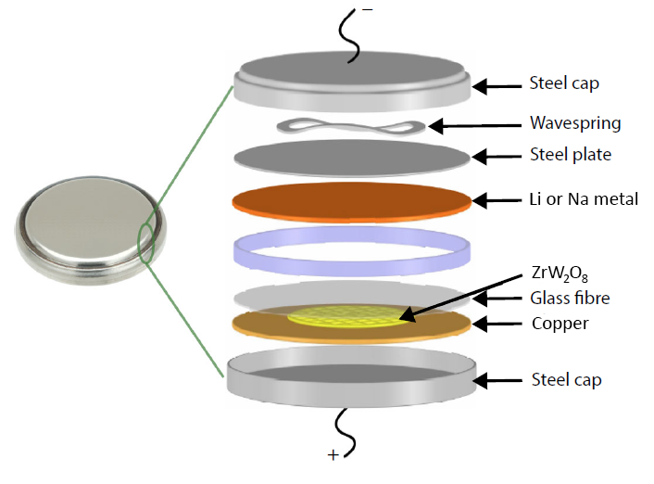
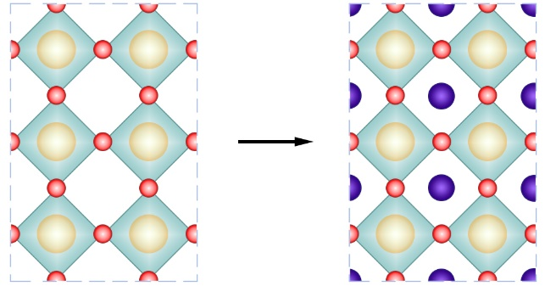
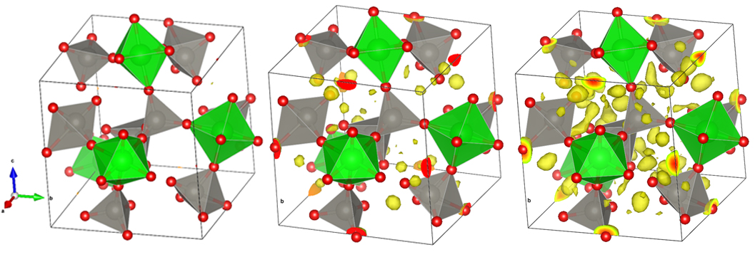
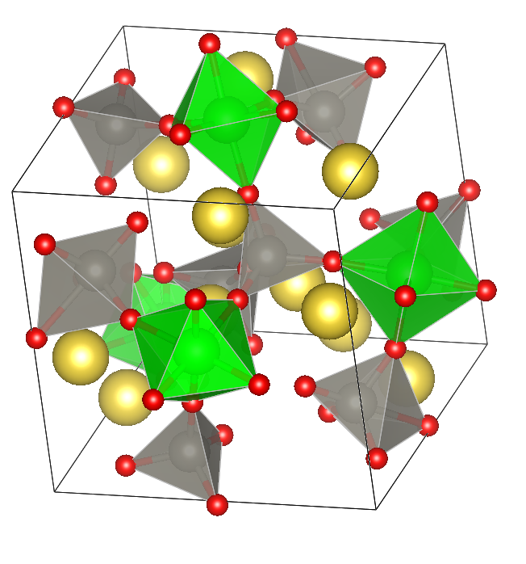
Intercalation into negative thermal expansion structures
1) NTE mechanism:
3) Electrochemical insertion:
2) Controlling NTE:
Blank
50%
100%
Na
4) Thermal expansion quantification:
ZrW₂O₈
Na_{x}ZrW₂^{(6-x)+}O₈

