Slide 1
Dynamic Study of Rising and Baking Bread Dough
Sheridan Mayo, Thu McCann, Li Day, Jenny Favaro, Helen Tuhumury, Anton Maksimenko & IMBL team
COMPUTATIONAL AND SIMULATION SCIENCES

Slide 2
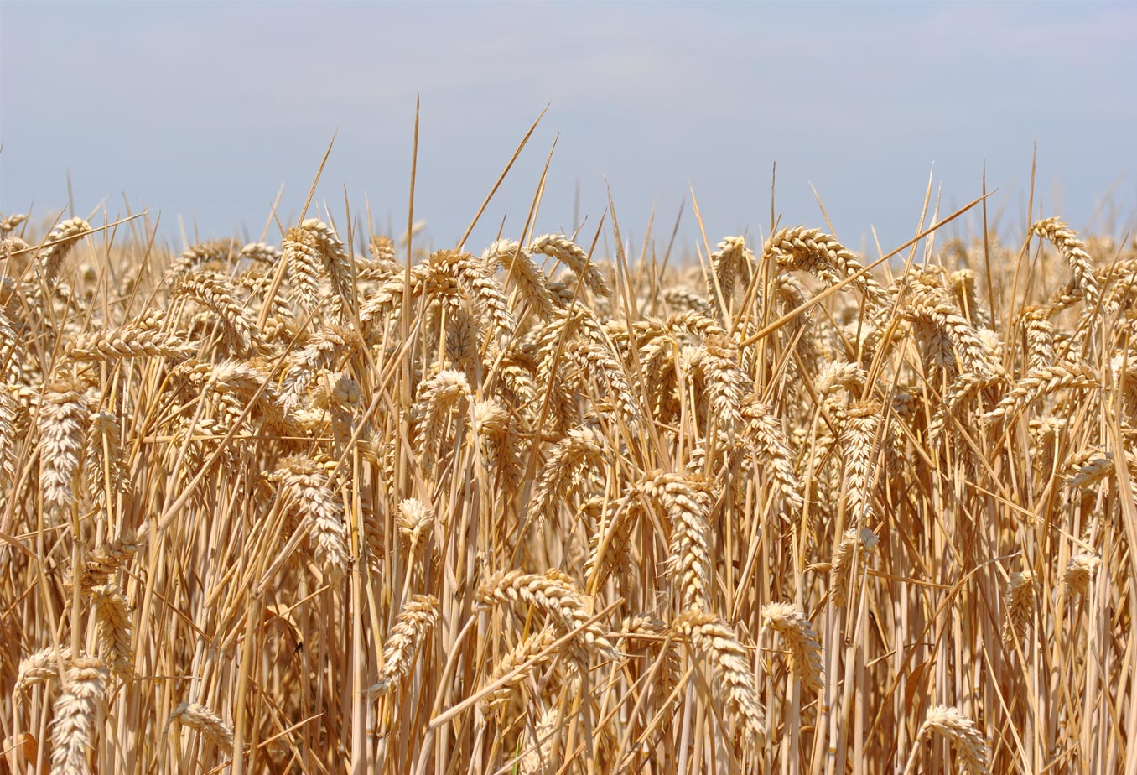
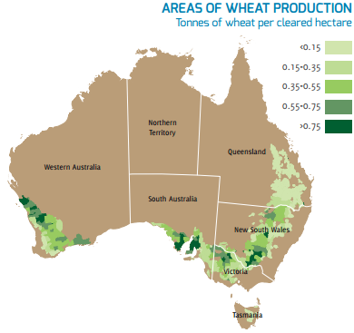
Australian wheat
Around 24 million tonnes of wheat produced per year (3.5% of global production)
It is very well suited to a variety of applications but in general has lower protein content than North American Flour – so not considered as suitable for making leavened bread.
CSIRO Food and health sciences has had a long interest in expanding the applications and hence value of Australian wheat
This work is part of ongoing efforts in modifying bread formulations to make better use of Australian wheat.

Slide 3
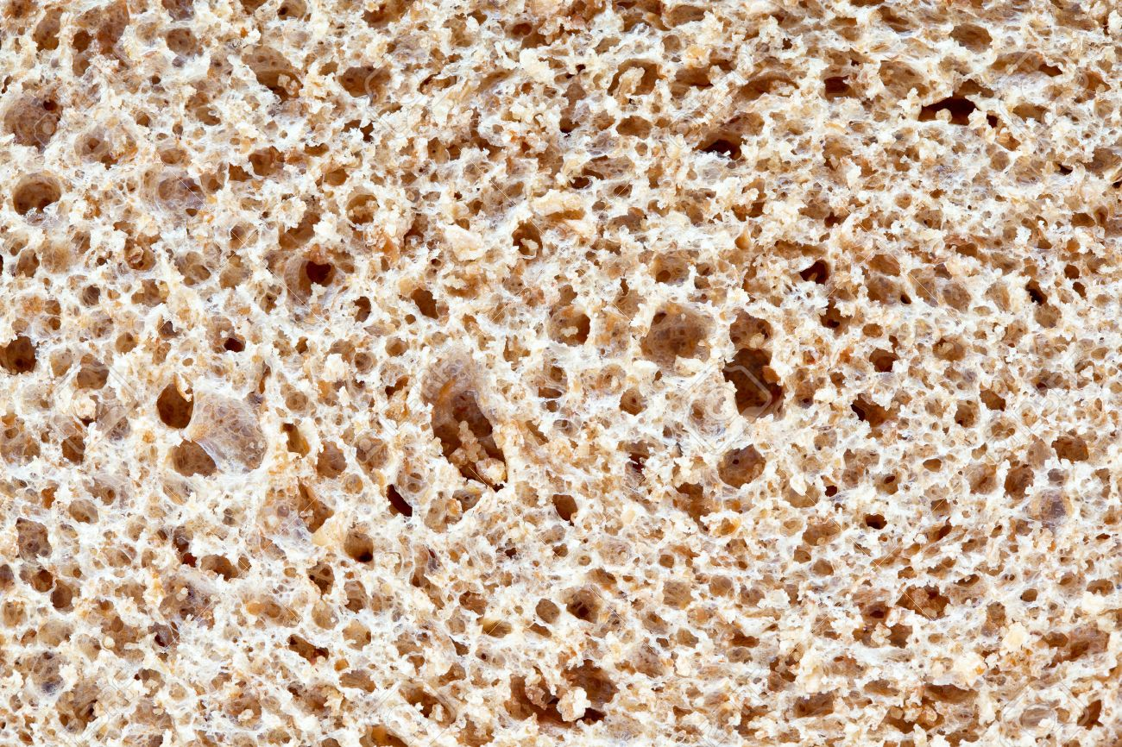
Investigating dough formulations
Flour contains glutenin and gliadin proteins that form gluten when the flour is mixed with water. Gluten gives strength and elasticity to the dough enabling it to contains bubbles of gas produced by yeast which cause the bread to rise. Salt additives have a significant effect on gluten performance in bread making.
The aim of the study was to compare the changes in morphology/porosity of doughs made from different salt and flour combinations during proving and baking.
A simple tubular bread oven was constructed from an aluminium tube and heating tape with a thermostat to provide a proving environment of ~ 33 degrees C for 2 hours and a baking environment of ~ 100 degrees C for 30 min.
This experiment provided an important test of some Big Data tools on the MASSIVE cluster

Slide 4
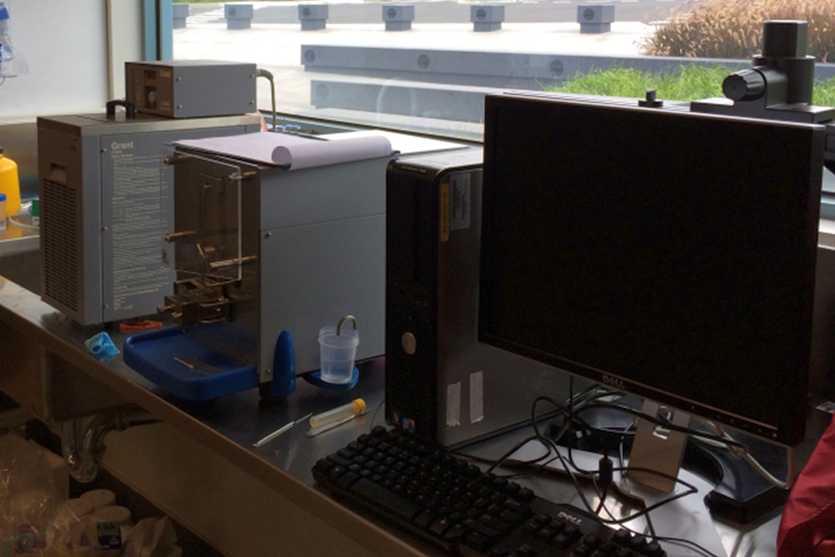
Dough recipes used (two samples of each)
 | Flour | Salt | Water | Yeast
1 | LPHR (4g) | No salt | 2.18 mL | 0.05 g
2 | HPHR (4g) | No salt | 2.24 mL | 0.05 g
3 | LPHR (4g) | 0.08 g NaCl | 2.18 mL | 0.05 g
4 | HPHR (4g) | 0.08 g NaCl | 2.24 mL | 0.05 g
5 | LPHR (4g) | 0.104 g KCl | 2.18 mL | 0.05 g
6 | HPHR (4g) | 0.104 g KCl | 2.24 mL | 0.05 g
7 | LPHR (4g) | 0.144 g NaBr | 2.18 mL | 0.05 g
8 | HPHR (4g) | 0.144 g NaBr | 2.24 mL | 0.05 g
Previous studies showed that KCl and NaBr impact dough rheology differently compared to NaCl so recipes chosen focussed on different salts with two extreme protein content flours.
5g dough samples were mixed for 8 min to get the correct film texture in aspecialised ‘test-batch’ dough-kneading machine which also provides a rheology plot during kneading.
Dough was pressed into the base of a plastic container used for proving and baking.

Slide 5
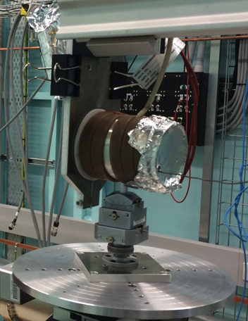
The experimental set-up
Oven, end view showing sample mounted inside
Oven, side view
X-ray
Imaging
detector
X-RAYS
Sample mount
attached to rotation stage
A simple tubular bread oven was constructed from an aluminium tube and heating tape with a thermostat to provide a proving environment of ~ 33 degrees C for 2 hours and a baking environment of ~ 100 degrees C for 30 min.
The sample is able to rotate in the oven being mounted on a teflon post which pokes up through a hole in the bottom of the furnace and which is attached to the tomographic rotation stage below the furnace.

Slide 6
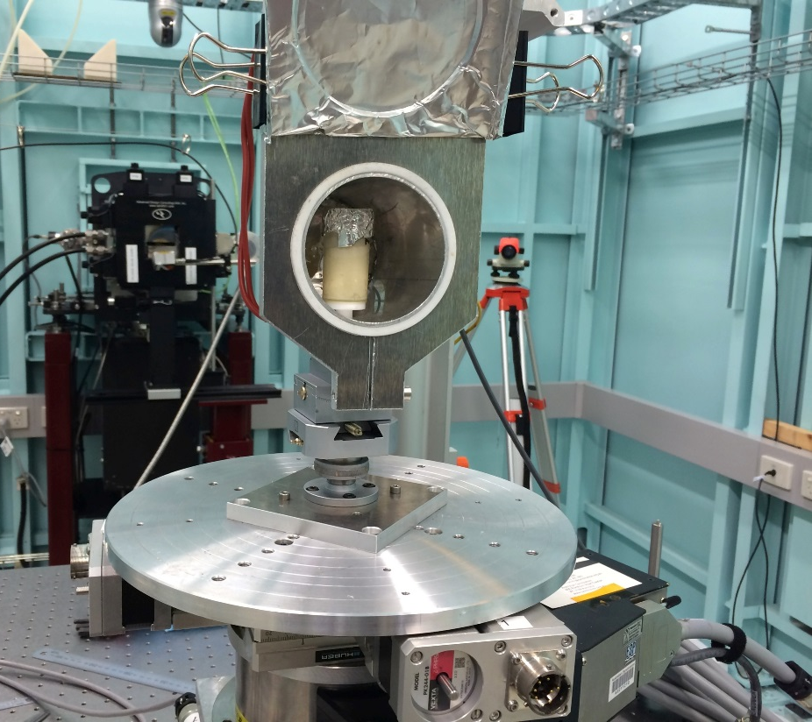
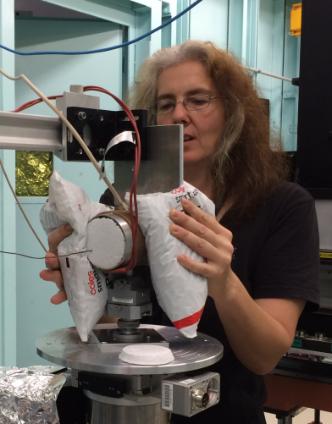
Experiment – 3 days of exhaustion!
Scanned 16 samples at 29 time points during baking and rising
Encountered problem with sample container loosening and ‘jiggling’ during bake scans due to rotation speed – solved by gluing samples on with silicone and repeating bake sequence for some sample types.
Even with 16s scans a small amount of sample movement can be seen in reconstructions during fastest expansion periods.
Only scanned the bottom few mm of the sample due to limited field of view – this was the most static region of the sample during the rise.

Slide 7
Rising and baking sequence of one sample

Slide 8
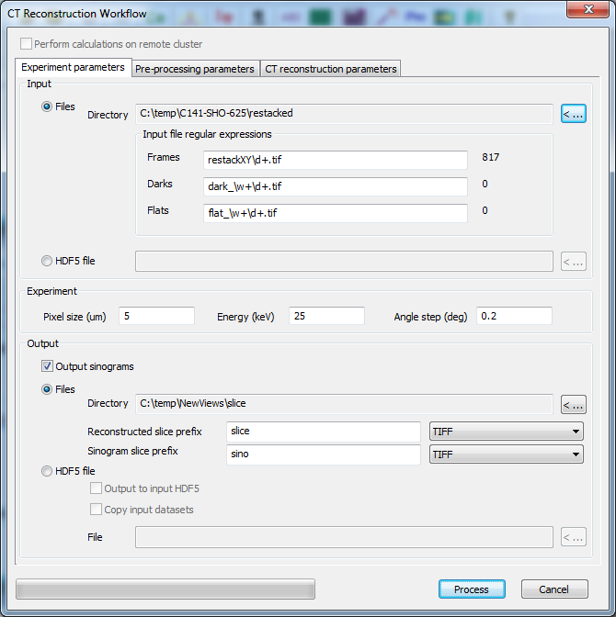
A Big data challenge!
16 samples x 2g time-point scans = 464 micro-CT datasets!!! All this data is saved directly from the IMBL beamline to the MASSIVE cluster.
Using X-TRACT software for image corrections, phase-retrieval and tomographic reconstructions. This is usually used from a Windows GUI which can access a server version of X-TRACT on the windows part of the MASSIVE supercomputer cluster.
X-TRACT has now been ported to Linux on MASSIVE – thishas a GUI interface similar to Windows X-TRACT Reconstruction Wizard Dialog – It can also be run from the command line enabling scripting to submit large numbers of jobs to the batch queue. This was used and around 12-20 reconstructions could run simultaneously from the queue in a few minutes.

Slide 9
Handling stacks/timeseries
Time series or vertical stack sequences for the same sample are automatically collected at IMBL with all the data in a single directory. To speed the submission of such time series to the queue a python script was used to generate the job files from a template based on some input info about the particular time-series/stack.
The script was written only for this job but I’ve already ended up sharing it with two other users dealing with similar issues – this functionality will be incorporated into the X-TRACT wizard. Slice stacking of reconstructed Z-stacks (also currently performed by python script) will also be incorporated. This is a computationally more efficient option than stitching the original views prior to reconstruction.
But This is only the
First half of the
Big Data Challenge!

Slide 10
What information do we need from our data?
The salt additives can affect characteristics like the strength and elasticity of the gluten and thus change the performance of the gluten framework. This in turn affect the rising and texture of the bread dough. This will also depend on the protein content of the flour which is why a low and high protein flour are being examined. Factors of interest to indicate gluten performance are:
Porosity
Wall thickness
Pore size distribution
Pore connectivity

Slide 11
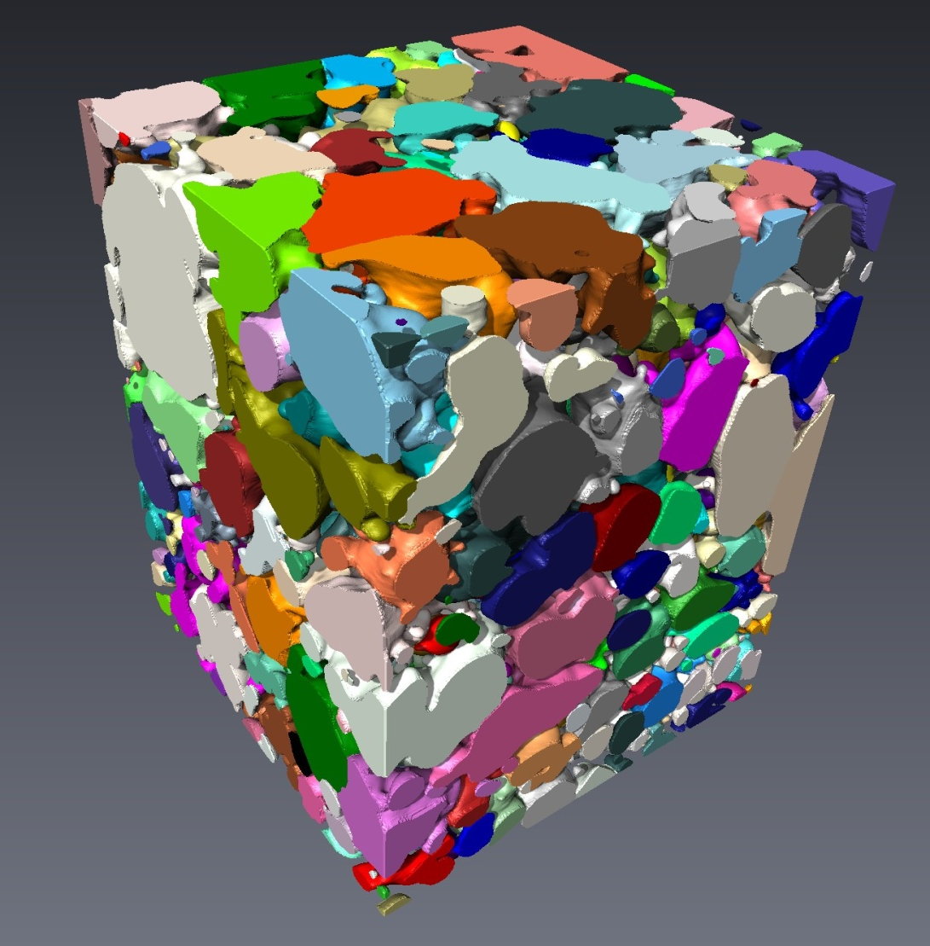
Segmentation and Analysis in Avizo Finding the meaning in our data
The MASSIVE supercomputer cluster also supports a wide range of tools for image visualisation and analysis: Avizo, Fiji and many more. Some of these tools are also available on the HPC facilities in CSIRO.
Avizo was used for our image analysis – typically used in interactive mode – we used it in scripting mode.
A script to analyse a 21 scan dough proving sequence would take several hours to run on ones node.
Three instances of Avizo running simultaneously (and 3 more on CSIRO system) made the analysis task tractable in a few days.

Slide 12
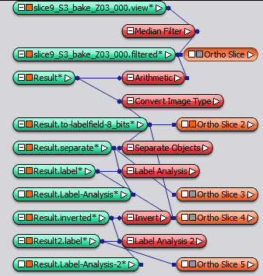
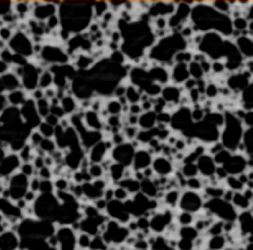
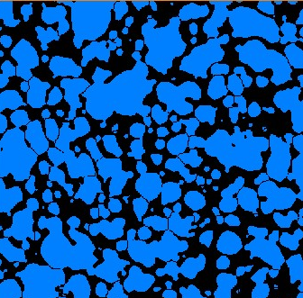
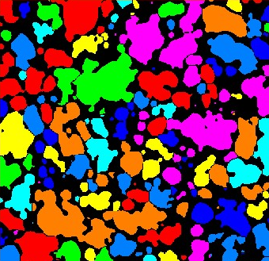
Segmentation and Analysis Workflow
FILTER
WORKFLOW SCHEME
THRESHOLD
SEPARATE
LABEL
LABEL STATISTICS

Slide 13
So what about the Dough?
Low
Protein
High
Protein

Slide 14
Three types of salt
NaCl
KCl
NaBr

Slide 15
Quantitative results – porosity & texture
NaBr

Slide 16
Wall thickness and ‘bursting’

Slide 17
Future work
Look into doing further dynamic experiments at the synchrotron drawing on our experience so far. Future synchrotron work may look at more bread samples and also dynamics of wetting of extruded/expanded snack products.
Imaging of the whole mini-loaf should resolve a lot of data fluctuations arising from seeing only part of the sample – this would require hutch 3 of IMBL and pink beam – exciting times!
For Big Data the ability to perform similar tasks on multiple similar samples is increasingly important. Reconstruction part of the problem is well on the way to being solved.
Avizo is very powerful but scripting features are poorly documented and don’t seems to work as expected in non-GUI mode, restricting the ability to truly batch tasks onto the queue to harness full power of cluster.

Slide 18
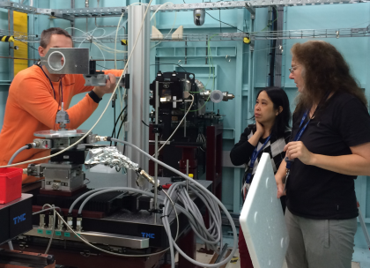
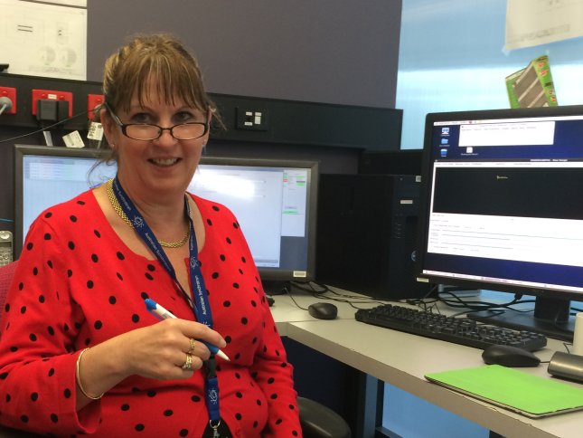
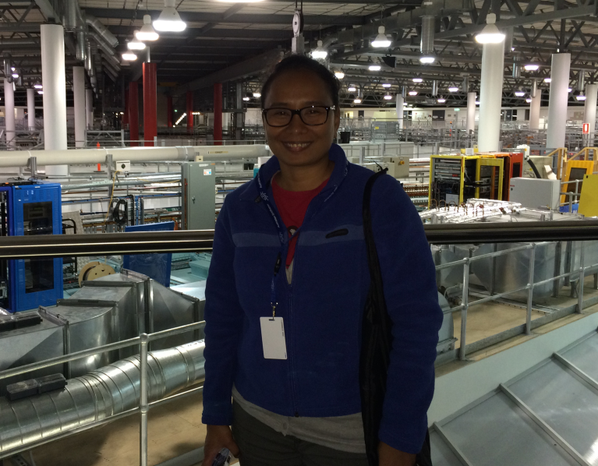
Thanks to: IMBL team CAHFS team Darren Thompson Peter Tyson This research is supported by the Science and Industry Endowment Fund
CMSE
Sheridan Mayo Presenter Title
t +61 2 9123 4567
e sherry.mayo@csiro.au
COMPUTATIONAL AND SIMULATION SCIENCES

