Slide 1
Please put together a maximum of 3 slides to describe a potential beamline at a new Australian Synchrotron Light Source
Content will be shared at the workshop and form the basis for further development of a Science Case for the new facility

Slide 2
Title Slide: Name of Beamline
Name of presenter
(Affiliation)
Email address:

Slide 3
Background Information (not to be included in beamline pitch)
If you are unfamiliar with the latest capabilities that are hosted at 4th Generation Synchrotron Facilities – please see the following sites:
MAX IV: https://www.maxiv.lu.se/accelerators-beamlines/beamlines/
SIRIUS: https://www.lnls.cnpem.br/beamlines/
ESRF-EBS: https://www.esrf.fr/home/UsersAndScience/find-a-beamline.html

Slide 4
Slide 1: Description of New Beamline or Capability
Describe the beamline to be hosted at the new Australian Light Source, as well as its purpose
eg X-ray Diffraction, Spectroscopy & Imaging under Extreme Conditions;
Physics, Engineering, Chemistry, Earth Science, & Materials Science research.
Give an estimate of key operational features of the beamline
High beam intensity: ~ 10¹⁴ photons/s; Beam size: 100 x 100 nm² to 10 x 10 μm²;
X-ray energies: 3 – 30 keV; Energy resolution (ΔE/E): 10⁻⁴ – 10⁻⁵;
Sample Environments: Pressures to 1000 GPa; Temperatures: 5 K – 5000 K;
Static Magnetic Fields Up to 10 T;
Sample sizes: up to 1 m³ ad 300 kg;
Measurement modes: XAS, XRD (powder / single crystal), X-ray Raman Scattering; and CDI;…
Equivalent Beamline at a new or planned 4th Generation Facility
The EMA (Extreme condition Methods of Analysis) beamline - SIRIUS

Slide 5
Slide 2: Description of Scientific Fields & Research Community
Describe the areas of research that would be undertaken using the new Beamline.
Explain the impacts of improved research outcomes associated with the improved performance from this new Light Source.
Mineral formation & extraction; Deep earth processes & vulcanology;
Condensed Matter Physics, Magnetism and Superconductivity;
Engineering materials under extreme conditions, fatigue, failure analysis & strain mapping
Describe the Business and Research Communities that will benefit from this new beamline.
Earth Science researchers; Mining, mineral exploration & processing companies; Geosciences Australia;
Materials Science researchers; Civil Engineering, construction and heavy engineering companies;
Defence; Maritime platforms; Rail engineering; Aerospace; Advanced manufacturing;
Transportation; Electric vehicles; Power generation & transmission;…

Slide 6
Scientific Case Studies
The following slides show several examples of Scientific Case Studies (not specifically associated with the “X-ray Diffraction, Spectroscopy & Imaging under Extreme Conditions” beamline that is outlined above).
Please put together just one Case Study slide that showcases the key capabilities of the proposed new beamline at a future 4th Generation Australian Light Source.
We will generate further scientific case studies in the future development of beamline science and business cases.

Slide 7
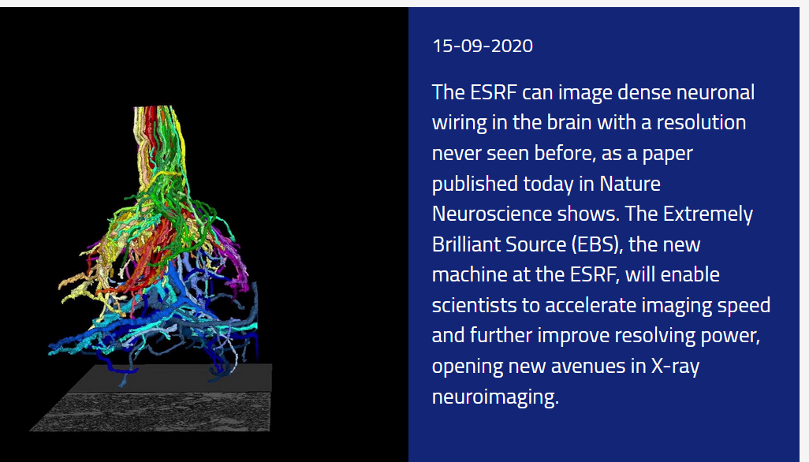
Slide 3: A Case Study to Highlight the New Beamline Capability
X-ray holographic nano-tomography (XNH) Nano-Imaging Beamline ID16A, ESRF
3D structure of thick biological tissues at spatial resolutions of tens of nanometres, with high sensitivity.
X-ray fluorescence microscopy enables nanoscale mapping of the native chemical compositions at ppm level.
A. T. Kuan, et al,
Nature Neuroscience,
14 September, 2020

Slide 8
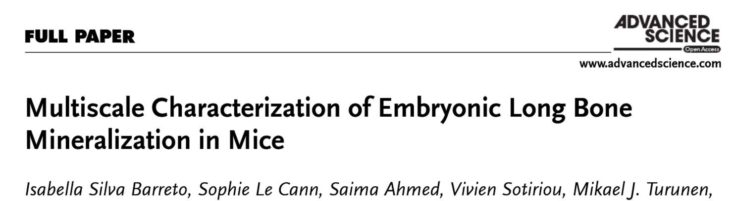
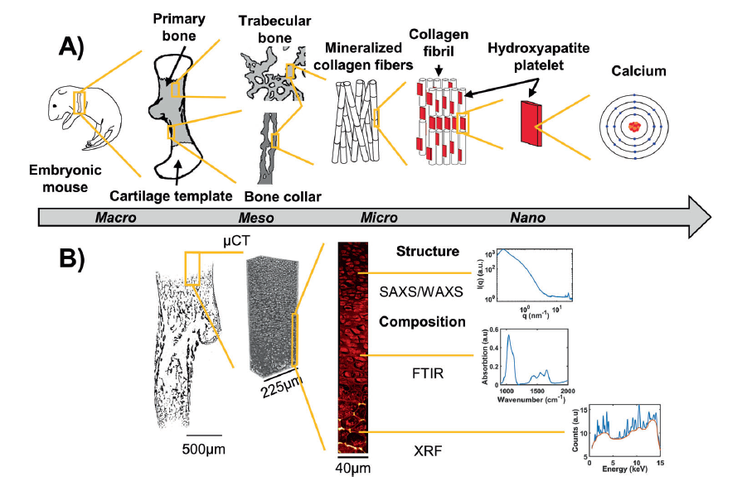
Slide 3: A Case Study to Highlight the New Beamline Capability
NanoMAX @ Max IV
Elemental mapping at 200 nm pixel size

Slide 9
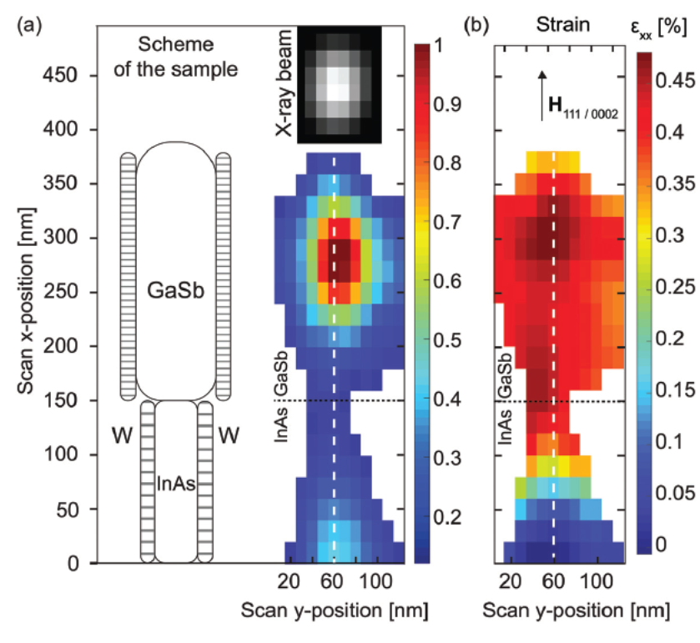
Slide 3: A Case Study to Highlight the New Beamline Capability
NanoMAX @ Max IV
Bragg scattering with a 56 x 53 nm² beam

Slide 10
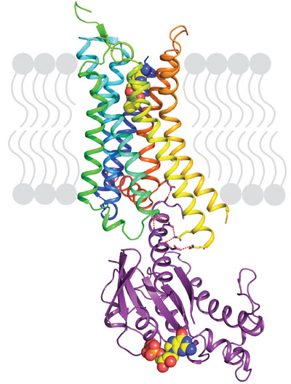
Slide 3: A Case Study to Highlight the New Beamline Capability
Gemini – ID23 @ ESRF
More than 157,000 protein structures have been solved by X-ray crystallography.
Only ~5000 Membrane Protein Structures in Protein Data Bank.
Membrane proteins are essential in cellular transport and signalling.
Targets for ~50% of all modern medicines.
20–30% of all genes in most genomes encode membrane proteins.
Membrane proteins are notoriously difficult to crystallise and typically require the brightest X-ray beams to get data from small, weakly diffracting crystals.
Structure of an activated G protein coupled receptor bound to an engineered G protein
Nature, 536, 104 (2016).

